Slide 1
Humachine: Humankind, Machines & The Future of Enterprise
Dr. Nada R. Sanders
Distinguished Professor
D’Amore-McKim School of Business
Northeastern University n.sanders@northeastern.edu

Slide 2
WHAT IS DIFFERENT TODAY?
Technologies associated with artificial intelligence (AI) have decisively changed the competitive landscape and the way we work.
Technology is everywhere
Robots run factories, bots place purchase orders, drones deliver packages, AI renders medical opinions.

Slide 3
WHAT IS DIFFERENT TODAY?
The organizational structures and leadership styles that worked over the past few decades are rapidly becoming obsolete.
Requires understanding how to make decisions
Knowing what to ask of the data and algorithms

Slide 4
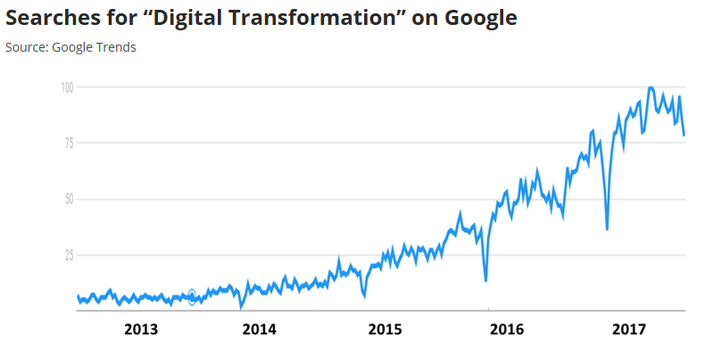
COMPETITION in the ai age
Hype & Confusion:
Digital transformation (DT) is the #1 corporate concern for 2020
70% of all DT initiatives do not reach their goals
Of $1.3 trillion spent on DT (2019) - $900 billion went to waste.
One third of companies are taking a passive approach to AI
Many executive are taking a ‘wait and see approach’ to technology or they see technology as a ‘plug and play solution’
Reality:
Just acquiring technology is not enough
Notes:
Productivity slow-down
Huge potential
Hype and confusion
What does it mean?
State of the art?
Most SCM visions of transformation are limited to process improvement/connectivity. Business model thinking virtually non-existent.
Missing big opportunities for top line impacts as well as process improvements
Why are so many firms still in infancy?
SCMOs not incentivized or empowered to think about strategy, customer value, and differentiation
Lack of centralized org structure hampers end-to-end transformation, even pits functions against each other
Innovation severely constrained by dominance and urgency of on-going operations (change the wheels on the car while driving it)
Lacking innovation budgets
Lots of org problems to solve: start with strategic, coordinated, longer-term thinking (including roadmaps)

Slide 5
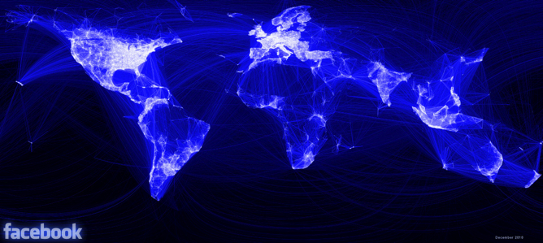
The “Intelligent SC” Is Data Driven
THE INTELLIGENT SUPPLY CHAIN IS DATA DRIVEN
RFID, POS, Geo-Location, ERP
Sensors for vibration, heat (e.g. mounted on an engine), sound
Social Media postings (Twitter “re-tweets,” Facebook “likes” blog/wiki entries)
Digital clickstream
Imagery (camera & surveillance)
Customer complaints
Maintenance logs

Slide 6
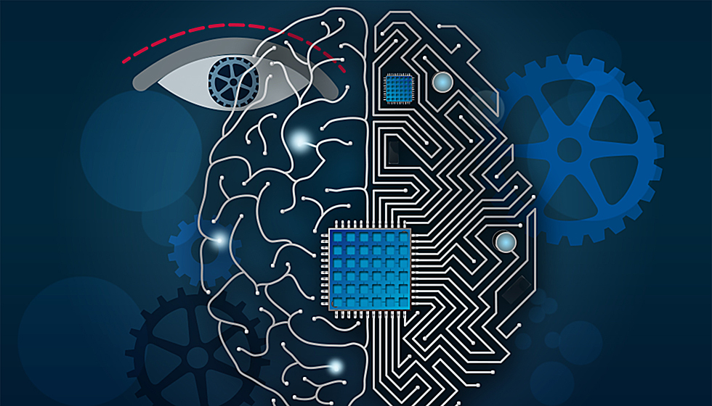
THE INTELLIGENG SUPPLY CHAIN
Sense
Respond
Analyze
Predict
INFORMATION
Connected
Combining
Filtering
Structuring
Reporting
Insight
Adaptive
Alerting
Matching
Orchestrating
Automating
DATA
Intelligent
Visualizing
Diagnosing
Predicting
Prescribing
Digitized
Sensing
Capturing
Standardizing
Action
IoT
Notes:
Visibility channels: demand (pos); capacity; inventory; assets (locations, utilization, operational status); process monitoring; disruptions/threats; KPIs (cost, service, quality)
- Standardizing: GS1 or other data capture and sharing protocols
- Sensing: from sensors, click data, POS, partner feeds, etc
- Reporting/filtering – overall data but also identifying “exceptions”
- Combining is “data integration” (e.g., combining customer and geocode data) and “data engineering“ - "the art and science of blending data from multiple (and different) sources, automatically cleaning and filtering the data, and transforming the data to be useful for analysis.“ (current, accurate, complete, useful format)
Analytics
- Structuring includes cleansing/validating integrity (e.g., deleting data that meet certain criteria, standardizing, etc.)
- Visualization includes description
- Cognifying usually involves machine learning
Responsiveness
Alerting – messaging about opportunities
Matching supply with demand
Automation: software agents as well as hardware
Giging – on demand capacity, configuring solutions from collectives and ecosystems
Coca Cola Co. is trying to put mobile commerce to work making its supply chain more efficient. Facing potential lost sales and distribution challenges for small retailers, the beverage giant is encouraging mom-and-pop stores to use a mobile app to replenish shelves with cans and cases on demand, the WSJ’s Kim S. Nash reports. Business-to-business apps modeled on consumer technology are inching into supplier-vendor relationships, and in this case Coca-Cola is extending the tactic to its logistics, promising a delivery time and then enlisting help from “gig” workers on motorbikes to handle the products. .
Flexing – response to anticipated changes with in given operational structure (configuration)
Agility” - response to unanticipated changes (resilience, reconfiguration)
Might improve reactiveness and flexibility greatly through uberization/crowd sourcing
Integration
Our research shows that firms rate the impact of visibility on responsiveness 5-6 times higher when they have high integration. At low levels of integration the impact of visibility is negligible
Intellectual capital
- Human capital – domain knowledge + data science skills
- Operates at three levels of planning/execution: Strategic, tactical, operational
Key enabling technologies: (where are these respectively on the PLC or diffusion curve?) all subject to Moore’s law growth/diffusion
IT (processing capability) + Internet (information ubiquity) + mobility (removing location as a constraint)
Sensors
Cloud
Machine learning/AI
Robotics/automation

Slide 7
The Supply Chain “System”
A SUPPLY CHAIN IS A ”SYSTEM”
Every SC is a system enabled by analytics & technology
The entire “system” must be optimized
Marketing may customize product offerings – but if operations cannot produce them, if logistics cannot deliver them, the system will not respond
Information at any one lever – a shortage on the Buy side, delayed shipments on the Move side, or production stoppage on the Make side – needs to be conveyed to other levers informing them and coordinating action.
BUY
MAKE
MOVE
SELL

Slide 8
ANALYTICS APPLICATIONS
● Inventory
● Capacity Constraints
● Facility Location
● Facility Layout
● Workforce Analytics
● Location Based Marketing
● Cross-selling
● In-store behavior analysis
● Customer segmentation
● Price optimization
Purchasing
Operations
Transportation
Marketing
● Supplier segmentation
● Supplier risk
● Sourcing channel options
● Supplier integration level
● Distribution & logistics
● Transportation alternatives
● Routing and Scheduling
● Warehousing

Slide 9
Optimizing individual functional silos creates a fragmented patchwork approach that does not result in a responsive supply chain.
It doesn’t provide visibility, coordination or connectivity
Successfully managing a SC requires optimizing the system and looking at each of these supply chain levers concurrently.
What is needed is using an algorithm that integrates human judgment with an end-to-end view of the supply chain.
CANNOT OPTIMIZE ‘SILOS’

Slide 10
Executive SURVEY
88% state technology is their priority.
72% will make some technology investment in the coming year.
83% have concerns regarding costs of technology and the adoption.
85%percent stated they were awash in data.
82% engaged in fragmented implementation efforts.

Slide 11
Analytical “Ruts”
Analytical “Ruts”
A Needle In A Haystack – Using analytics randomly in search for causation and relationships with the hope that something will eventually turn up.
Islands of Excellence – Using analytics to optimize subprocesses; these function efficiently but have little bearing on optimizing the system.

Slide 12
Analytical “Ruts”
Analytical “Ruts”
Measurement Minutiae – Trying to measure everything; most of companies don’t know which ones to focus on.
Analysis Paralysis – Overwhelmed with the rapid change of technological capability; they understand they must do something but are in a state of paralysis.

Slide 13
Barriers to Implementation
Barriers to Implementation
▪ IT Not Integrated
▪”Siloed” Decision Making
▪ Lack of Incentives
PEOPLE
TECHNOLOGY
PROCESSES
▪Leadership
▪No Analytical Talent
▪Unsupportive Culture
▪Need to Upgrade Systems
▪Legacy Systems
▪Access to Data

Slide 14
OPPORTUNITY FOR STRATEGY & LEADERSHIP
Huge opportunities for
Change management
Digital transformation
Leadership in the digital era
Motivation and talent management
Organizational structures and hierarchies
Flat versus silos
Self governing (e.g. Zappos’ Holacracy)
Need for end-to-end visibility and coordination

Slide 15
THE HUMACHINE
An emerging form of enterprise
Combines the better qualities of humans—creativity, innovation, compassion, and judgment—with the mechanical efficiencies of machines— economies of scale, big data processing capabilities, and artificial intelligence or AI.
Combines humans and machines in a symbiotic relationship – as co-workers.
Not science fiction – it is already here.

Slide 16
WHY IT WORKS: MORAVEC’S PARADOX
As counter-intuitive as it may seem, the best way to take advantage of emerging AI technology is to invest more in human resources – in reskilling, upskilling, training and lifelong learning.
That is explained by something called Moravec’s Paradox: where humans are naturally gifted, machines are deficient, and vice versa. Leading companies leverage it.

Slide 17
Moravec’s Paradox in Management
WHAT MACHINES CAN DO
• Process large data sets
• Precision & accuracy
• Flexible & can scale
• Strength & speed
WHAT MACHINES CANNOT DO
• Only as good as the data
• Lack creativity & innovation
• Cannot explain their decisions
• Lack empathy & emotion
COMPLEMENTARITY
WHAT HUMANS CAN DO
• Connect unrelated areas
• Creative & innovative
• Can explain decisions
• Have empathy & emotion
WHAT HUMAN CANNOT DO
• Have processing limitations
• Subject to cognitive biases
• Inconsistent
• Physical limitations

Slide 18
HUMACHINE TRAITS
Human-centric
Has intentionality & purpose
AI & Technology adopted to support vision
Meaningful relationships
Systems thinking
Flexible structures
Integrated work teams
Physical and virtual work environments
Aspirational & measurable metrics

Slide 19
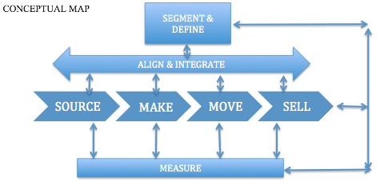
Implementation Framework
Framework
Develop purpose & vision.
Shift from contractual to meaningful relationships.
Adopt technology that supports vision & integrates with people.
Create flexible structures that break down silos.
Implement steps to cultivate talent
Move from traditional productivity measures to aspirational metrics.

Slide 20
IMPLEMENTATION LESSONS
Begin with Vision
Assess Current State & Allocate Sufficient Resources
Invest More In People
Leverage insiders
Create a culture of belonging
Utilize people for focused decision-making, leaving technology for repetitive tasks
Prevent atrophy of decision-making
Integrate tech with people & processes
Start With A Pilot
Everyone Needs To Prepare For The Workplace Of The Future

Slide 21
Concluding thoughts
CONCLUDING THOUGHTS
Technologies associated with AI have changed the competitive landscape
Even more important:
- Understanding what questions to ask of the data
- Critical thinking
- Creative problem solving
Jobs in the Analytics Era involve integrating people & technology
Requires a different leadership style: the humachine, a concept that takes advantage of both humans and machines in a symbiotic relationship.

Slide 22
Concluding thoughts
CONCLUDING THOUGHTS
For companies to survive and advance in the era of AI, they must understand that technology is not just another initiative
It is necessary to develop the awareness and the ability to harness the power of humans and technology
One size does not fit all.
Create your own Humachine

Slide 23
Concluding thoughts
THANK YOU!

