Slide 1
Recent Developments in Sustainability Reporting
Khrystyna Bochkay
Associate Professor, University of Miami
Academic Fellow, ISSB

Slide 2
Agenda
Introduction
Sustainability reporting ecosystem
Preparers and users of sustainability information
Role of sustainability standards
Global regulatory initiatives
Role of industry-specific sustainability standards developed by SASB
SASB Standards under ISSB

Slide 3
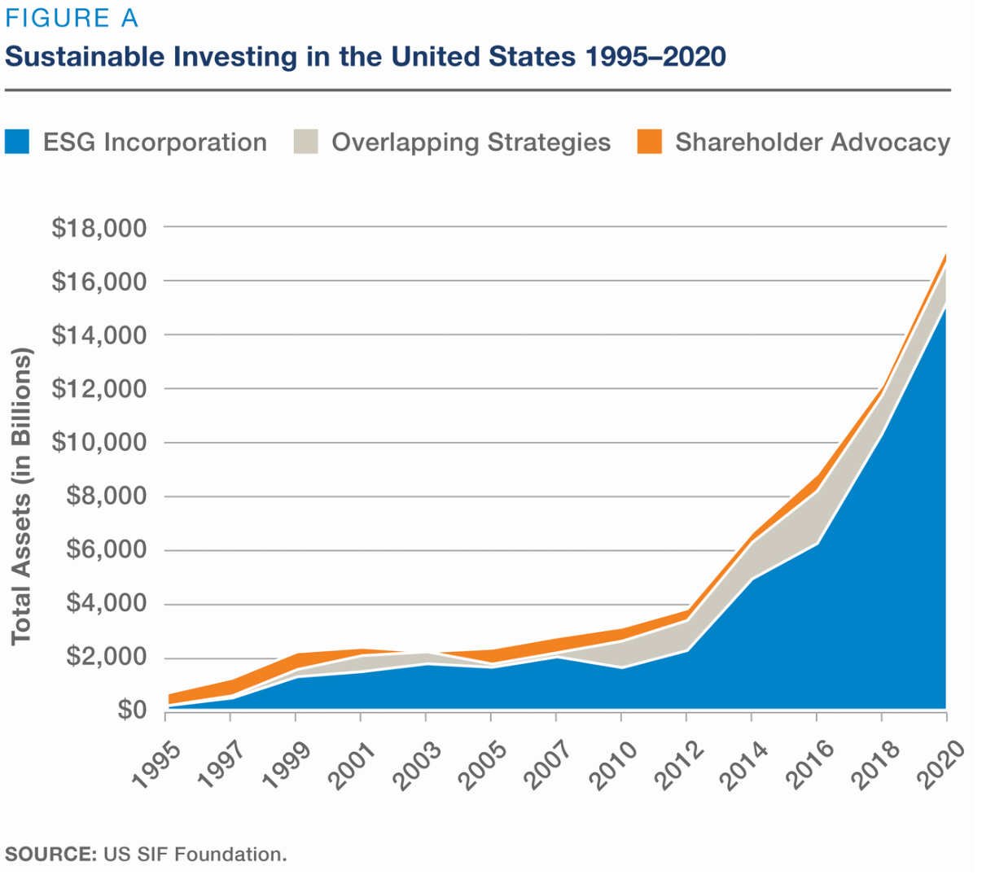
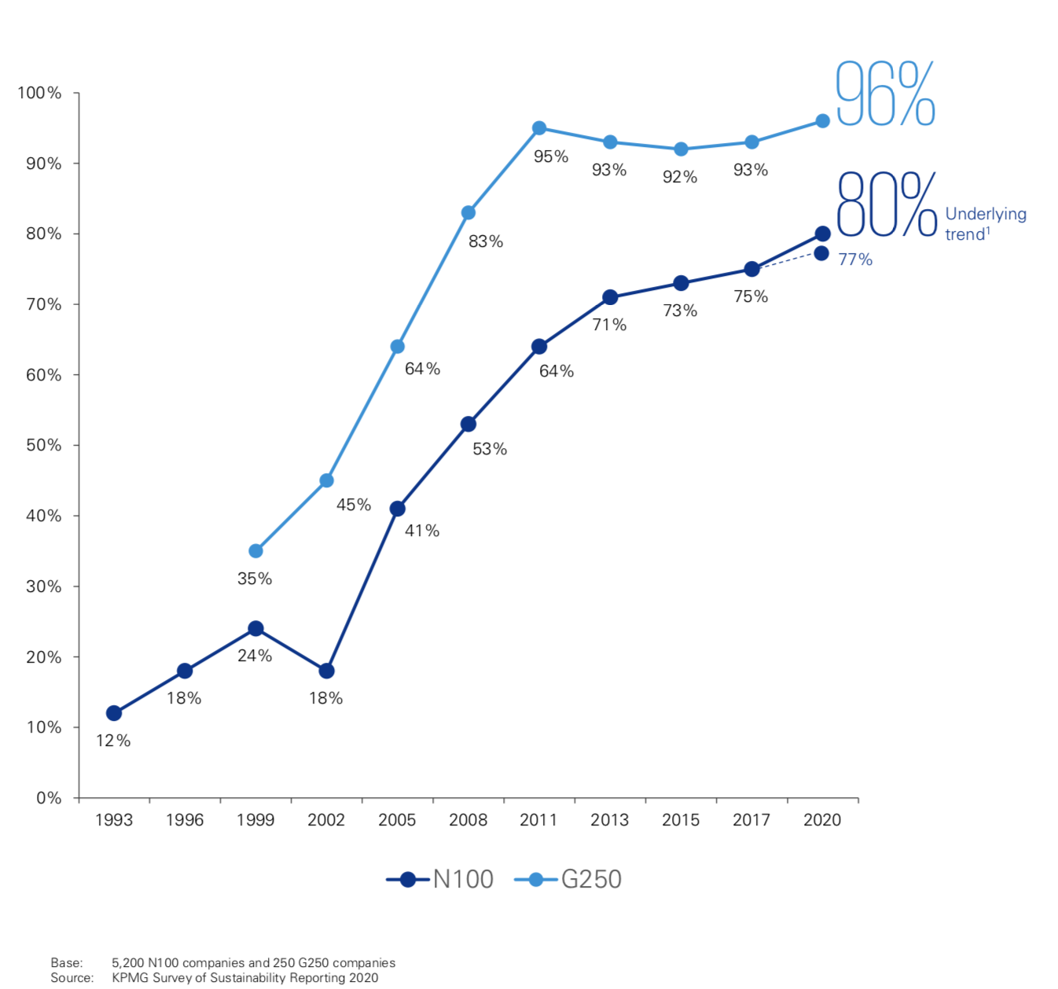
Introduction
Growing demand for and supply of sustainability information
Source: KPMG Survey of
Sustainability Reporting 2020
N100: the largest 100 companies, by revenue, in each of the 52 countries
G250: the largest 250 companies, by revenue, worldwide

Slide 4
Introduction
Yet, there are a lot of inconsistencies in what companies report on the matter
Lack of
sustainability reporting oversight and assurance
Confusion about users’ needs
Too much time spent on surveys & data collection
Too many ESG
issues to report on
Frustration with disparate ratings & rankings

Slide 5
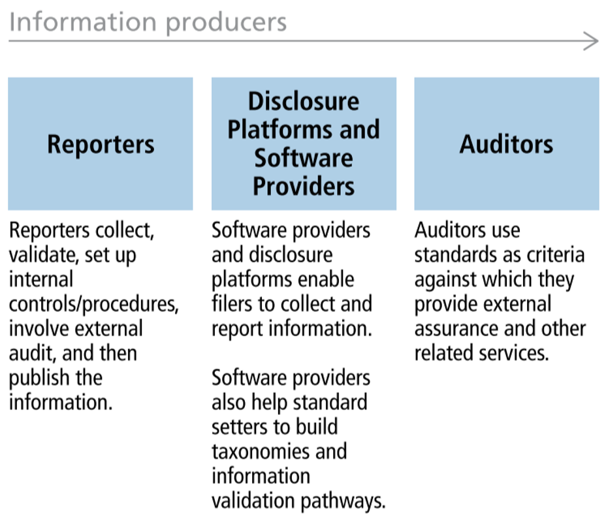
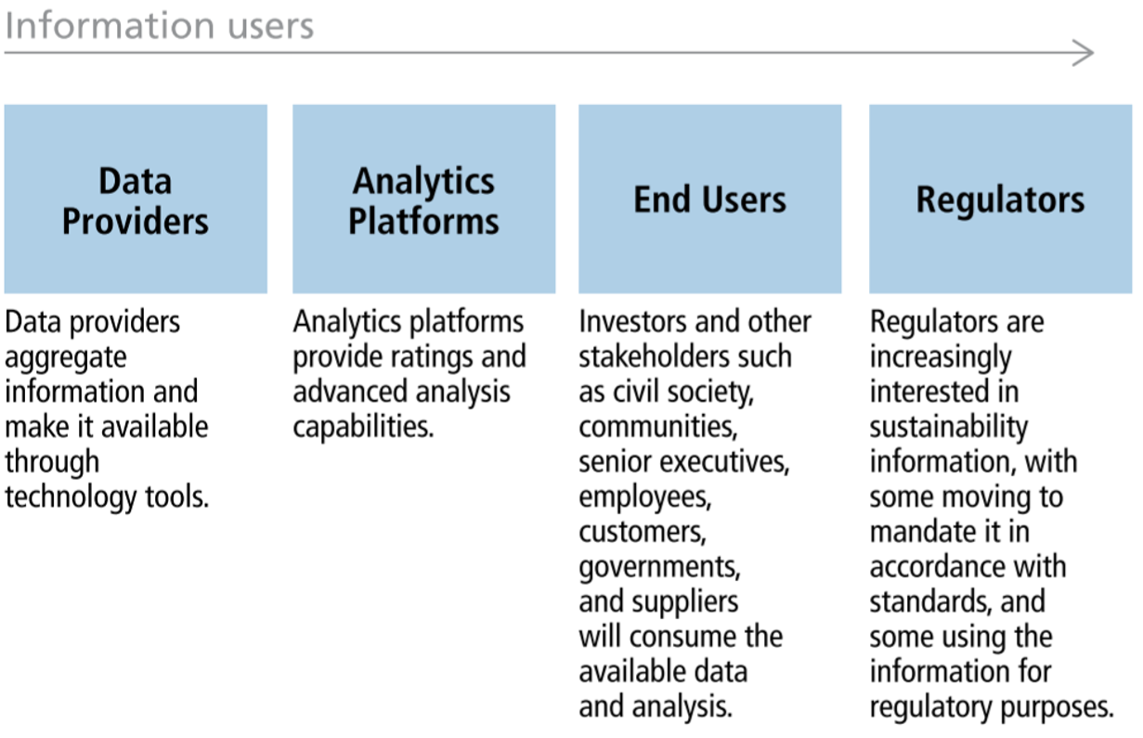
Corporate Reporting Ecosystem

Slide 6
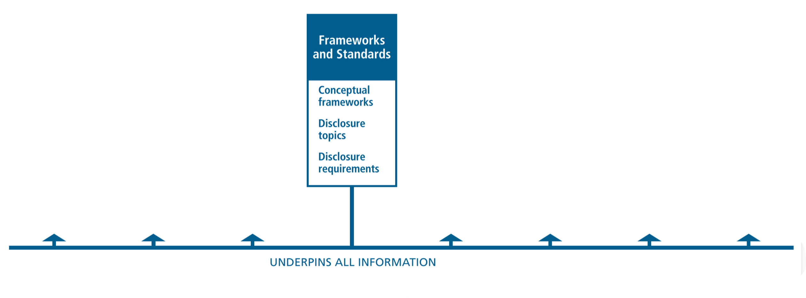
Corporate Reporting Ecosystem
What is the problem?

Slide 7
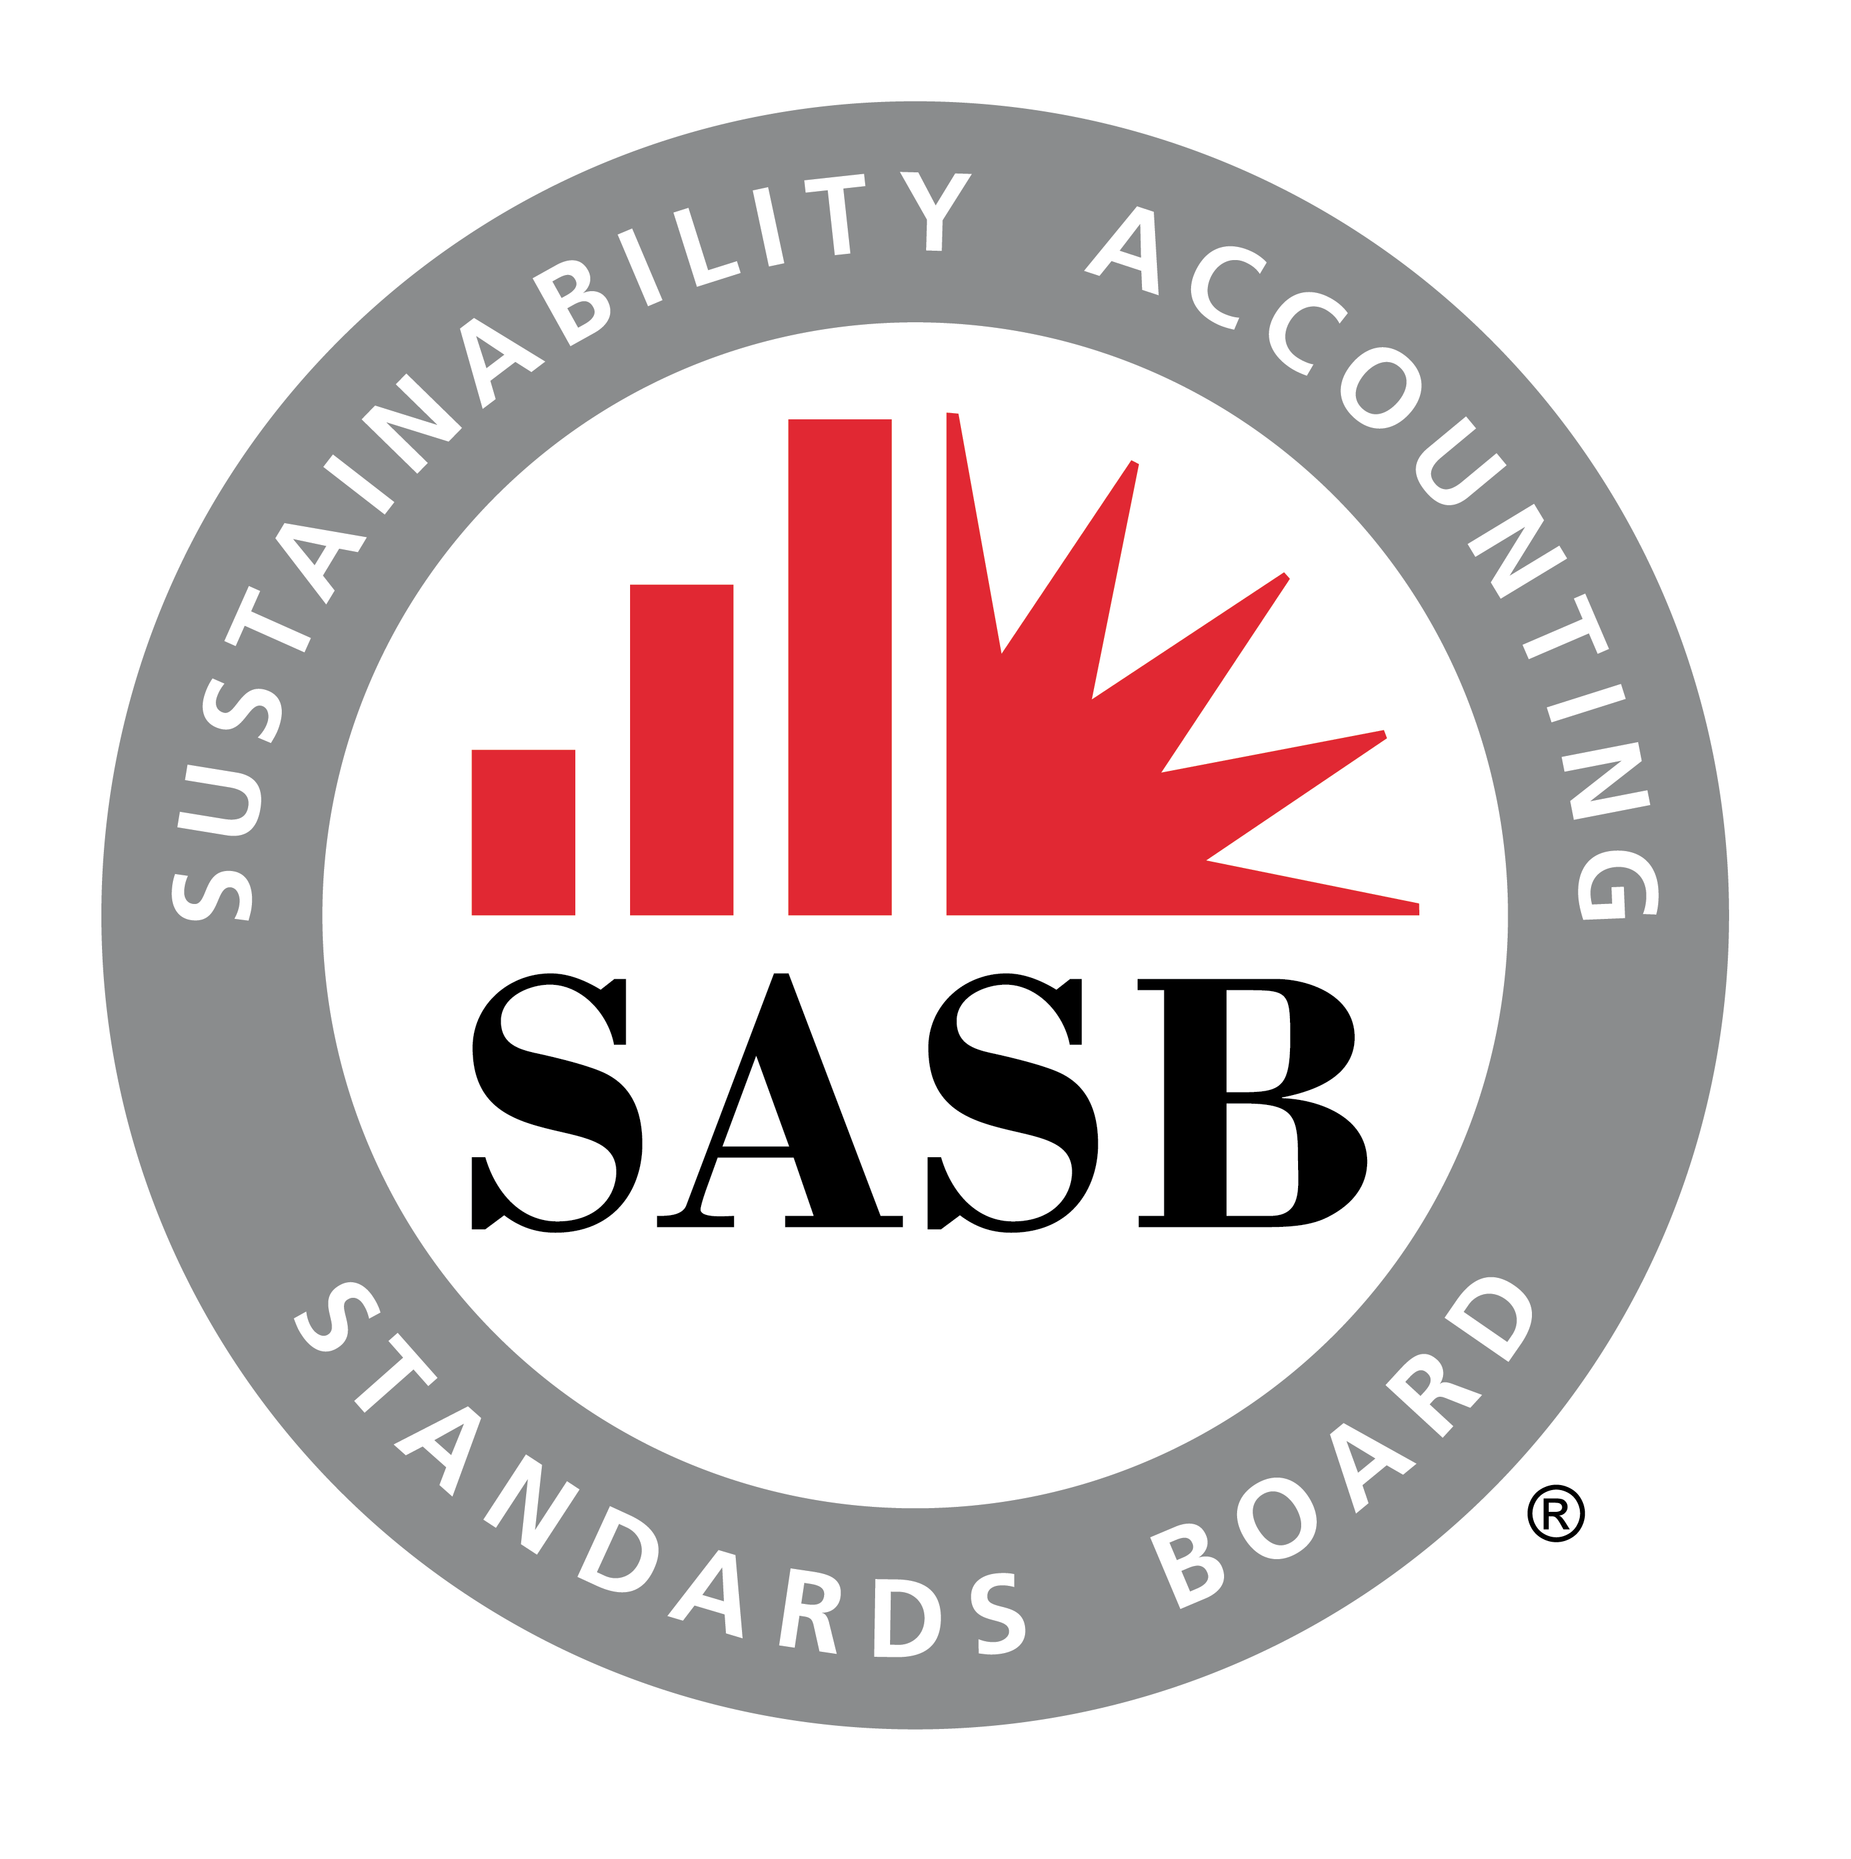
Frameworks vs Standards
Source: Value Reporting Foundation

Slide 8
Evolving Global Regulatory Landscape
In March 2022, the Securities and Exchange Commission SEC proposed rules on climate disclosure
In November 2021, the International Financial Reporting Standards Foundation (IFRS) announced the establishment of the International Sustainability Standards Board (ISSB)
In March 2022, ISSB issued its first two Exposure Drafts, [draft] IFRS S1 General Requirements for Disclosure of Sustainability-related Financial Information and [draft] IFRS S2 Climate-related Disclosures
In April 2022, the European Financial Reporting Advisory Group (EFRAG) released the first set of European Sustainability Reporting Standards

Slide 9
Common Ground on “How”
Even though proposed ESG reporting standards differ in their objectives and scope, they all build on four TCFD principles. That is:
Companies would be required to disclose:
Information about their governance and management oversight of sustainability reporting
Information about the company’s strategy to address significant sustainability-related risks (opportunities)
Information about the process(es) by which sustainability-related risks (opportunities) are identified, assessed and managed
Information about the measurement, goal setting, and monitoring of sustainability-related risks (opportunities)
Governance
Strategy
Risk Management
Metrics and targets

Slide 10
Some Key Differences – “What” Information to Report
Source: EY AccountingLink July 2022

Slide 11
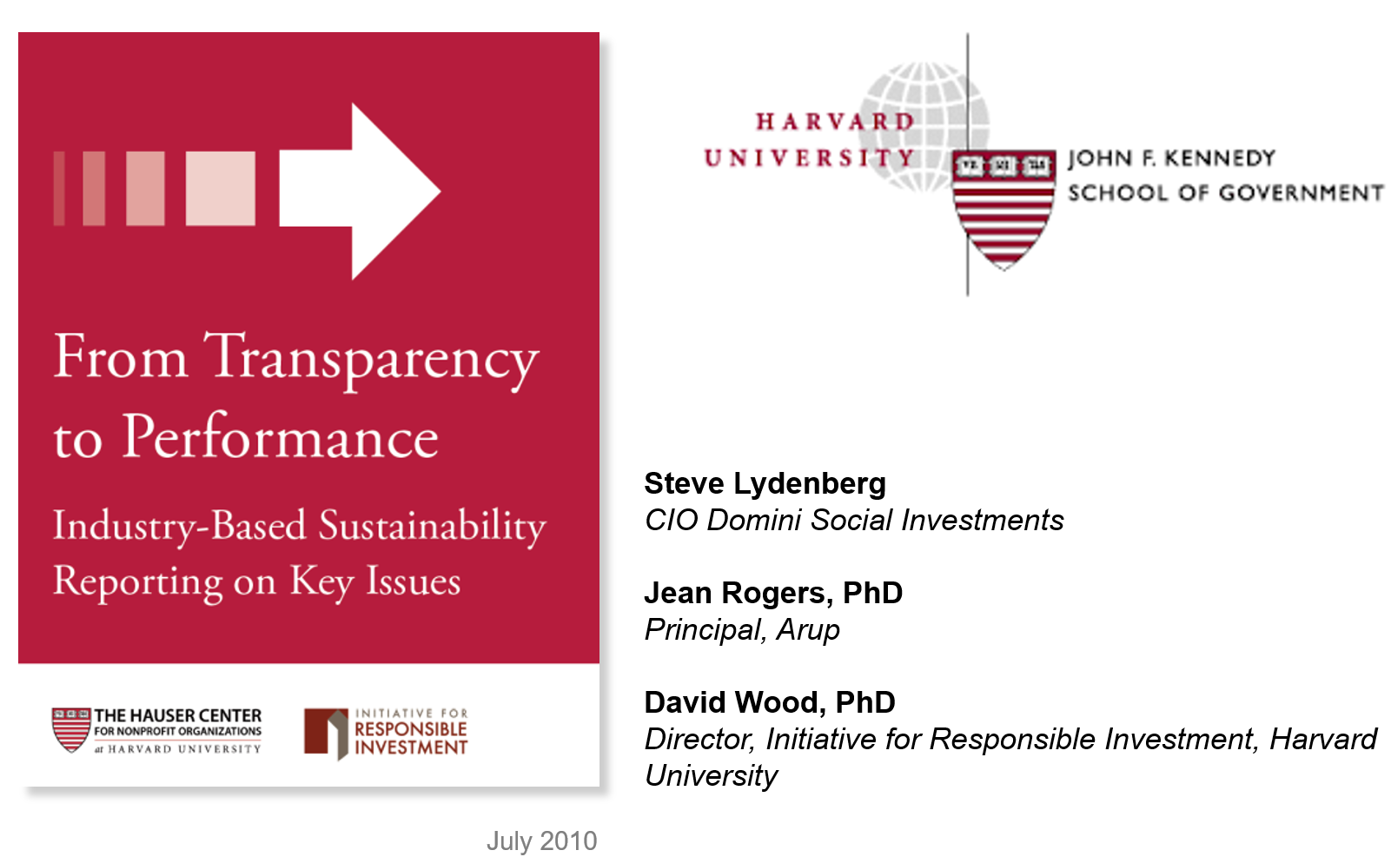
Firms’ Adoption of Voluntary Sustainability Standards
More on Industry-Based Sustainability Reporting

Slide 12
Development of SASB standards

Slide 13
A Starting Point: Five Broad Dimensions of Sustainability
Environment
GHG Emissions
Air Quality
Energy Management
Water & Wastewater Management
Waste & Hazardous Materials Management
Ecological Impacts
Leadership & Governance
Business Ethics
Competitive Behavior
Management of the Legal & Regulatory Environment
Critical Incident Risk Management
Systemic Risk Management
Social Capital
Human Rights & Community Relations
Customer Privacy
Data Security
Access & Affordability
Product Quality & Safety
Customer Welfare
Selling Practices & Product Labeling
Human Capital
Labor Practices
Employee Health & Safety
Employee Engagement, Diversity & Inclusion
Environment
Social Capital
Universe of SUSTAINABILITY Issues
Leadership & Governance
Human Capital
Business Model & Innovation
Business Model & Innovation
Product Design & Lifecycle Management
Business Model Resilience
Supply Chain Management
Materials Sourcing & Efficiency
Physical Impacts of Climate Change
Notes:
I've heard from a lot of corporate folks that when they see this slide (or share it with their colleagues), they get overwhelmed by the range of issues. It’s important to note that this is a starting point. SASB takes an industry-specific view to determine which of a broad set of issues are most important and why, with an average of only 6 out of these 26 topics per industry.

Slide 14
SASB Standards Development Process
Industry Research
Evidence of Financial Impacts
Universe of ESG Issues
Market Input
SUSTAINABILITY ISSUES
Standards Advisory Group and Issuer, Investor Consultation
Evidence Vetting
Standards Board Review
Environment
Social Capital
Human Capital
Business Model & Innovation
Leadership & Governance
Public Comment
Exposure Drafts
Revisions & Board Approval
Ongoing standards maintenance
SASB Standards
77 Industries

Slide 15
Disciplined Focus on Direct Financial Impacts SASB identifies disclosure topics with evidence of impact on financial condition, operating performance, or risk
Financial
Impact
REVENUE
COST
ASSETS & LIABILITIES
COST OF CAPITAL
Types of Financial Drivers
Demand for Core Products and Services
Intangible Assets and
Long-Term Growth
Operational Efficiency/Cost Structure
Valuation of Core Assets and Liabilities
Governance, License to Operate and Risk
Example SASB Disclosure Topics
Health & nutrition in processed foods
Diverse workforce in technology
Energy-efficient chemicals production
Stranded assets in Oil & Gas
Operational safety of gas pipelines
Notes:
Here, the "revenue" and "cost" channels related to "operating performance," the "assets/liabilities" channel relates to "financial condition," and the "cost of capital" channel relates to market valuation.

Slide 16
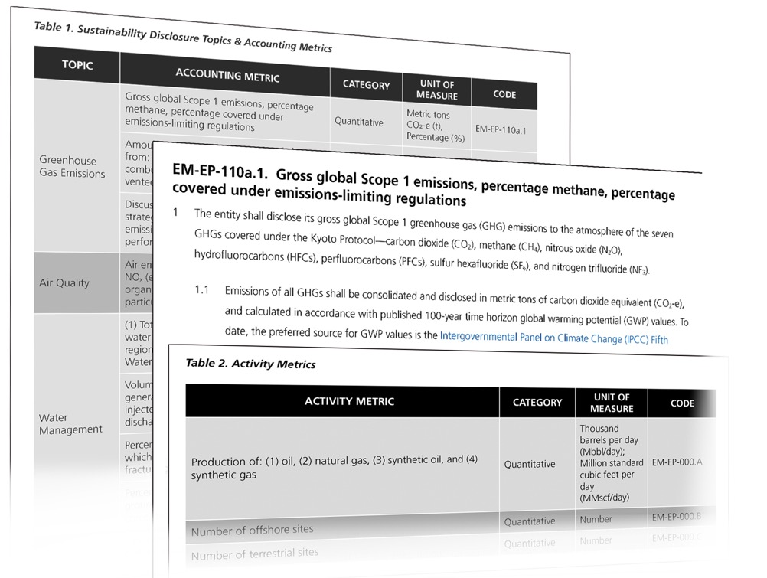
The SASB Standards Format
Industry-specific disclosure topic
Accounting metrics
Technical protocol for compiling data
Activity metrics for normalization

Slide 17
What role do voluntary sustainability standards by SASB play for sustainability reporting and actions?
Stock returns, liquidity, cost of capital
Management Actions
Disclosures
Investors’ Use of Information
Operational
effects
Disclosure effects
More details in:
Bochkay, Khrystyna and Hales, Jeffrey and Serafeim, George, Disclosure standards and communication norms: Evidence of voluntary disclosure standards as a coordinating device for capital markets (September 22, 2021). Available at SSRN: https://ssrn.com/abstract=3928979
Bochkay, Khrystyna and Choi, Seungju and Hales, Jeffrey, 'Mere puffery' or credible disclosure? The real effects of adopting voluntary ESG disclosure standards (July 20, 2022). Available at SSRN: https://papers.ssrn.com/sol3/papers.cfm?abstract_id=4167391

Slide 18
Part I: Effect of SASB standards on voluntary disclosures
Part II: Effect of SASB standards on companies’ fundamental sustainability performance
Bochkay, Khrystyna and Hales, Jeffrey and Serafeim, George, Disclosure standards and communication norms: Evidence of voluntary disclosure standards as a coordinating device for capital markets (September 22, 2021). Available at SSRN: https://ssrn.com/abstract=3928979
Bochkay, Khrystyna and Choi, Seungju and Hales, Jeffrey, 'Mere puffery' or credible disclosure? The real effects of adopting voluntary ESG disclosure standards (July 20, 2022). Available at SSRN: https://papers.ssrn.com/sol3/papers.cfm?abstract_id=4167391

Slide 19
Part I
What is the impact of SASB standards on the topic of conversation in earnings conference calls?
Unique features of the setting:
Voluntary reporting regime
SASB’s staggered releases of provisional industry standards
More than 50,000 transcripts of earnings calls in the sample
Notes:
investor-focused voluntary sustainability standards

Slide 20
SASB Standards
Investor-oriented
Market informed
Industry-specific
Focus on sustainability issues with the material impact on firm operations and financial condition
Provide explicit accounting metrics and technical protocols for a manageable set of sustainability issues
We use release dates of SASB’s provisional standards to examine changes in companies’ ESG focus

Slide 21
Earnings Conference Calls
One of the major forms of corporate communications
Include interactions between management and participating analysts and investors
Brokerage firms, asset management firms, and media outlets often highlight ESG disclosures in the context of earnings calls

Slide 22
SASB Standards
Earnings Calls
Natural Language
Processing (NLP)

Slide 23
SASB Standards
Industry-specific disclosure topic
Disclosure Topic Description
Industry | Disclosure Topic Code | Disclosure Topic | Disclosure Topic Description
Airlines | TR-AL-110a | Greenhouse Gas Emissions | As a result of its heavy reliance on hydrocarbon fuels, the Airlines industry generates a significant amount of emissions, over 99 percent of which are in the form of carbon dioxide (CO). The industry is thus subject to compliance costs and risks associated with climate change mitigation policies. The main sources of greenhouse gas (GHG) emissions for airlines companies are aircraft fuel use and emissions, ground equipment, and facility electricity. Aircraft fuel use is the largest contributor to total emissions from the industry, and fuel management is a critical part of reducing emissions. Management of the environmental impacts of fuel usage includes increasing fuel efficiency through fleet upgrades, retrofits, and optimization of flight speed and route design as well as and incorporating alternative and sustainable fuels. These initiatives require capital expenditures, but in the long-run can reduce fuel costs and decrease a company’s exposure to the risks of GHG emissions programs and regulations.
Airlines | TR-AL-310a | Labor Practices | Many workers in the Airlines industry are covered under collective bargaining agreements that cover fair wages, safe working conditions, and freedom of association, which are among basic worker rights. Unionization of key personnel may result in higher labor costs via wage or benefits increase. At the same time, labor practices can impact the long-term profitability of the business. Effective management of, and communication around, issues such as worker pay and working conditions can prevent conflicts with workers that could lead to extended periods of strikes, which can slow or shut down operations and damage a company’s reputation, potentially reducing revenue and market share.

Slide 24
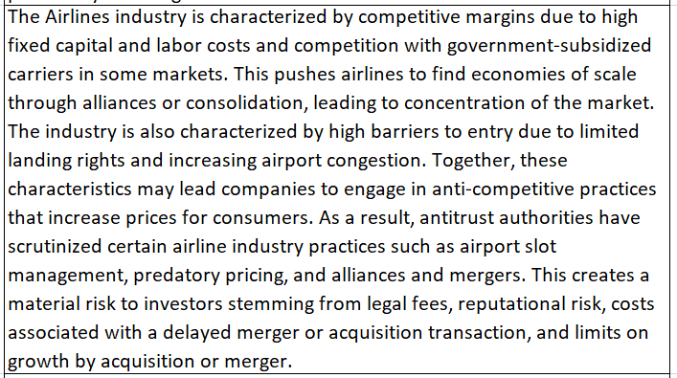
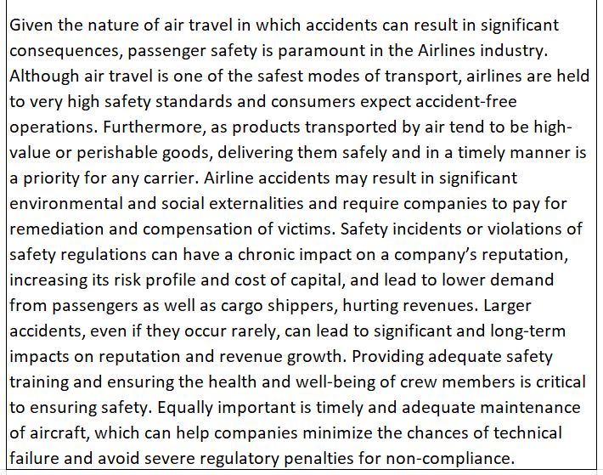
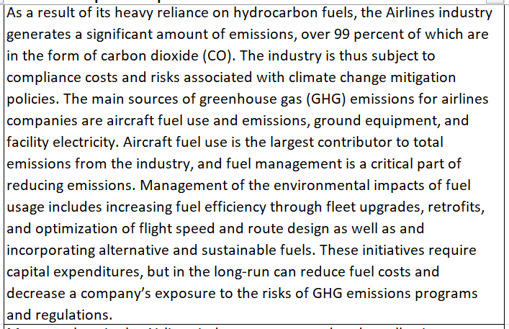
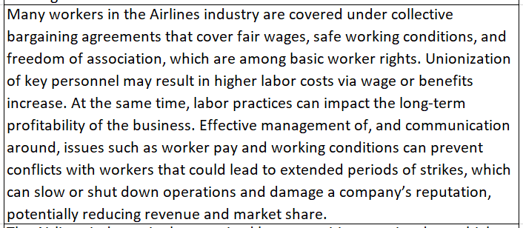
Sustainability keywords for NLP analyses
GHG, emissions, greenhouse gas, climate change, fair wages, working conditions, passenger safety, …..
Industry Topics
Universe of ESG Issues
GHG Emissions
Labor Practices
Competitive Behavior
Accident and Safety Management
SASB Standards:
77 Industries
444 disclosure topics

Slide 25
There is a significant increase in the coverage of ESG topics in earnings calls following SASB standards

Slide 26
The increase in ESG discussion is particularly prominent among firms that provided little or no ESG discussion prior to SASB standards
The increase in ESG discussion is particularly prominent for industries with high uncertainty around ESG reporting

Slide 27
Part II: Companies’ Voluntary Adoption of Sustainability Standards
What factors drive the decision to adopt?
What are the real effects of sustainability standards adoption?

Slide 28
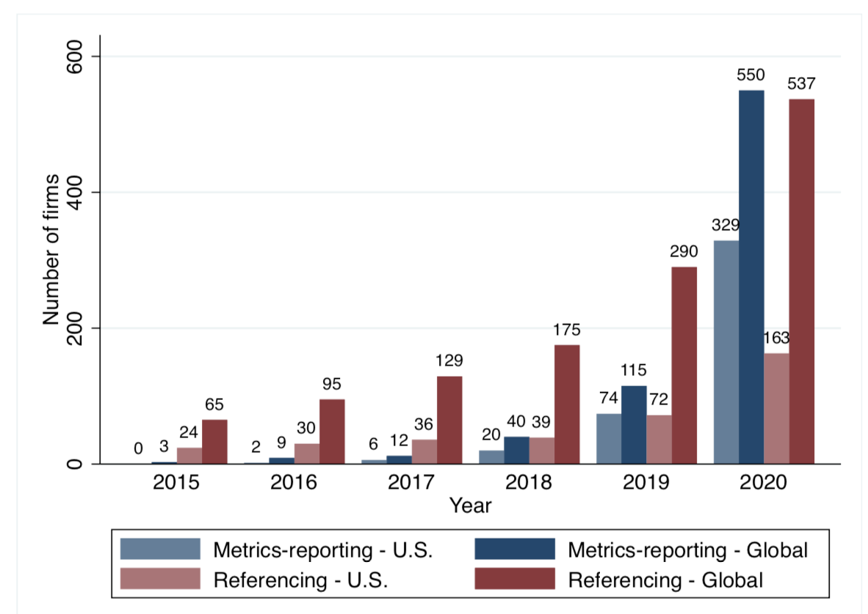
SASB Standards Adoption
As of today, more than 69% of S&P Global 1200 companies report on sustainability following SASB standards
Adopter = equals one if a firm reports its sustainability information in accordance with SASB standard either by referencing SASB standards as a reporting framework or by reporting its ESG performance with SASB metrics in public communications, and zero otherwise
Notes:
Companies responded to calls from the investor community. Especially, in recent few years, growing number of companies have voluntarily adopted the SASB standards. Dark-shaded bars show the number of SASB adopters worldwide, and the light-shaded bards show the number of US companies adopting SASB standards, where SASB adopters are split by type of adoption.
Starting with 68 global companies adopting SASB standards in 2015, as of the end of 2020 more than 1,000 companies are reporting with SASB standards worldwide, and half of them are U.S. companies.
Given the increasing use of SASB standards, in this paper we are trying to explore what are the determinants and consequences of SASB standards adoption.

Slide 29
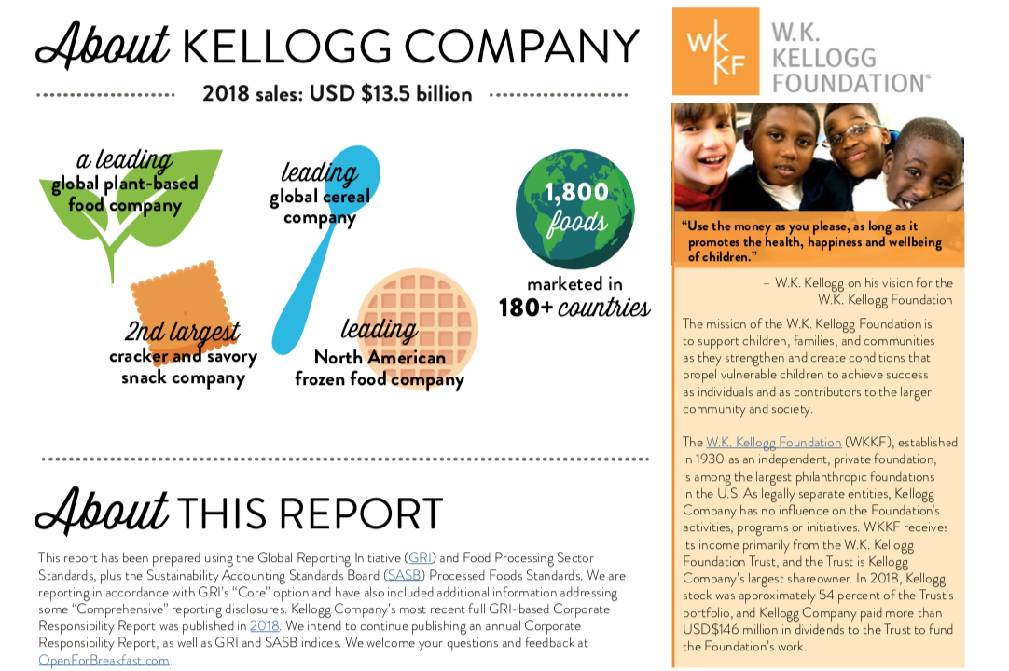
Examples of SASB adoption: (1) Referencing
SASB Referencing - Kellogg’s 2018 Corporate Responsibility Report
Notes:
This is the excerpt from the Kellogg’s 2018 Corporate Responsibility Report. In the section called “About this report”, the company stated that this report ~.

Slide 30
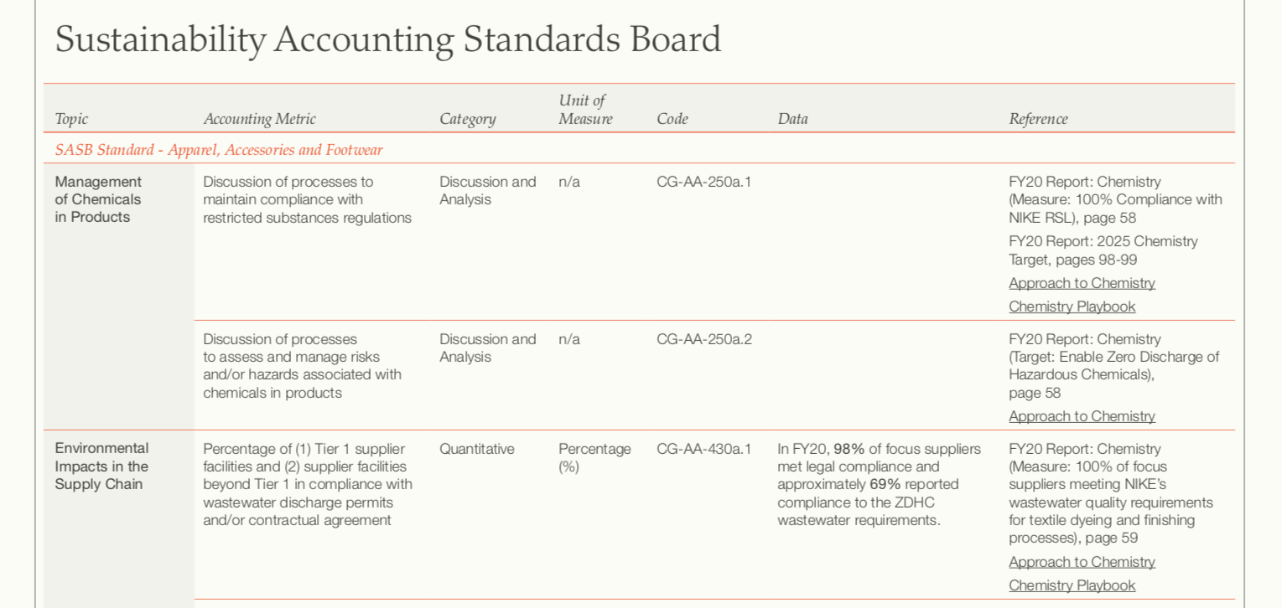
Examples of SASB adoption: (2) Metrics-reporting
Full Adoption of SASB Standards - Nike’s 2021 Impact Report
Notes:
Here is an example from Nike’s 2021 Impact Report. In its CSR report, the company has separate section that mapping their ESG disclosure with the SASB standards. As you can see, for each of the accounting metrics, the company provide relevant information or reference on where you can find such information.

Slide 31
Results - Determinants
We find that the reporting behavior of industry peers and having sustainability-conscious institutional ownership are both significant determinants of SASB standards adoption, along with firm size, proprietary costs, financial performance, and sustainability performance
Non-adoption Standard Referencing Complete Adoption
Notes:
Our empirical model is quite straight forward.
To test the potential determinants of SASB adoption, we regress the indicator for SASB adoption on several firm characteristics.
As a proxy for peer effect, we include PeerRatio variable, which is the proportion of SASB adopting peers within the same industry as of the beginning of the period. Since this variable is highly dependent on industry classification used, we test with three different proxies. The first and the second proxy variables are based on SASB industry classification, where PeerRatio SW is the size-weighted peer ratio and PeerRatio EW is the equal-weighted peer ratio. Our third proxy variable is based on Hoberg & Phillip’s textual based industry classification. This industry classification is generated using textual similarity of product description section of 10-K report. It also provides similarity score between two companies. So we use this similarity score as a weight in calculating peer ratio to test whether companies are influenced by more similar peers.
SusIO is included to test the effect of institutional investors. Especially, we focus on institutional investors who care about ESG issues since they are likely to influence firms’ ESG reporting practices among other investors. Those investors are identified using UN PRI signatory.
Factors that generally affect voluntary disclosure are included, such as ~.

Slide 32
Real Effects of SASB Standards Adoption

Slide 33
Potential Consequences of SASB standards adoption
SASB standards adoption is a mere “puffery”/”greenwashing”
Improvement in sustainability performance
Increased Investor Scrutiny and Reliance
Across Firm Learning
Increased comparability across firms facilitates benchmarking
Within Firm Learning
Relative ESG performance provides a ‘red flag’
Quantification and consistent measurements of performance
Lower management discretion, greater management focus on financially relevant sustainability issues, less noise in the sustainability report
Lower costs to process sustainability disclosures, increased investors’ reliance on and scrutiny of ESG information
Consistent sustainability reporting can help uncover inefficiencies and identify areas for improvement

Slide 34
Consequences of SASB adoption
Equals to 1 if ESG performance is improving relative to the past, and 0 otherwise
“apples to apples”
research design
vs.
SASB Adopters
Non-Adopters

Slide 35
Measuring Firm’s Real ESG Activities
 | Measure | Source
More Broad Measures | Negative ESG-related Incidents | RepRisk
 | Negative ESG-related Violations | Violation Tracker
 | ESG Ratings | Refinitiv
More Specific Measures | Scope 1, Scope 2 GHG Emissions | Trucost
 | Toxic Releases | US EPA Toxic Release Data
 | Workplace Injuries | US Department of Labor, OSHA Data

Slide 36
Compared to non-adopters, adopters of SASB standards have fewer negative ESG incidents and violations, lower pollution levels and GHG emissions, lower work-related injuries, and higher ESG ratings, respectively, in years following the standards adoption
GHG emissions, pollution levels and workplace safety results are more pronounced among industries for which these issues were identified as material
Improvements in fundamental
sustainability performance

Slide 37
Takeaway
Voluntary sustainability standards play an important role in coordinating sustainability reporting and actions
Notes:
Larger firms tend to lead when it comes to adopting sustainability disclosure practices
our results may not generalize to smaller firms
Voluntary choice gives insights into relative cost/benefits for the adopters, but not for the non-adopters
we can’t conclude that all companies would respond in the same way, if disclosures became mandatory
It is still possible that real effects are the outcome of collective changes within firms (e.g., sustainability committees, top management involvement, adoption of other frameworks)

Slide 38
The Future of SASB Standards under ISSB
ISSB is committed to industry-based approach to standards development
Market tested and validated
ISSB included SASB Standards in the Exposure Drafts
S1 General Requirements
S2 Climate-related Requirements
ISSB is committed to improving international applicability of SASB Standard
ISSB encourages continued use of SASB Standards
Until superseded by ISSB Standards
Emmanuel Faber, ISSB Chair: “We are convinced that the industry-based approach used to develop the SASB Standards is a market-validated model for the development of decision-useful and cost-effective sustainability disclosure standards. . . . Further enhancing and evolving the SASB Standards will be a priority for the ISSB, as embedding the industry-based approach in the work of the ISSB is essential to delivering Standards that support investors’ assessments of enterprise value across a broad range of sustainability issues.”

Slide 39
Being an Academic Fellow at ISSB…
Comment letter analysis (~1,400 letters)
Analysis of expected costs/benefits of IFRS S1 and IFRS S2
From users’ perspective
From preparers’ perspective
Digital sustainability reporting
Use of data analytics to aid standard setting processes
Post implementation review of standards’ effects
And many more…

Slide 40
THANK YOU! Khrystyna Bochkay University of Miami, kbochkay@bus.miami.edu IFRS ISSB, khrystyna.bochkay@ifrs.org

