Slide 1


Slide 2
Current CSR Reporting Regulation and Issues to Consider before Mandating CSR Reporting More Broadly
Hans Christensen

Slide 3
Corporate Social Responsibility: Who Cares?

Slide 4
What is corporate social responsibility?
Corporate social responsibility (CSR); Environment, Social, and Governance (ESG); Sustainability (used interchangeably)
What type of activities could CSR/ESG be?
  Treat employees well
    Labor safety, fair pay, equal pay, etc.
  Treat customers well
    Charge fair prices, not mislead customers, equal treatment, etc.
  Avoid pollution
    CO2 emissions, water consumption, deforestation, etc.
  Do good for the community
    No corrupt payments, support local infrastructure, etc.
  Probably many more topics…

Slide 5
Do CEOs/firms have social responsibility or should they only focus on profit? In whose interest should managers act?
Friedman in NYT September 13, 1970
  https://www.nytimes.com/1970/09/13/archives/a-friedman-doctrine-the-social-responsibility-of-business-is-to.html
What does it mean to say that executives have social responsibility?
  Act in some way that is not in the interest of shareholders
    E.g., Refrain from increasing the price of the product in order to contribute to the social objective of preventing inflation
    Reducing pollution beyond the amount that is in the best interests of the corporation or that is required by law
    CEO spend someone else's money for a general social interest.
      Effectively imposing taxes and spending the tax proceeds
Companies should focus on making money and leave ethical issues to individuals and government
Notes:
“This is the basic reason why the doctrine of “social responsibility” involves the acceptance of the socialist view that political mechanisms, not market mechanisms, are the appropriate way to determine the allocation of scarce resources to alternative uses.”
“The difficulty of exercising “social responsibility” illustrates, of course, the great virtue of private competitive enterprise — it forces people to be responsible for their own actions and makes it difficult for them to “exploit” other people for either selfish or unselfish purposes. They can do good—but only at their own expense.”
“In a free society, it is hard for “good” people to do “good,” but that is a small price to pay for making it hard for “evil” people to do “evil,” especially since one man's good is anther's evil.”

Slide 6
Another view
Hart and Zingales (JLFA, 2017):
  Friedman’s argument only holds if one of the following two statements are true:
    Money-making and ethical activities are separable
      Example of non-separable: Walmart selling high-capacity magazines of the sort used in mass killings. If shareholders are concerned about mass killings, transferring profit to shareholders to spend on gun control might not be as efficient as banning the sales of high-capacity magazines in the first place.
      Example of separable: Donation to charity
    Government perfectly internalizes externalities through laws and regulations
      Examples of reasons it may not be true: Political constraints, corruption, incompetency.
  If not, shareholder welfare ≠ market value
    Corporations should maximize shareholder welfare, not market value
  Note by me: Corporate governance is also imperfect
    Inseparability can also be addressed with Pigouvian tax on externalities

Slide 7
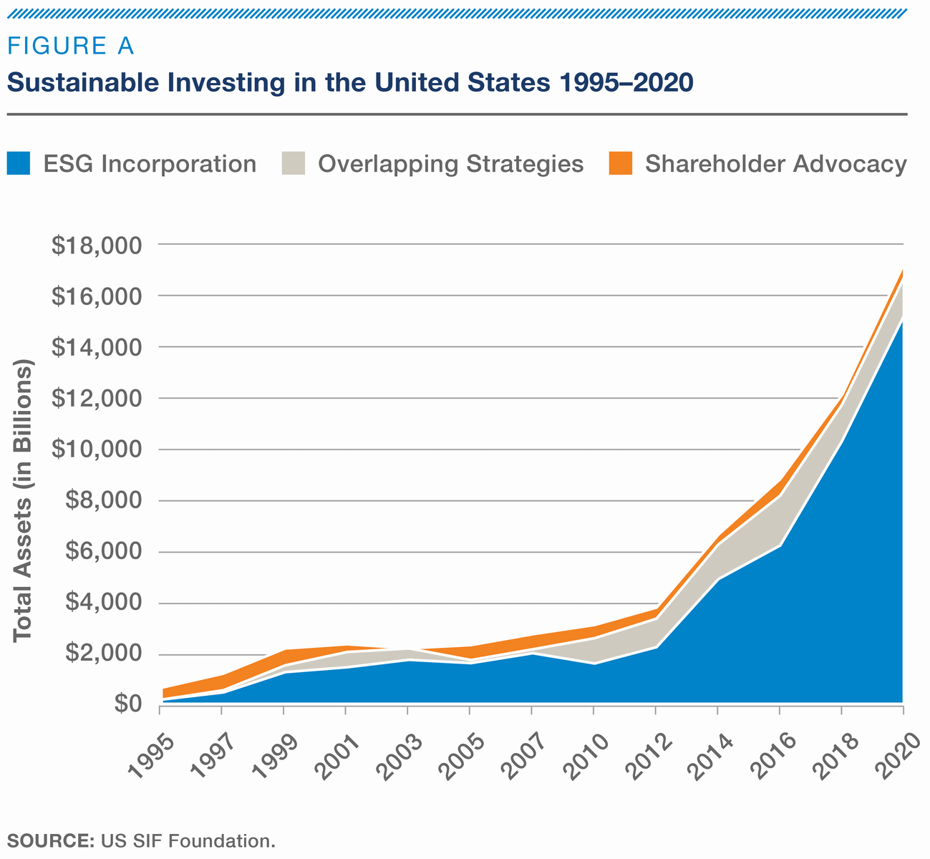

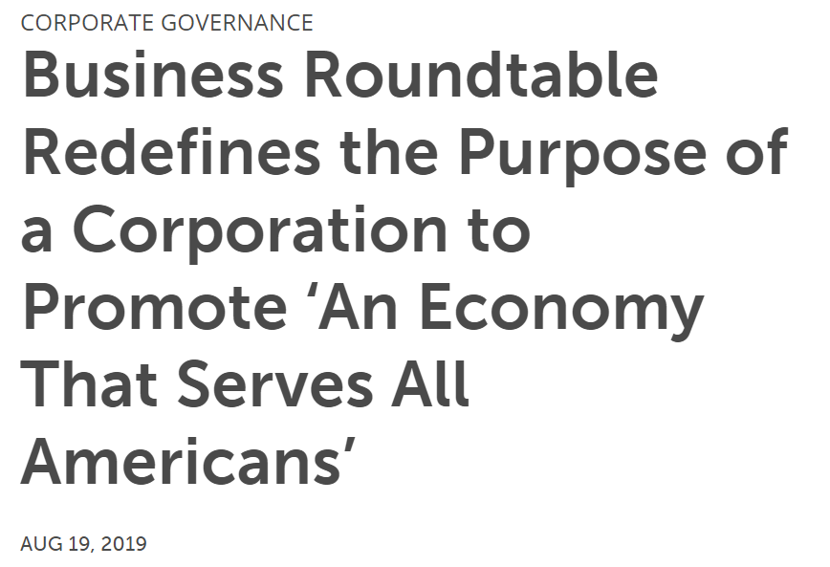
A shift in opinions: Why?
Sustainable investing assets > $30 trillion, according to some estimates
Stakeholders respond to the failure of governments to address some of our greatest problems
  Globally (e.g., climate change)
  Nationally (e.g., diversity in the US and poor working conditions in developing countries)
  Perhaps expected that people turn to corporations when they feel politicians fail
If corporations is the solution, we need accountability and reporting (areas accountants are experts in)
  Can accountants save the world?

Slide 8



US Securities Regulation Today

Slide 9
No general CSR reporting mandate
There is no general CSR reporting mandate in the US (or any other country I know)
  There are some targeted disclosure requirements
    For instance, mine-safety and conflict-mineral disclosures (see later slides)
But, general materiality requirement apply
  Supreme Court defines information as “material” if there is a substantial likelihood that the disclosure of the omitted fact would have been viewed by a reasonable investor as having significantly altered the “total mix” of information made available
Does that mean that firms must report CSR information if investors care?
  Not really

Slide 10
Disclosure under U.S. securities law
Basic principles (I am not a lawyer):
  When you speak, speak truthfully
  When a specific disclosure duty exists, you must speak
  Once you speak on an issue or topic, there is a duty to tell the whole truth
“There must be a substantial likelihood that the disclosure of the omitted fact would have been viewed by a reasonable investors as having significantly altered the ‘total mix’ of information available”
Source: SASB LEGAL ROUNDTABLE at HARVARD LAW SCHOOL

Slide 11


Examples of targeted disclosure requirements in U.S. securities law
Unprecedented use of securities regulation to address non-financial issues in Dodd-Frank (Sections 1502 and 1503)
  Disclose safety performance in financial reports
  Conflict mineral disclosures (in special disclosure documents and due diligence requirement)
Address broad societal problems rather than protect investors:
“Currently, there is no requirement to publicly disclose safety records, which has allowed companies to operate without critical checks and balances. West Virginia suffered a terrible loss recently at the Upper Big Branch mine and we owe it to our miners and their families to do more to make mine safety a top priority”. (Senator John D. Rockefeller IV)
Upper big branch disaster West Virginia 2010
Conflict Minerals in the DRC

Slide 12
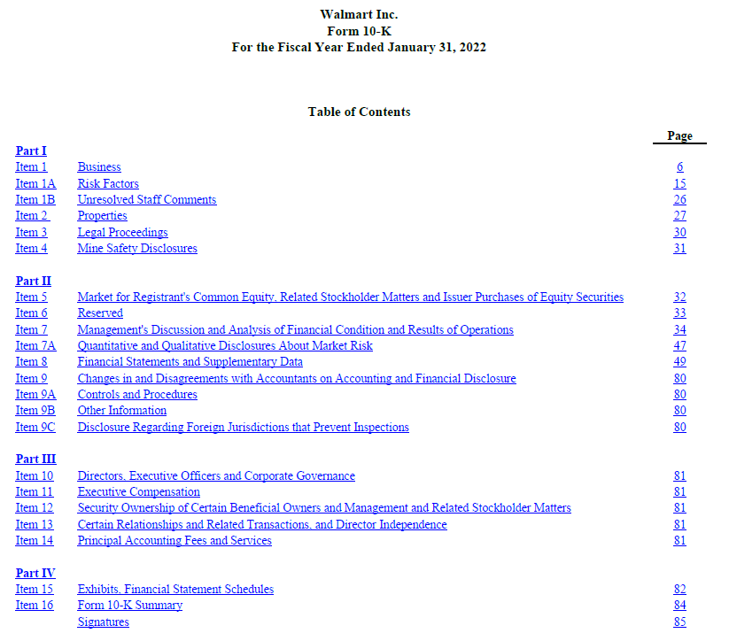

Form 10K: Mine-safety disclosure
What is item 4 in a 10K filing?

Slide 13
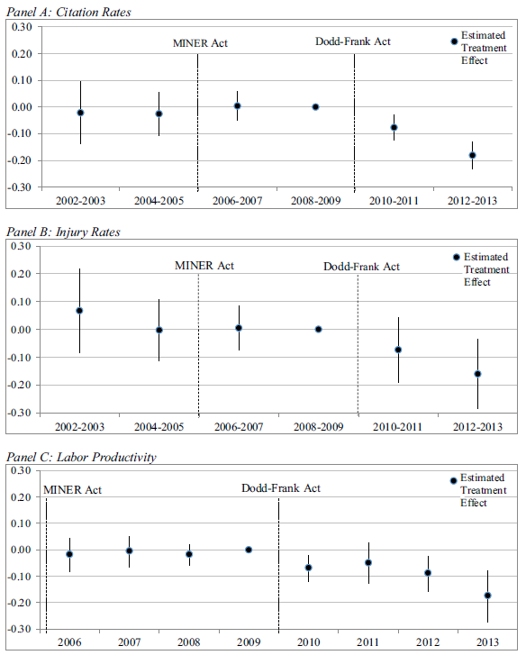
What happened to mine-safety in the United States?
Compares mines owned by SEC-registrants to those owned by non-SEC-registrants
Firms change behavior around disclosure mandate
  Less violations
  Less injuries
  But also lower productivity
Source: Christensen, Floyd, Liu, and Maffett (JAE 2017)

Slide 14
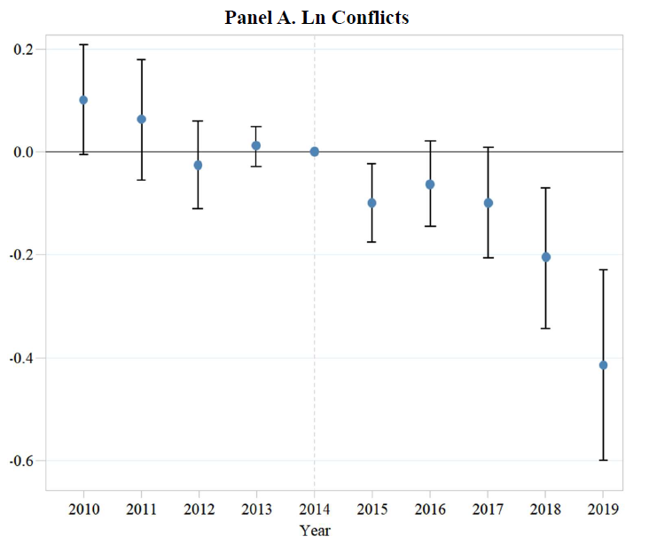
What happened to conflicts in the DRC and neighboring countries?
Something changed in and around the DRC
  Less conflicts compared to the rest of Africa
  But many things changed in Africa’s Great Lakes region from 2010 till 2020
Better identified evidence on changes in supply chains
Lots of evidence in accounting that disclosure mandates change firm behavior
This is likely what proponents of a CSR reporting mandate have in mind
Source: Baik, Even-Tov, Han, and Park (WP 2022)
Newest version available on SSRN: https://papers.ssrn.com/sol3/papers.cfm?abstract_id=3908233

Slide 15
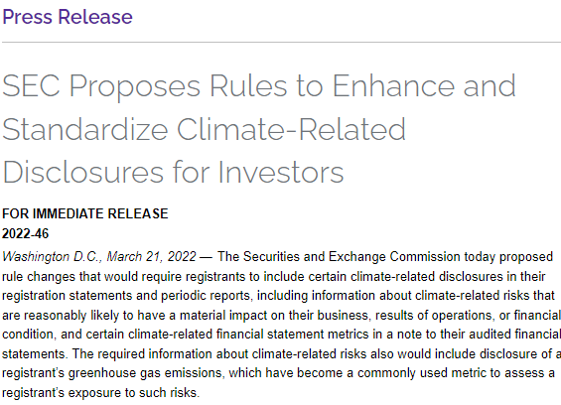
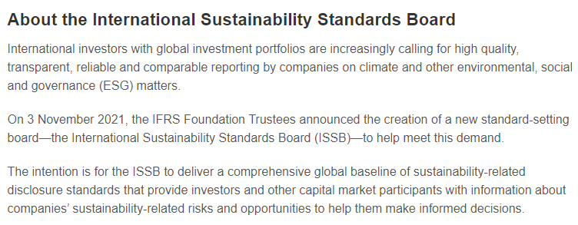
More disclosure regulation on its way…
SEC has proposed rule on climate disclosure
  Heavily debated at the moment
IFRS foundation announced at COP 26 the creation of the International Sustainability Standards Board (ISSB)
  A full set of CSR reporting standards in the future
  Do you think it is likely countries will mandate these reporting standards?
    Like many did for IFRS that focus on financial reporting
(Note: not a complete list of initiatives)

Slide 16
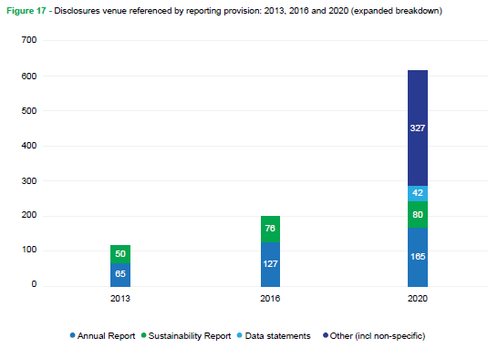
Major push for mandatory sustainability reporting globally
More than 600 targeted disclosure initiatives globally by 2020
  Not only securities regulation
Source: Carrots & Sticks 2020
(See their website for initiatives by country)

Slide 17
Takeaways on current mandatory CSR reporting
No broad CSR reporting mandate
  General materiality rules are likely hard to enforce in the CSR setting
Some targeted disclosure mandates
  E.g., conflict mineral disclosures and mine safety disclosures
Likely a lot more regulation on its way (not just in the US)
  At least, it is heavily debated at the moment

Slide 18
Politics of a CSR Regulation

Slide 19
Politics a CSR reporting
Unsuccessful lobbying for more traditional policy instruments
  E.g., carbon tax/quota, custom laws on conflict minerals
Politically difficult to address challenges through traditional regulation
  For instance, climate change is a global problem
    Complicated politics between developed and developing countries
  Reporting standards “merely” prescribe disclosure, not particular actions
  Transparency or disclosure regulation is viewed as less intrusive
Transparency is viewed as a “good thing”
  Politically, it is hard to argue against transparency
  That is why more regulation is likely
Disclosures “unleash” incentives and market forces
  “Sunlight is the best disinfectant”
  Allow investors and other stakeholders to monitor (pressure) firms
  Many other examples where disclosure regulation is used in this way
    Consumer protection, health care, political campaign contributions, etc.

Slide 20
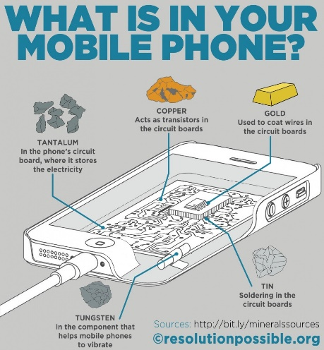
An illustrative example: Conflict minerals
(evidence from historical background)
Background: Aftermath of the Great War of Africa (aka the Second Congo War)
  In and around the Democratic Republic of Congo (DRC)
  Bloodiest conflict since World War II (fatalities > 5 million)
  Funded (in part) by the trade in conflict minerals (e.g., used in phones)
    But minerals are not the root cause. Political failures such as political power struggles, access to land, and citizenship are.
  Revelations that multinational firms such as Apple, Intel and Motorola were unwittingly buying conflict minerals
First, NGO conflict mineral campaign in early 2000s around the time of the Kimberley Process
  Enough Project became a key player (created in 2007)
Political traction (Senate) in 2008: The Conflict Coltan and Cassiterite Act
  Traditional regulation: US Customs law
  Not sufficient political support
  Later transformed into securities regulation and added to Dodd-Frank Act in 2010 (Section 1502)
  Notice similarity to current push for “climate disclosures”
    Also, started with push for CO2 taxation/quota

Slide 21
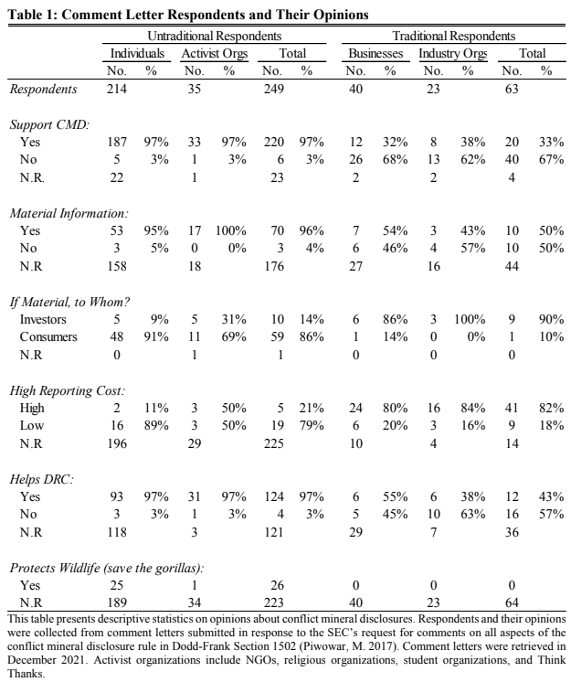
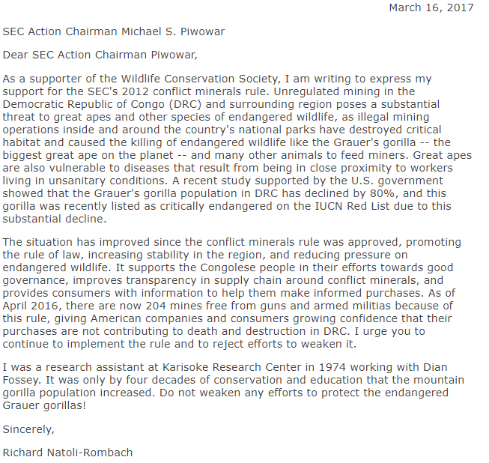
An illustrative example: Conflict minerals
(evidence from comment letters)
SEC question: What do you think about mandatory conflict mineral disclosure?
Not only the usual suspects replied
80% of comment letters from NGOs, religious groups, student organizations, and Think Tanks
They do not have the same opinions or types of arguments as the usual suspects
NOTE: The alleged causal chain from CMD to gorillas' wellbeing appears rather long and is not well articulated by the comment-letter writers making this argument. From the limited number of comment letters that include a rationale, the writers' positions seem to be rooted in anecdotal evidence that miners occasionally hunt endangered gorillas for bush meat, presumably when they get sufficiently hungry and have few alternatives. Those letter writers do not explain how CMD reduce hunger among miners or how CMD protect gorillas in other ways.

Slide 22
Reporting mandate used to show political action but no real change (political greenwashing)
Worst case: Disclosure regulation used politically to say we did something but ultimately ineffective
  Political greenwashing
Consider requirement for healthcare providers to disclose charge prices
  Charge prices are list prices (similar to room rate written hotel door)
    (Almost) nobody pays the list price
  Hospitals reduced list price and discount by similar amount
    Disclosed item (charge prices) can be decoupled from construct of interest (actual payments)
    Some stakeholders’ did not understand (e.g., voters)
    See evidence in Christensen, Floyd, and Maffett (2020): “The Only Prescription is Transparency” and associated NPR podcast
Political greenwashing can delay real action on real problems (e.g., climate change)

Slide 23
Likely scenarios related to CSR politics
Focus on issues that lack (traditional) political solutions in Congress
  Traditional policy instruments: Taxation, penalties, etc.
  Often start with potentially better traditional regulation
    Proponents probably know reporting mandate is not the best solution. Just the solution which is politically feasible
    Decision-decision power further away from voters
Different groups enter the lobbying process
  Different arguments and objectives
    “Conflicts are bad” versus “capital formation”
    “Save the world” versus “reduce the cost of capital”
    Difficult for lawyers and accountants to make reasonably objective decisions
Tough to manage SEC agenda
  Disclosures on abortion coverage in healthcare plans?
Instances of political greenwashing
“Because expertise about these events does not reside within the Commission or our staff, we have drafted these proposed rules carefully to follow the direction of Congress.” Then chairperson Mary L. Schapiro in speech on December 15, 2010.
Link: https://www.sec.gov/news/speech/2010/spch121510mls-2.htm

Slide 24
Real effects of a CSR Reporting Mandate

Slide 25
There will be real effects
By real effects, I mean changes in corporate investment policies
  For instance:
    Increase investment in CSR (e.g., labor safety, non-conflict mineral supply chain, lower CO₂ emissions)
    Exit from high CSR-risk areas
Lot’s of evidence in accounting that disclosures/reporting change investment policies (both CSR and financial reporting)
  One of very few findings most accounting researchers agree on
But, not all real effects benefit society more broadly
  Shifting mining operations from US SEC-registrants to US private or Chinese/Russian firms (no evidence this will improve the lives of people in DRC or mine safety more broadly)

Slide 26
Bad measurement can lead to bad real effects
Uninformative CSR metrics (e.g., disclosure/ratings) can have real effects
  Good (bad) CSR metrics are (un)correlated with underlying CSR activities
  Hard to measure many aspects of CSR
If some stakeholders that can impose costs on firms do not understand
  E.g., consumers or voters
After a random CSR disaster, a bad CSR metrics can still be used to shame the CSR reporter
  A good rating can be used as an excuse (“we did all we could”)
  Create incentives to invest (real effect) in “favorable” uninformative CSR metrics
Unlikely that real effects from this channel are desirable from society’s perspective

Slide 27
Existence of real effects of CSR disclosure not enough to justify a reporting mandate
Unintentional consequences can easily happen
  Especially with unsophisticated users (e.g., consumers)
  Trade-offs are complicated
    Users (e.g., consumers) unwilling to spend time understanding issues
  In the presence of nefarious political objectives
    For instance, Amazon does not pay federal taxes. (the average person does not understand deferred taxes)
Evidence that CSR reporting causing real effects are costly
  Lower productivity (Christensen at al. JAE 2017)
  Exit by regulated firms can lead to lower aggregate productivity (Rauter JAR 2021)

Slide 28
Cost Effectiveness of Mandatory CSR Reporting

Slide 29
Reporting mandate versus traditional policy instruments
Traditional policy instruments: Taxation, subsidies, penalties
Even if reporting mandate leads to desirable real effects and politics managed well, is it cost effective?
Example: Conflict mineral disclosure:
  Early estimates by the commission suggested initial cost of $3 to $4 billion and reoccurring costs of $207 to $609 million. Anecdotes from businesses suggest that is an understatement but debatable.
Proponents of reporting mandates realize they are unlikely cost effective
  The first thing they argued for:
    Conflict mineral disclosures → Customs law
    Healthcare → actual price disclosures
    Climate change → Taxation and quota
  Reporting regulation is just the policy instrument with the least political resistance

Slide 30

Should we replace the Federal Aviation Authority (FAA) with a plane-safety disclosure mandate?
FDA inspect airlines and air planes and assess whether safety procedures meet a certain code
  If it does, airline can operate
What if we replaced the FAA with disclosures on safety instead:
  You can decide which airline you fly with and that will create an incentive for airlines to keep a certain safety level, right?
  Problems with this idea include
    Costs of becoming informed (we are not all experts in flight safety)
    Duplication of effort
Many CSR issues are also complex, for instance:
  Trade-offs between pollutants
  Measurements of labor safety
  Conflict in and around the Democratic Republic of the Congo

Slide 31

Takeaways
Little regulation, lots of variation in reporting practices
  Potential for a reporting mandate: Accountability and reporting is important
But three issues to consider before a reporting mandate enforced by the Securities and Exchange Commission
  Politics
  Unintentional real effects
  Cost effectiveness
Limited evidence on these issues (or even conceptual arguments for some of them)
  Large scope for evidence and conceptual arguments
  “Whatever you do, just don’t mess it up”
    The future of the planet depends on it!

Slide 32
Appendix:
CSR Information Available Today
(in addition to targeted-disclosure rules)

Slide 33
ESG landscape
Largely voluntary disclosures
  Except for targeted disclosure rules and general SEC materiality rules (see prior slides)
Most S&P firms report standalone CSR reports
  More than 95%
  Use different names (CSR, sustainability, climate report, community reports, etc.)
  No SEC form (like 10K or 10Q) so formats vary widely
    Firms generally just upload them to their website and sometimes send out a press release
    Even make changes after first publishing the reports (and simply upload new report to website)
    Some only report every second year

Slide 34
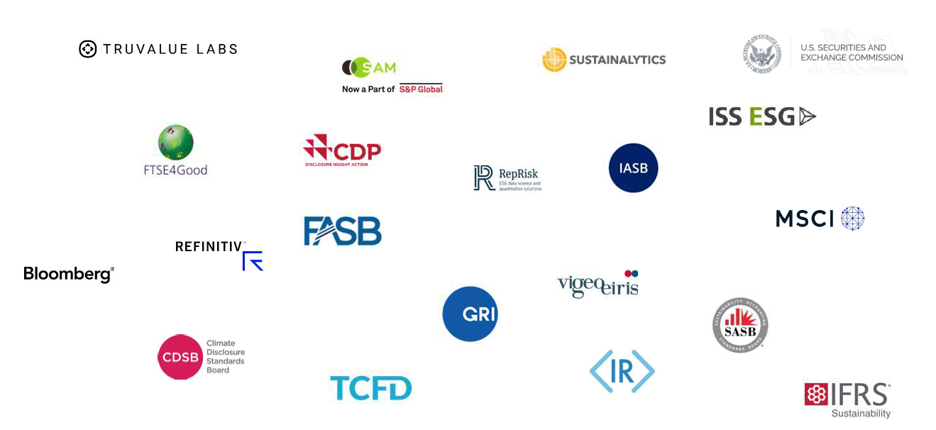
Lots of standard setters and data providers

Slide 35
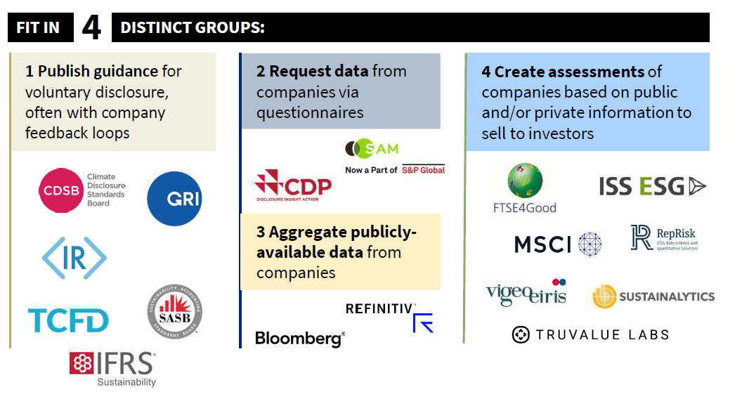
Making sense of the information sources
Source: Value Reporting Foundation

Slide 36
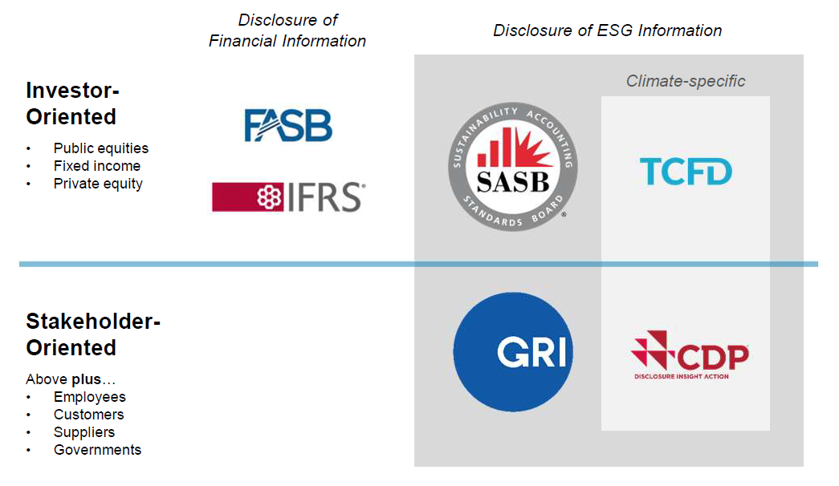
Guidance for different purposes
Should reporting standards focus on investors?
What is the difference in practice?

Slide 37
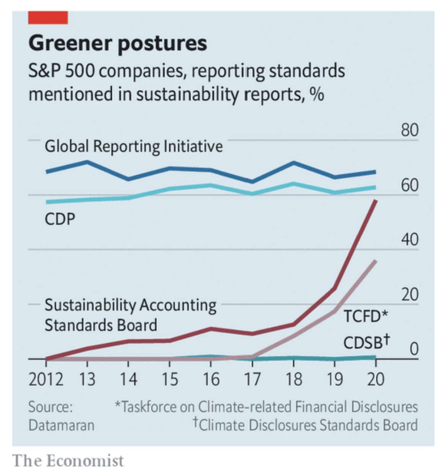
Trending towards a capital market focus
SASB is gaining traction
SASB standards focus on investors and have an industry focus
  That is, there is one standard per industry.
What information is material in a particular industry?

Slide 38
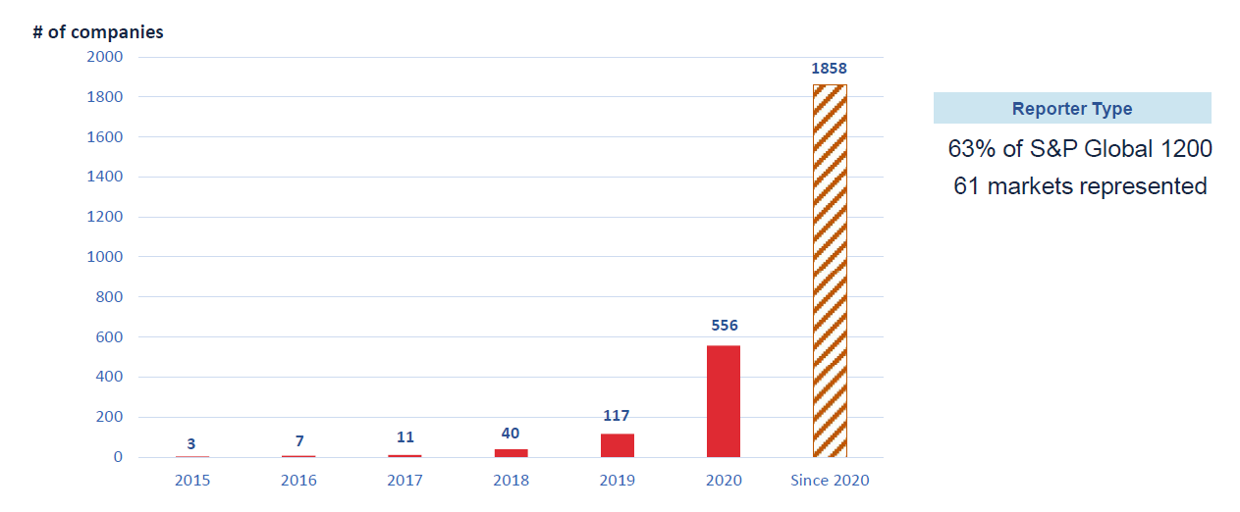
Increasing use of SASB standards globally
Growth is global and across small, mid, and large cap
A mandate will likely look somewhat like SASB standards (e.g., IFRS foundation)

Slide 39


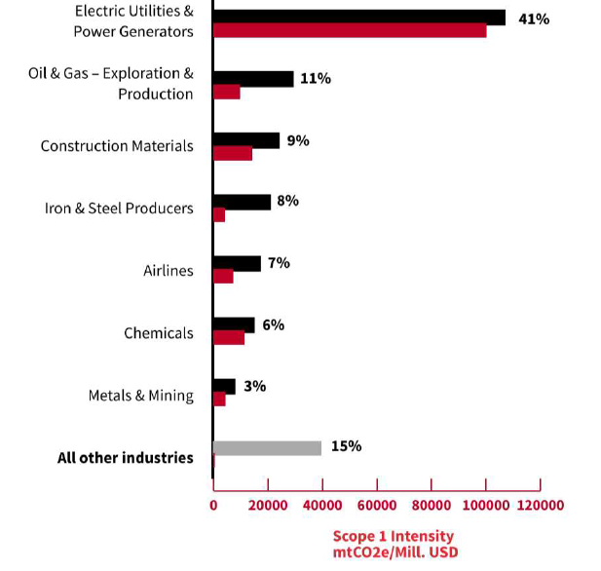
Many CSR topics are (somewhat) industry specific
Data analyzed from CDP indicates that 85% of Scope 1 GHG emissions comes from 7 industries
  Scope 1 emissions are direct greenhouse (GHG) emissions that occur from sources that are controlled or owned by an organization (e.g., emissions associated with fuel combustion in boilers, furnaces, vehicles)

Slide 40
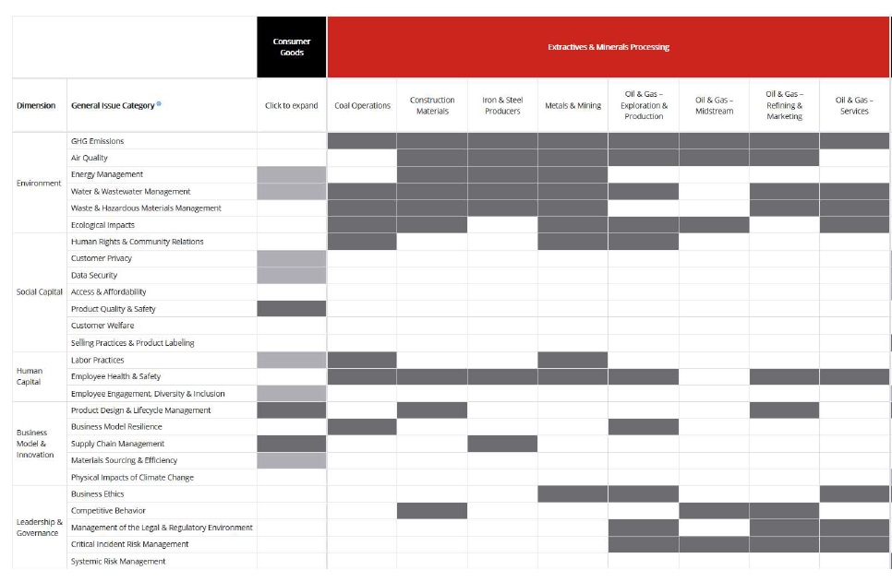
Materiality
SASB’s Materiality Map®
  11 sectors and 77 industries
  Here just extractive industries
When does human rights & community relations matter a lot in extractive industries?

Slide 41
Materiality is a tricky construct for sustainability reporting
Sustainability information is rarely expressed in monetary units and usually concerns activities with a long-term horizon
Materiality of sustainability topics is time-variant (e.g., plastic bottles)
  Probably change faster than for financial reporting (e.g., Me too and BLM movements)
  But standard setting/new regulation is often a slow process
Sustainability could target investors only
  Everything that stakeholders (that can impose costs on firms) care about, investors potentially care about if they want to predict future cash flows
  Also, once information is publicly disclosed, anyone can use it (e.g., customers, activists, and NGOs)
    Disclosure could make something that is immaterial, material

Slide 42
Quality of voluntary CSR information: Evidence from UK gender pay gap information
All UK employers with > 250 employees must report
  Median female versus male compensation and quantiles
  No audit requirement and little government enforcement
  Can litigation and stakeholder monitoring ensure accurate reporting?
Evidence from Bailey et al. (WP 2022)
  In 5% of disclosures, reported numbers are mathematically impossible
    Among impossible disclosures, restatements mainly occur when information is unfavorable to employer
    Voluntary audits only has limited effect
    Firms with ESG controversies are more likely to report impossible numbers
  Unusual high number of employers report 0.0% pay gap
    And they have higher ESG ratings
Can we trust voluntary CSR/ESG reporting?

Slide 43
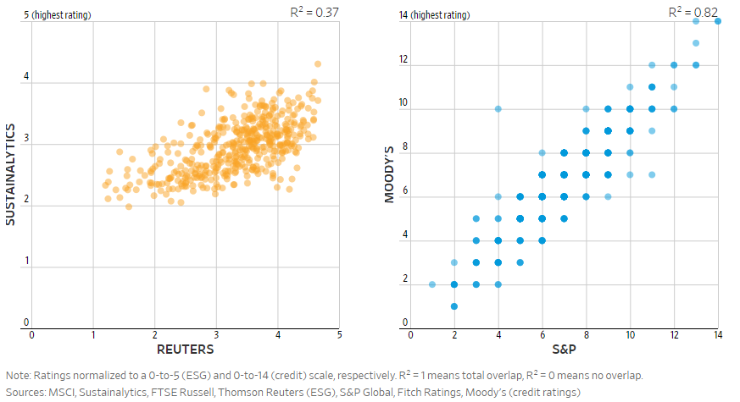
Can we “just” rely on ESG ratings?
Investor spending on ESG ratings increased from $200M to $500M from 2014 to 2018
  Most funds probably mainly rely on ESG ratings
Sustainability also is hard to quantify. A Journal analysis of four leading ESG ratings providers found that they come to completely different conclusions about what makes a company a “sustainable” investment.
ESG ratings
Credit ratings
General Motors Co., for example, is given an ESG score of about average by Sustainalytics, but rated at the very bottom by MSCI, which puts more weight on GM’s focus on building low-fuel efficiency vehicles…..
That is in sharp contrast to credit ratings, which measure the riskiness of a company’s debt. The three major credit rating companies—S&P, Moody’s and Fitch—tend to give similar ratings to companies in the S&P 500. S&P and Fitch both give GM’s debt the same BBB rating.
“Everyone has their own definition of ESG, so what we’ve done is come up with our own definition of ESG for our products,” Mr. Rieger, Deutsche Bank asset management
Takeaway: We need reporting and accountability
(i.e., accountants)
  Similar to financial information
The Wall Street Journal “Why It’s So Hard to Be an ‘Ethical’ Investor” September 1, 2018

Slide 44
Securities and Exchange Commission is cracking down on “ bad voluntary” disclosures…
SEC created its Climate and ESG Task Force
  Democrats and investor advocates pushed to put ESG at the top of the agency’s agenda
Allegations of misleading claims
  E.g., Bank of New York Mellon Corp., health insurance distributor Benefytt Technologies Inc., and Brazilian mining company Vale S.A
    E.g., BNY Mellon fined $1.5 M for misstating in prospectuses that its mutual funds received ESG quality reviews when that wasn’t always the case
  The SEC is investigating claims that some of Goldman Sachs’ funds didn’t align with ESG metrics touted in marketing material
  SEC is looking to see how ESG fund investment in practice lines up with companies’ promises to shareholders.
    Basic principle: When you speak, speak truthfully

Slide 45
Conclusions: Current CSR Reporting
No broad CSR/ESG reporting mandate
  Some targeted disclosure regulation (e.g., mine safety and conflict minerals)
  Several initiative on its way (e.g., climate change and diversity)
Most reporting is voluntary
  Almost all S&P 500 firms discloses CSR reports
  Information varies widely but some voluntarily apply reporting standards (e.g., SASB)
  It is unclear how high the quality of voluntary CSR reporting is
ESG/CSR ratings are only a partial solution
  They too largely rely on firms’ voluntary disclosures
  Unlike credit ratings, ESG/CSR ratings vary widely depending on agency providing the ratings
Highly likely that there will be more regulation of ESG/CSR reporting going forward

