Slide 1



SUSTAINABLE ENTERPRISES
Sustainability: A Call to Action
Andrew J. Hoffman
Holcim (US) Professor of Sustainable Enterprise
Ross School of Business
School for Environment & Sustainability
University of Michigan
November 19, 2021
@HoffmanAndy

Slide 2
What do we mean when we say “sustainability”?
@HoffmanAndy

Slide 3

What do we mean when we say “sustainability”?
1987
@HoffmanAndy

Slide 4
What do we mean when we say “sustainability”?
1987
CHANGING:
Scientific Knowledge and Nature of Environmental and Social Issues
Political Environment
Public Awareness
Technological Development
Corporate Posture and Approach
@HoffmanAndy

Slide 5
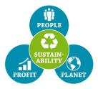
What do we mean when we say “sustainability”?
1987 1997
CHANGING:
Scientific Knowledge and Nature of Environmental and Social Issues
Political Environment
Public Awareness
Technological Development
Corporate Posture and Approach
@HoffmanAndy

Slide 6




What do we mean when we say “sustainability”?
1987 1997 1997 2000 2008 2011
CHANGING:
Scientific Knowledge and Nature of Environmental and Social Issues
Political Environment
Public Awareness
Technological Development
Corporate Posture and Approach
@HoffmanAndy

Slide 7

What do we mean when we say “sustainability”?
1987 1997 1997 2000 2008 2011 2015
CHANGING:
Scientific Knowledge and Nature of Environmental and Social Issues
Political Environment
Public Awareness
Technological Development
Corporate Posture and Approach
@HoffmanAndy

Slide 8
What do we mean when we say “sustainability”?
1987 2018 1997 2000 2008 2011 2015
CHANGING:
Scientific Knowledge and Nature of Environmental and Social Issues
Political Environment
Public Awareness
Technological Development
Corporate Posture and Approach
@HoffmanAndy

Slide 9
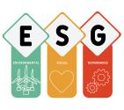
What do we mean when we say “sustainability”?
1987 1997 1997 2000 2008 2011 2015 2018
CHANGING:
Scientific Knowledge and Nature of Environmental and Social Issues
Political Environment
Public Awareness
Technological Development
Corporate Posture and Approach
@HoffmanAndy

Slide 10
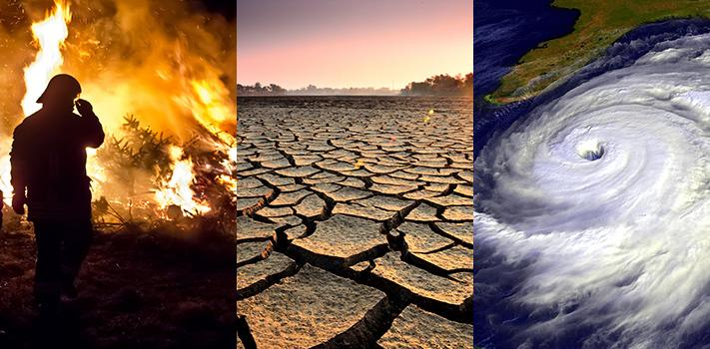
At the root of all these - The market as solution.
@HoffmanAndy

Slide 11
^{SUSTAINABLE} ^{ENTERPRISE – 2 VIEWS}
¹
²
^{ENTERPRISE INTEGRATION}
^{MARKET TRANSFORMATION}
Sustainability as a Market Shift
Level of Analysis: Corporation/ Product/ Service
Model: Translate into pre-existing business considerations.
Objective: Reduce unsustainability
Corporate Posture: Reactive
Will help you get a job in today’s markets.
Foundational for business sustainability.
Sustainability as Systems Change
Level of Analysis: System
Model: Transform markets by reexamining taken-for-granted assumptions.
Objective: Create sustainability
Corporate Posture: Proactive
Will help you set a vision for tomorrow’s markets.
Additive to Enterprise Integration
Source: Hoffman, A. (2018) “The next phase of business sustainability,” Stanford Social Innovation Review, Spring: 34-39; Hoffman, A. and J. Ehrenfeld (2015) “The fourth wave: Business management and business education in the age of the Anthropocene.” In E. Lawler, S. Mohrman and J. O’Toole (eds) Corporate Stewardship: Organizing for Sustainable Effectiveness, (Sheffield, UK: Greenleaf Publishing): 228-246;
@HoffmanAndy

Slide 12

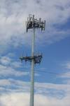




1. Sustainability
as a Market Shift
Market
Shift
@HoffmanAndy

Slide 13
1. Sustainability
as a Market Shift
Coercive
Drivers
Domestic Regulation
The Community
International
Regulation
Who is Driving it externally?
What Department will handle it internally?
What Frame best explains the Business Imperative?
Social
Drivers
Academia
The Courts
Sustainability
Strategy
Religion
Suppliers
& Buyers
The Press
Banks
Environmental
NGOs
Shareholders
& Investors
Resource
Drivers
Consultants
Insurance
Companies
Competitors
Consumers
Trade Associations
Market
Drivers
@HoffmanAndy

Slide 14
1. Sustainability
as a Market Shift
Government Affairs
Marketing
Accounting
Who is Driving it externally?
What Department will handle it internally?
What Frame best explains the Business Imperative?
Human Resources
Sustainability
Strategy
Strategic Planning
Legal Counsel
Environmental
Health & Safety
Community
Relations
Finance
Research &
Development
Operations
Engineering
@HoffmanAndy

Slide 15
1. Sustainability
as a Market Shift
Regulatory Compliance
Strategic Direction
New Product Development
Who is Driving it externally?
What Department will handle it internally?
What Frame best explains the Business Imperative?
Sustainability
Strategy
Corporate Reputation
Supply Chain Logistics
Disaster Preparedness/
Resilience
Internal Culture/
Employee Retention
Resource Availability
Consumer Demand
Operational Efficiency
Cost of Capital
Insurance Risk Management
@HoffmanAndy

Slide 16
1. Sustainability
as a Market Shift
P&G
Regulatory Compliance
Strategic Direction
New Product Development
Who is Driving it externally?
What Department will handle it internally?
What Frame best explains the Business Imperative?
Sustainability
Strategy
Corporate Reputation
Supply Chain Logistics
Disaster Preparedness/
Resilience
Internal Culture/
Employee Retention
Resource Availability
Consumer Demand
Operational Efficiency
Cost of Capital
Insurance Risk Management
@HoffmanAndy

Slide 17
1. Sustainability
as a Market Shift
Walmart
Regulatory Compliance
Strategic Direction
New Product Development
Who is Driving it externally?
What Department will handle it internally?
What Frame best explains the Business Imperative?
Sustainability
Strategy
Corporate Reputation
Supply Chain Logistics
Disaster Preparedness/
Resilience
Internal Culture/
Employee Retention
Resource Availability
Consumer Demand
Operational Efficiency
Cost of Capital
Insurance Risk Management
@HoffmanAndy

Slide 18
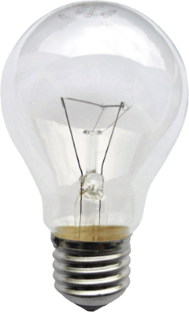












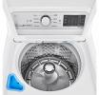
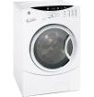
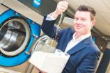
1. Sustainability
as a Market Shift
Market
Shift
@HoffmanAndy

Slide 19


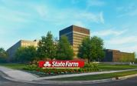
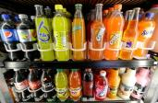
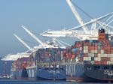
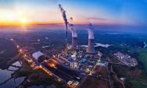


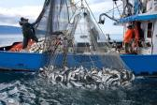
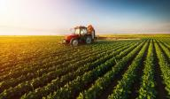
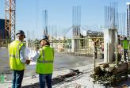
1. Sustainability
as a Market Shift
1. Adaptation
2. Mitigation
3. Opportunity
Tourism
Finance
Insurance
Beverages
Shipping
Energy
Water
Livestock
Fisheries
Agriculture/Forestry
Construction
@HoffmanAndy

Slide 20
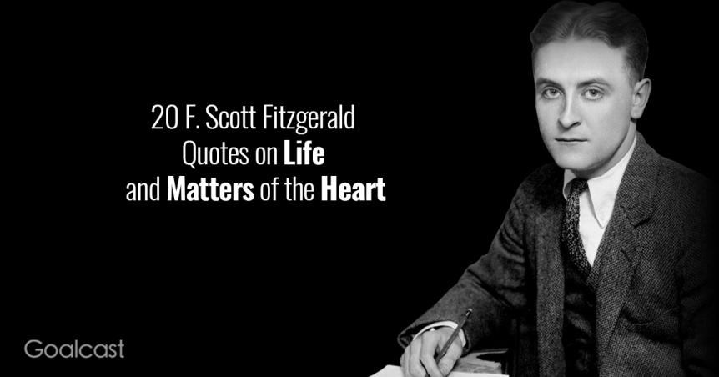
But…
“The test of a first-rate intelligence is the ability to hold two opposed ideas in the mind at the same time, and still retain the ability to function.”
F. Scott Fitzgerald
@HoffmanAndy

Slide 21

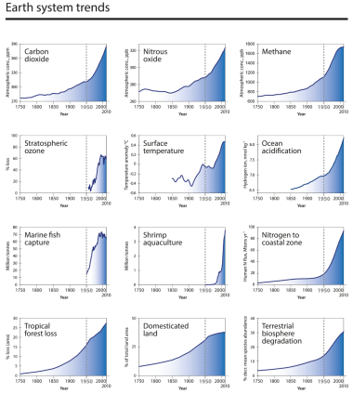
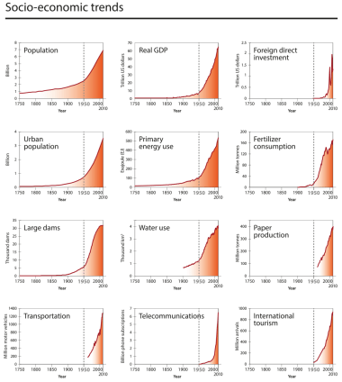
Subcommission on Quarternary Stratigraphy
Working Group on the Anthropocene
But…
@HoffmanAndy

Slide 22
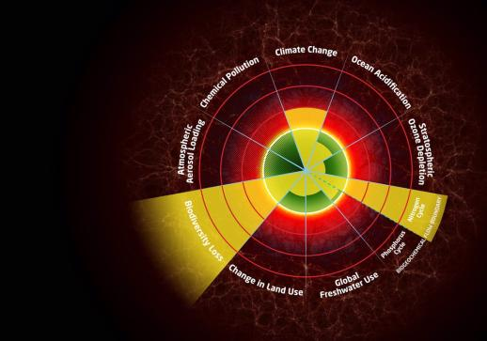
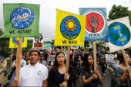
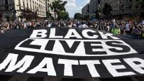
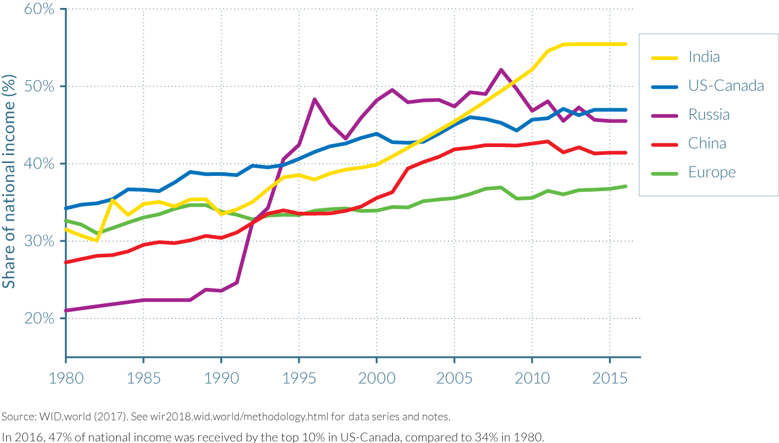
But…
Planetary Boundaries
Social Equity
@HoffmanAndy

Slide 23
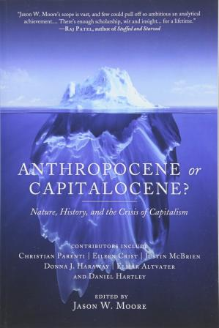
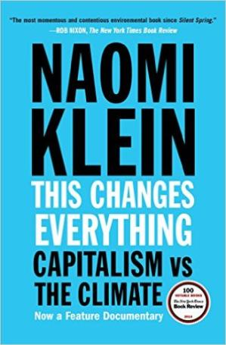
But…
@HoffmanAndy

Slide 24
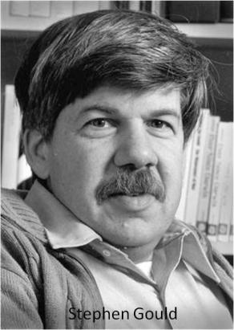
“We have become, by the power of a glorious evolutionary accident called intelligence, the stewards of life's continuity on earth. We did not ask for this role, but we cannot abjure it. We may not be suited to it, but here we are.”
Stephen Jay Gould
@HoffmanAndy

Slide 25
2. Sustainability as Systems Change
Reexamining Capitalism
Capitalism need to be “saved from itself.” – Joseph Stiglitz, Nobel Laureate
Capitalism is “a damaged ideology” that “needs to be reinvented for the 21st century.” –
Paul Polman, Former CEO of Unliever
This moment in the market’s history is a “strategic inflection point.” - Andy Grove, Intel cofounder
“Capitalism, as we know it…with its obsession on maximizing profits for shareholders…is dead.” –
Marc Benioff, CEO of Salesforce
Today’s capitalism is “broken.” If we don’t fix it, we could face increased populism, conflict and “revolution of one sort or another.” - Ray Dalio, founder of Bridgewater Associates, the world’s biggest hedge fund.
Climate change and income inequality “threaten our democratic values, discourse, and institutions.” –
Darren Walker, President of the Ford Foundation
@HoffmanAndy

Slide 26
2. Sustainability as Systems Change
Where do the Systemic Solutions to Sustainability Lie?
Reducing
Unsustainability
Creating
Sustainability
@HoffmanAndy

Slide 27


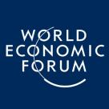
2. Sustainability as Systems Change
What is the Purpose of the Firm?
Sent a letter to CEOs telling them that they have a responsibility to make “a positive contribution to society.”
Redefined “the purpose of a corporation” as investing in employees, protecting the environment and dealing fairly with suppliers to assure “the future success of our companies, our communities and our country.”
Redefined “the universal purpose of a company” as one that “serves society at large…supports communities…pays its fair share of taxes…acts as a steward of the environmental and material universe for future generations.”
@HoffmanAndy

Slide 28
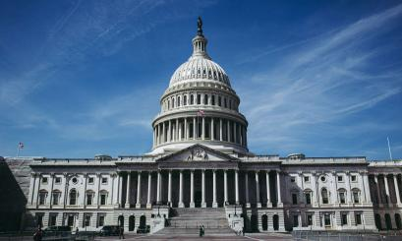

2. Sustainability as Systems Change
What is the Role of Government in the Market…
and the Role of Business in Policy-Making?
@HoffmanAndy

Slide 29


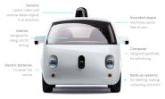
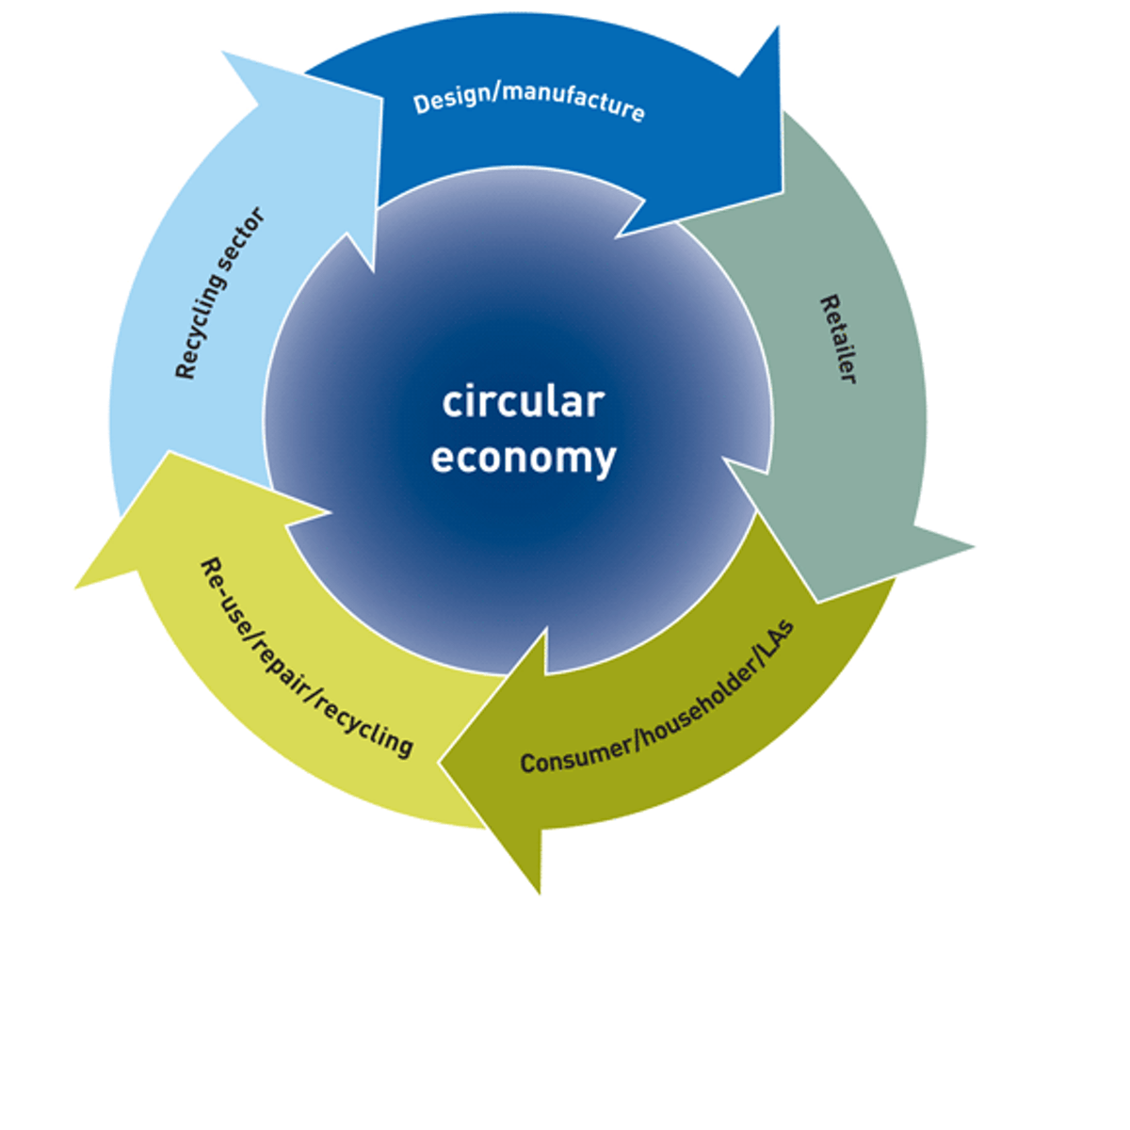
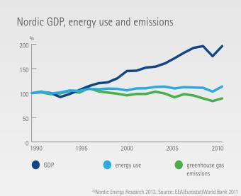

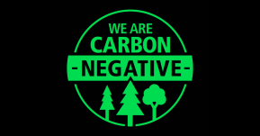
2. Sustainability as Systems Change
Reconsider Material Use
@HoffmanAndy

Slide 30
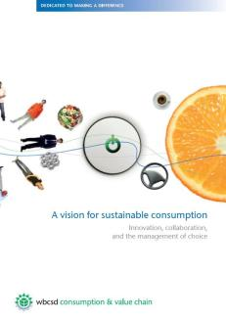
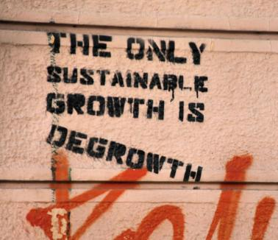
2. Sustainability as Systems Change
Reconsider Consumption and Growth
@HoffmanAndy

Slide 31
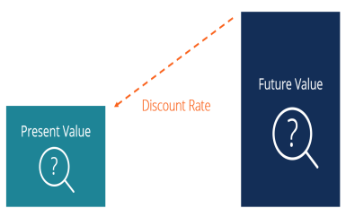
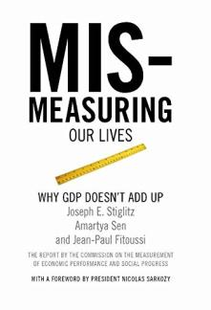
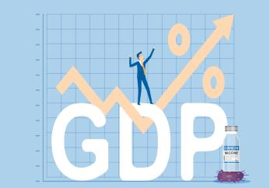
2. Sustainability as Systems Change
Reconsider Metrics
@HoffmanAndy

Slide 32
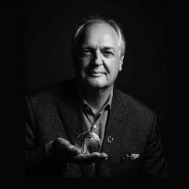

2. Sustainability as Systems Change
New Models of Business Competition & Collaboration
@HoffmanAndy

Slide 33



















Systems Change Is Underway and Will Continue
November 2021
Market
Capitalization
$1.07 Trillion
$86 Billion
$77 Billion
$80 Billion IPO
11/11/21
November 2021
Market
Capitalization
$167 Billion
$83 Billion
$74 Billion
$271 Billion
$173 Billion
$91 Billion
@HoffmanAndy

Slide 34
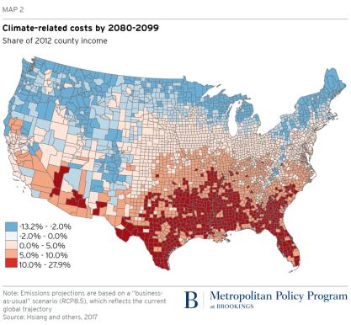
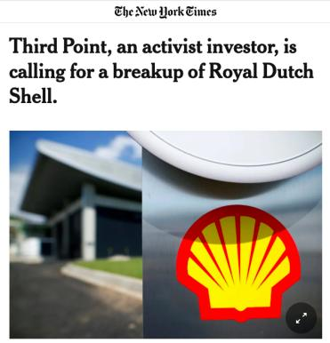
Systems Change Is Underway and Will Continue.
@HoffmanAndy

Slide 35
A closing thought
@HoffmanAndy

Slide 36

Christina Johanna Schneider (1899-1995)
Joseph Leo Hoffman (1898-1967)
Married on September 29, 1921
@HoffmanAndy

Slide 37
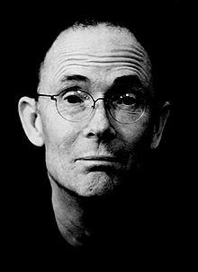
“The future is already here;
it’s just not very evenly distributed.”
William Gibson
@HoffmanAndy

Slide 38
Thank you
Andrew J. Hoffman
Holcim (US) Professor of Sustainable Enterprise
University of Michigan email: ajhoff@umich.edu web: www.andrewhoffman.net
@HoffmanAndy

