Slide 1
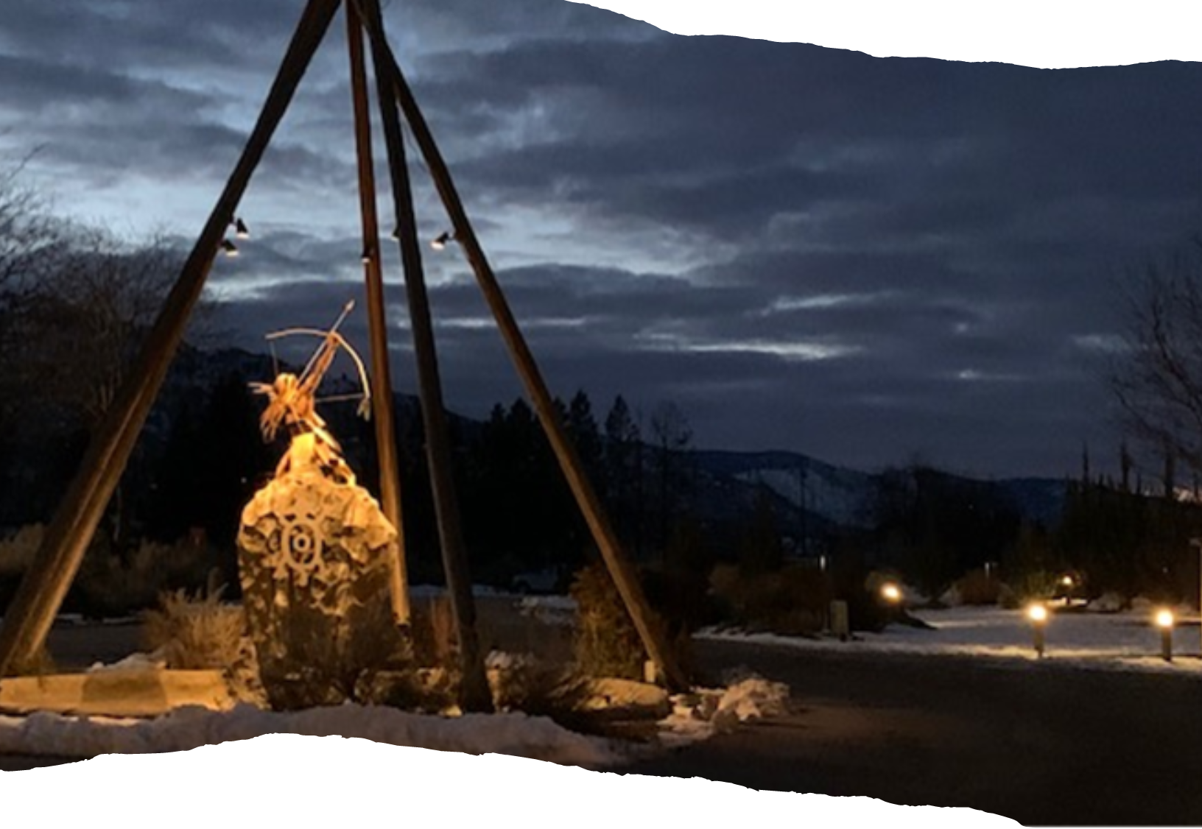
Indigenous Perspectives on Sustainability
Sustainability: A Call to Action
2021 MMPA Conference
University of Toronto
November 19, 2021
Terry Goodtrack MPA, B.Admin, FCPA, CAPA, C.Dir, CAPA, CAFM
President and Chief Executive Officer
AFOA Canada

Slide 2
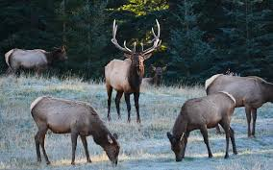

Slide 4
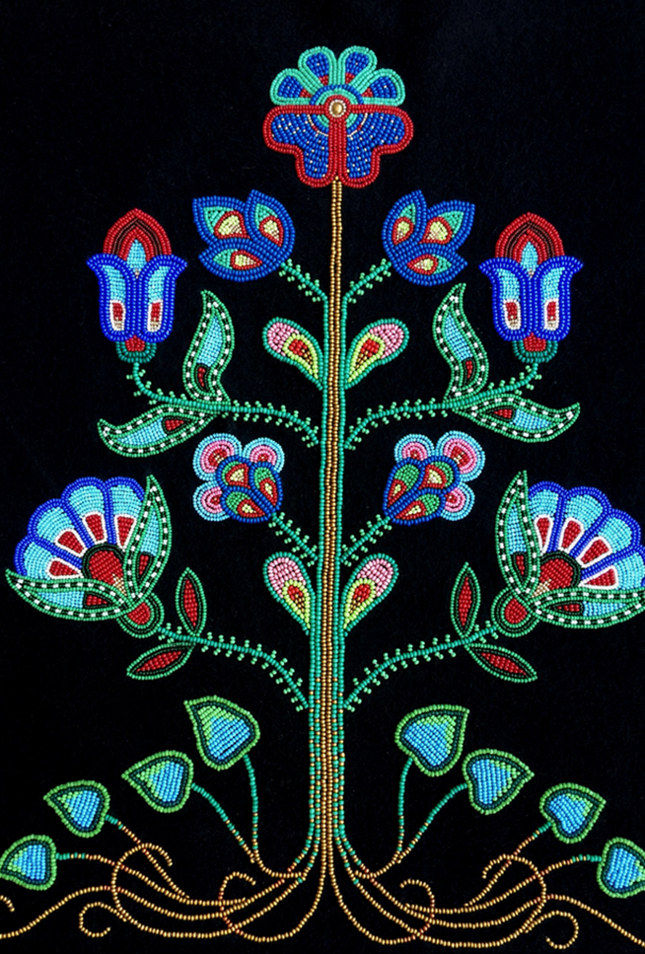
Take only what you need and give back
Stewardship Role
Interconnectedness
Seven Generations

Slide 5
Seven Generations

Slide 6
Sustainability Views
 | Dominant View of Sustainability | Indigenous View of Sustainability
Basic definition of sustainability | Enduring well-being of human societies and communities | Overall enduring well-being
Root assumptions | Dualistic worldview, as reflected in nature’s objectification and the human nature divide (emphasis on separation) | Interconnection and interdependence of all elements of the universe (emphasis on unity and relationality)
Human relationship with nature | Utilitarian attitude toward nature, essentially oriented toward a “regulated” exploitation | Sense of respect, giving and reciprocity, as expressed in the idea of caretaking or guardianship
Key notions and metaphors | Development Resources, Commodities, Ecosystem services, Natures benefits to people | Living well, Gifts, Relatives, Mother Earth
Mazzochi, Fulvio, 2020 “A Deeper meaning of sustainability: Insights from Indigenous Knowledge” The Anthropocense Review Vol 7

Slide 8
Hinerangi Raumati-Tuua September 2017
“Don’t cause harm to our reputation or to others in the process including the environment”

Slide 9
