Slide 1
International Sustainability Standards Board

Slide 2
About the IFRS Foundation
Our organisation
Not-for-profit, public interest organisation
Three-tier governance model
Monitoring Board (oversight)
Trustees (governance & strategy)
IASB + ISSB (standards)
Extensive, inclusive due process
Our mission
Develop IFRS Standards that bring transparency, accountability and efficiency to financial markets around the world
IFRS Accounting Standards
Required for use by more than 140 jurisdictions around the world

Slide 3
Current sustainability reporting landscape
International initiatives
Voluntary application
Multiple standards
Multiple audiences
Jurisdictional initiatives
Different jurisdictions, different requirements
Differences in scope, ambition and pace

Slide 4
Consequences
‘Alphabet soup’ of requirements
Cost & complexity in reporting
Selective & inconsistent application of voluntary standards
‘Greenwashing’ risk
Different requirements by different jurisdictions
Lack of global comparability & consistency
Lack of capital market rigour (mandated standards, audited information, digital reporting)
Lack of confidence and trust in information
Impediment to financial market participation in drive towards Net Zero

Slide 5
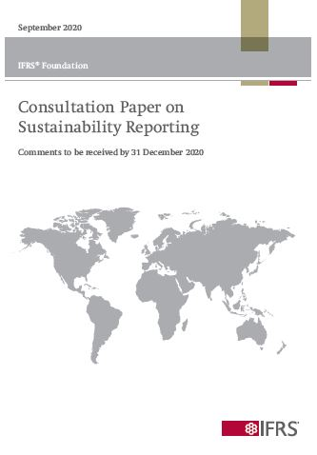
Demand-driven process
What we asked
Demand for global sustainability standards?
Should the IFRS Foundation play a role?
Is the solution a sustainability-focused standard-setting board within the IFRS Foundation?
What we heard
Growing and urgent demand for global standards to improve consistency and comparability
Broad support for Foundation to play a role
ESG focus but climate first

Slide 6
COP26 announcement
1. Formation of the International Sustainability Standards Board (ISSB)
2. Consolidation with Climate Disclosure Standards Board (CDSB) & Value Reporting Foundation (VRF)
3. Publication of climate and general disclosure prototype requirements
Creates the necessary institutional arrangements and technical groundwork for a global sustainability standard-setter for the financial markets

Slide 7
1. International Sustainability Standards Board (ISSB)
Develop global baseline of sustainability disclosure standards
Focus on meeting the information needs of investors
Will enable companies to provide comprehensive sustainability information for the global capital markets
Facilitate compatibility with requirements that are jurisdiction-specific or aimed at a broader group of stakeholders

Slide 8
2. Consolidation with VRF & CDSB
Becomes part of the IFRS Foundation
Additional members of Technical Readiness Working Group
International Accounting Standards Board

Slide 9
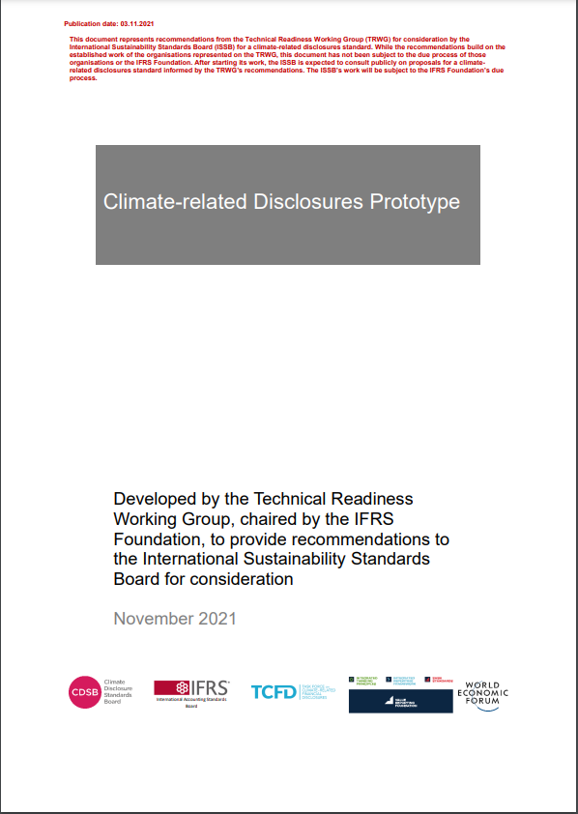
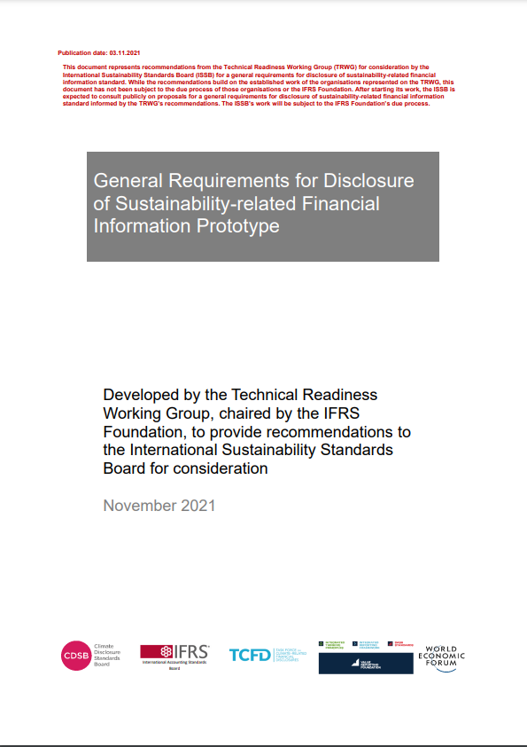
3. Publication of prototype requirements
Climate-related
Disclosures
General Requirements
for Disclosure of
Sustainability-related
Information
Recommendations – Technical Readiness Working Group to ISSB
ISSB to consider as part of initial work programme

Slide 10
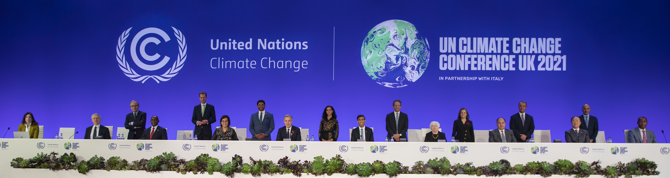
COP26 Statement
“
Finance Ministers and Central Bank Governors from 40+ jurisdictions* from 6 continents joined the UK in publicly welcoming the announcement of the establishment of the ISSB and its work programme to develop a set of internationally consistent, high-quality, and reliable baseline standards for disclosure of sustainability-related information on enterprise value creation.
* Australia, Brazil, Canada, Chile, China, Costa Rica, Egypt, Ethiopia, European Commission, Fiji, France, Germany, Greece, Guatemala, India, Indonesia, Italy, Jamaica, Japan, Kenya, South Korea, Luxembourg, Maldives, Mexico, Morocco, Netherlands, New Zealand, Nigeria, Paraguay, Philippines, Russia, Saudi Arabia, Seychelles, Singapore, Spain, Switzerland, Tonga, Turkey, UK, Uruguay, USA

Slide 11
Global baseline approach
Sustainability reporting (broader multi-stakeholder focus)
Reporting on all sustainability matters that reflect significant positive or negative impacts on people, the environment and the economy
Sustainability-related financial disclosures (investor focus)
Reporting on those sustainability-related matters that may reasonably create or erode enterprise value over the short, medium and long term
Financial reporting (investor focus)
Reflected in monetary amounts in the financial statements

Slide 12
ISSB within IFRS Foundation Governance structure
Public accountability
IFRS Foundation Monitoring Board
IFRS Advisory Council
(provides advice to Trustees, IASB & ISSB)
Governance, strategy & oversight
IFRS Foundation Trustees
International Accounting Standards Board (IASB)
International Sustainability Standards Board (ISSB)
Independent standard-setting
& related activity
IFRS Accounting Standards
IFRS Sustainability Disclosure Standards
IFRS Interpretations Committee

Slide 13
Compatible standards to meet investors’ needs
International Accounting Standards Board
(IASB)
IFRS Accounting Standards
Investors
and other capital market participants
Financial statements
International Sustainability Standards Board
(ISSB)
IFRS Sustainability Disclosure Standards
Sustainability disclosures

Slide 14
ISSB composition
14 board members
Majority full-time
Diversity in expertise and experience
Geographical balance

Slide 15
ISSB locations
Global footprint through multi-location presence
Coverage across the Americas, Asia-Oceania and EMEA (Europe, the Middle-East & Africa)
Frankfurt & Montreal to host key functions, cooperation with regional stakeholders
Frankfurt to serve as seat of the board and office of the Chair
San Francisco & London to provide technical support and platforms for market engagement
Further discussions with Beijing and Tokyo to finalise Asia-Oceania footprint
Engagement with developing and emerging economies a priority

Slide 16
Informed by expert advice
Sustainability Consultative Committee
Technical expert advice to the ISSB
Multilateral institutions & other technical experts
Sustainability Standards Advisory Forum (TBC)
Formal mechanism for jurisdictional engagement
Membership TBC, representing all regions, both developed, developing and emerging economies
IFRS Advisory Council
Mandate extended to include strategic advice to ISSB (in addition to Trustees & IASB)
Approx. 50 members representing cross-section of key stakeholder organisations

Slide 17
Steps to achieving global capital market standards
Comprehensive global baseline of standards
Require by adopting or incorporating standards
Assess standards with a view to recommend adoption
Develop assurance standards
ISSB
IOSCO
Audit standard-setters
Jurisdictions

Slide 18
Next steps
Appointments
Chair, Vice-Chair(s), remaining ISSB members
Consultations
Proposed climate and general disclosure standards, work plan and future priorities (due process)
Advisory groups
Appoint members to technical and jurisdictional groups
Consolidation
Complete consolidation with CDSB and VRF
Location
Implement multi-location approach for global footprint

Slide 19
Call to action
Continue applying existing frameworks
Get familiar with the prototypes – early indication of direction of travel
Be ready to share your views – public consultation early 2022
Sign up for alerts – ifrs.org/sustainability

Slide 20
Find us online

