Slide 1
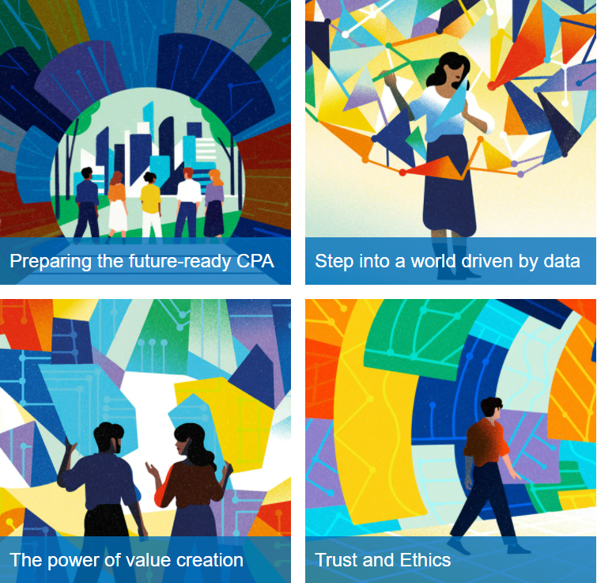
Transforming to meet the needs of the future
The CPA “Way Forward” Competency Map (CM2.0) – based on the initial draft issued for comment on July 5, 2021
Irene M Wiecek (Competency Map Task Force Member)
MMPA 2021 Conference
Sustainability: A Call to Action

Slide 2
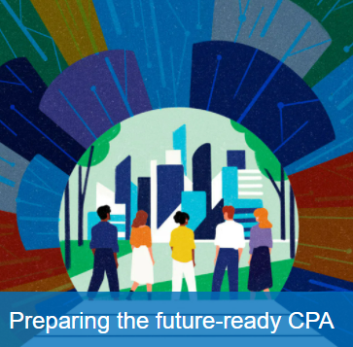
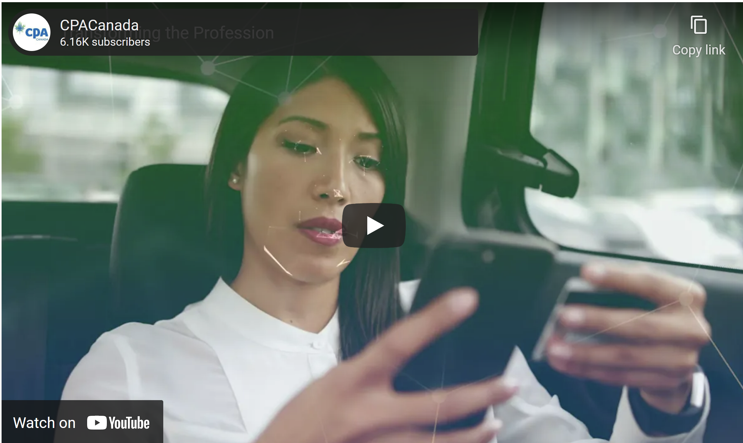
Agenda
Emerging themes
How CM2.0 prepares future-ready CPAs
CM2.0 and sustainability
https://www.cpacanada.ca/en/become-a-cpa/why-become-a-cpa/the-cpa-certification-program/competency-map-task-force

Slide 3
Emerging themes from CM2.0 research and consultation
Emerging and growing areas of opportunity – including data analytics, sustainability, value creation and innovation
The influence of automation
The burgeoning body of knowledge
Interconnectedness – we are all part of broader hyperconnected systems
CPAs as leaders – bring traditional mindset to emerging and growing areas

Slide 4
CM2.0 Feedback Survey – responses to survey questions
 | Survey questions
8. | Throughout the process, we have discussed the importance of visibility in CM2.0 as it speaks to what we, as a profession, think is important. The following areas are sufficiently visible in CM2.0, in the CM2.0 Decision Process Cycle and related Competencies (including the Integrated Common Core that is made up of two intertwined parts—the CPA Ethical Mindset and the Foundation Common Core).
 | Equity, diversity and inclusion
 | Indigenous views
 | Systems thinking and complexity theory
 | Emerging and transformative technologies and tools
 | Sustainability, including environment, social and governance (e.g., long term stakeholder perspective)
 | Organizational behaviour including human behaviour/bias
 | Value creation
 | Big data and analytics
 | Innovative thinking
 | Traditional accounting (i.e. what CPAs have traditionally focused on)
 | Evergreen learning (i.e., having curiosity, a thirst for knowledge and a commitment to continually acquire knowledge and skills)

Slide 5
CM2.0: preparing future-ready CPAs by……
Creating future-focused pre-certification CPAs
Laying the foundations for evergreen learning
Focusing on a foundational common core
Embedding an ethical mindset
Embracing the higher calling of the profession
Fostering human skills and values
1
2
3
4
5
6
Notes:
Fostering human skills and values that are more resilient to automation (including curiosity and creativity).
Creating future-focused pre-certification CPAs who understand complex and interconnected systems and are tech savvy in order to take advantage of technological and other innovations.
Laying the foundations for evergreen learning and future specialization in existing and emerging areas.
Focussing on a foundational common core for all pre-certification CPAs which will facilitate collaboration with other experts (e.g., in the areas of science and data science).
Embedding an ethical mindset with an emphasis on integrity and ethical decision making.
Embracing the higher calling of the profession (to act in and protect the public interest) in an increasingly complex, diverse and global environment.

Slide 6
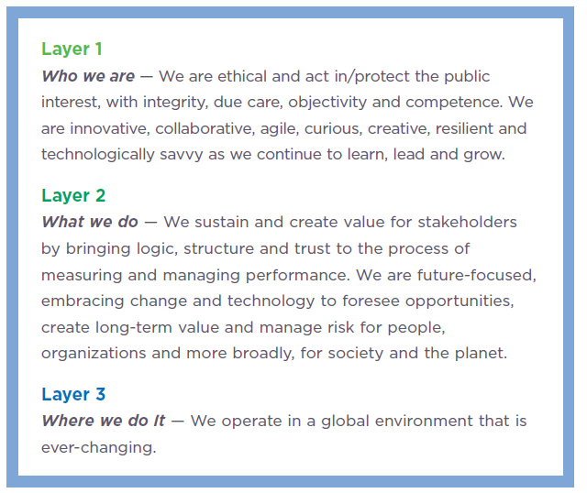
CM2.0 CPA Ethical Mindset

Slide 7
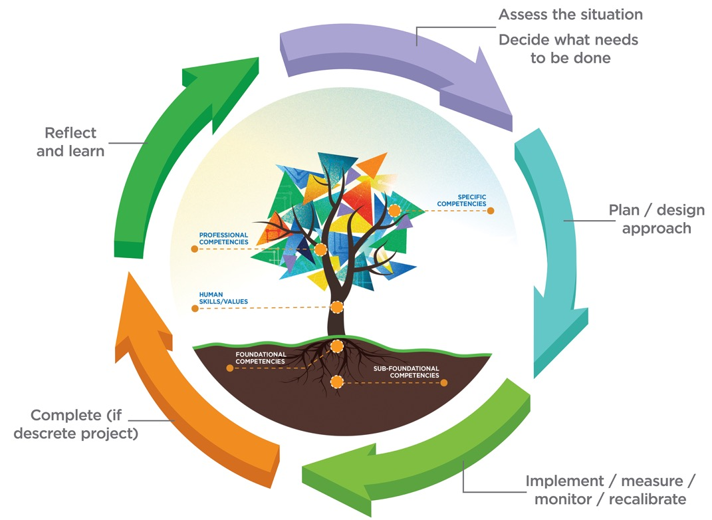
Integrated Common Core
CM2.0 Decision Process – 35 competencies in total
At the centre – Integrated Common Core – the tree (CPA Ethical Mindset fully integrated with Foundational Common Core)
Around the edges – 5 steps (building on and applying the Integrated Common Core)
Complete (if discrete project)
Andrea Sewell <ASewell@cpacanada.ca>
Andre Sewell <ASewell@cpacanada.ca>

Slide 8
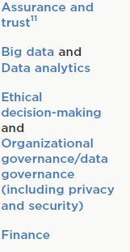
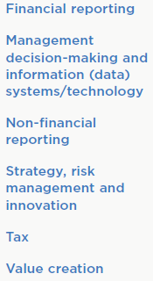
CM2.0 Foundational Common Core: Specific Competencies (Topic Areas)
Look at each of these through a sustainability lens – opportunities for CPAs

Slide 9
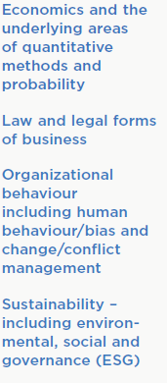
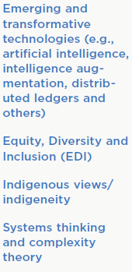
CM2.0 Foundational Common Core:
Sub-foundational and Foundational
(Topic Areas)
Sustainability is foundational

Slide 10
Thank you!
What is the call to action for universities?
Visit CPA Competency Map Task Force webpage

