Slide 1
Measuring Sustainability
Andrew King
Questrom Professor of Management
Boston University

Slide 2






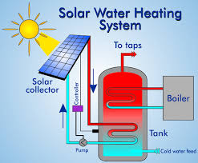





A bit about me: sustainability practice and research
2020s
2010s
2000s
1990s
1980s

Slide 3
Nutshell of my talk
We need to be careful
  Promise of transparency has long been used to forestall regulation.
We should understand our limitations
  Corporate sustainability is extremely difficult to calculate.
Let’s focus our efforts
  Measure eco-efficiency and political activity.
  Push for a carbon tax and other regulation

Slide 4
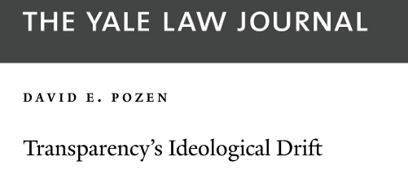
We need to be careful:
Promise of transparency long used to forestall regulation.
1970s – UN Conference on the Human Environment in Stockholm.
  Climate change, ocean health, ozone, nitrogen disruption are all on agenda.
  Business leaders: transparency + voluntary action instead of regulation
1980s – Bhopal accident, Love Canal, Valdez accident, Ozone Hole.
  Business leaders: transparency + voluntary action to forestall regulation.
    Responsible Care™ proves ineffective and allows green-washing
1990s – Measurement begins, deep green investors formed.
  Shopping for a better world, KLD, Innovest, Domini 400
  Pundits: transparency + voluntary action.
  20xxs – Sustainable accounting standards, light green funds formed
  SASB materiality, Blackrock funds, Impact accounting.
  Many: transparency + voluntary action.
Notes:
Transparency’s rightward drift. Pozen

Slide 5
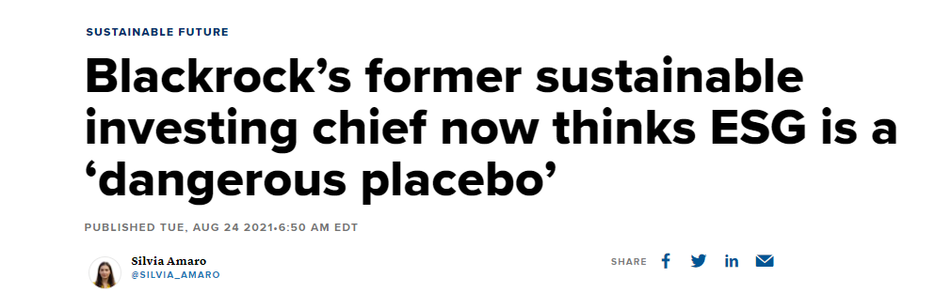
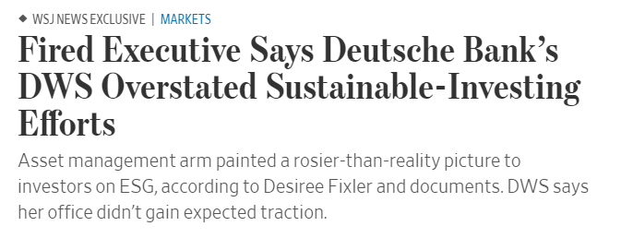

And it continues today.
“We’re going to see a vast change in the public company arena worldwide,” [Larry Fink] said at a Brookings Institution event Tuesday. “They are going to move forward. We’re not going to need really governmental change or regulatory change.” –Jan 2021

Slide 6
Nutshell of my talk
We need to be careful
  Promise of transparency has long been used to forestall regulation.
We should understand our limitations
  Corporate sustainability is extremely difficult to calculate.
Let’s focus our efforts
  Measure eco-efficiency and political activity.
  Push for a carbon tax and other regulation

Slide 7
Why is it so difficult?
Sustainability is a system-level construct, so “corporate sustainability” is the effect of the corporation on the entire system.
Requires massive information about the corporation, the economy, and all effects on resources. Requires calculating the response of entire system.
Notes:
No boundary

Slide 8

Consider an analogy: the effect of an animal on the sustainability of an ecosystem.
In North America, the red fox helps to control the populations of small rodents and makes the ecosystem more stable and sustainable.
In Australia, the fox destroys the native marsupials and makes the ecosystem less stable and sustainable.
Same fox, different implications. The sustainability of the fox depends on the ecosystem.
“Fox sustainability” requires measuring its effect on the ecosystem.

Slide 9

Another example: honeybees
In some parts of North America, Honeybees provide valuable pollination services to farms and honey.
In other parts of North America, Honeybees compete with Bumblebees and transmit diseases.
Same bee, different implications. The sustainability of the bee depends on the ecosystem.
“Bee sustainability” requires measuring its effect on the ecosystem.

Slide 10
Consider a gas-electricity plant.
In New England, gas is needed to provide dispatchable power when renewables are unavailable. It makes the grid more stable and sustainable.
In Iceland, gas would simply replace the dispatchable power from hydro and geothermal. It would make the grid less sustainable.
Same gas-plant, different implication.
“Corporate sustainability” requires measuring its effect on the system.

Slide 11
So, lets start at the system level
Sustainability is the maximization of human welfare subject to equity constraints.
  “Sustainable development is development that meets the needs of the present without compromising the ability of future generations to meet their own needs.”
  A well-regulated economy should be weakly sustainable.
  Government taxes and permits should correct factor prices and allow all actors to make welfare enhancing choices.
Notes:
In practice, the term has become “motherhood-and-apple-pie…often meaning nothing more than ‘environmentally desirable’”
- Pezzey & Toman Resources for the Future

Slide 12
Measuring corporate sustainability
With respect to human welfare, is the firm doing too little or too much of some activity?
  lithium mining, renewable power, water use, and so on.
What is the marginal effect of the firm’s activities on welfare?
  How much would welfare change if the firm adjusted its activities?

Slide 13
Current measures fail to capture corporate sustainability
Measure average effects, not marginal ones.
Use dangerous simplifications.
Ignore local conditions
Ignore tradeoffs among impacts.
Emphasize direct effects

Slide 14
Problems with measuring average rather than marginal: solar in ISO NE
Model of ISO New England
At optimal prices for externalities such as carbon
Consider a solar supplier to the network.
Notes:
Model of ISO New England
At optimal prices for externalities such as carbon
Consider a solar supplier to the network.

Slide 15
Example: adding solar to ISO NE
optimal prices for externalities such as carbon

Slide 16
Considering alternatives

Slide 17
Optimizing Welfare
optimal
Based on average analysis

Slide 18
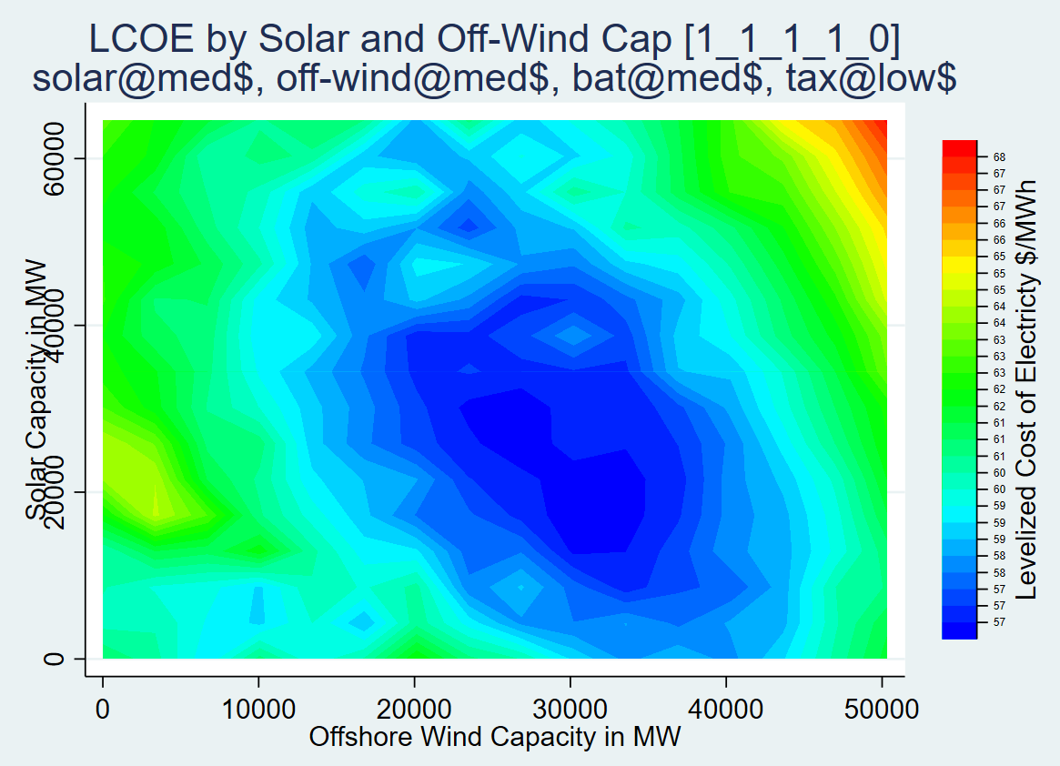
Finding right mix requires careful marginal analysis
Reduce solar
Add wind
Reduce wind
Add
solar

Slide 19
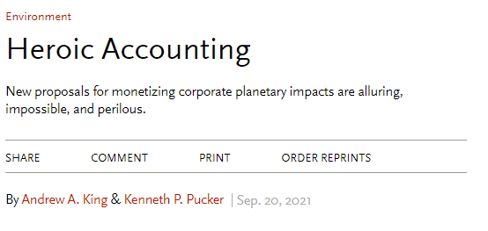

Current proposals won’t work.
Measure average effects, not marginal ones.
Use dangerous simplifications.
Ignore local conditions
Ignore tradeoffs among impacts.
Emphasize direct effects

Slide 20
Nutshell of my talk
We need to be careful
  Promise of transparency has long been used to forestall regulation.
We should understand our limitations
  Corporate sustainability is extremely difficult to calculate.
Let’s focus our efforts
  Measure eco-efficiency and political activity.
  Push for a carbon tax and other regulation

Slide 21
A proposal: measure efficiency and support for system change
  Eco-efficiency - Given current factor prices, is the firm wasting resources?
  Regulatory Support – To what extent does the firm support rule making to correct sub-optimal factor prices?

Slide 22
Eco-efficiency Measurement Example
  Since 1987, US has required reporting of detailed information on 612 toxic chemicals.
  Every facility in the US with 9 or more employees ~20% of the economy.
  Use, storage, release, disposal, recycling, energy recovery, accidents, etc.
  Multiple measures or relative toxicity available.
  Linked to other data on production
  Used by KLD & Innovest/MSCI

Slide 23
Eco-efficiency
line of constant
quantity
Facilities are efficient given local factor prices.
Facilities are inefficient and can improve.
P_{e} << P_{c}
Eco-(in)efficiency
Environment
P_{e} >> P_{c}
Capital

Slide 24
Self-regulation
line of constant
quantity
P_{e} << P_{c}
Facilities are efficient given local factor prices.
Self-regulation: Because cost of additional capital>> savings: Profits decline.
Environment
P_{e} >> P_{c}
Capital
Additional
capital

Slide 25
Rule-making to fix factor prices
line of constant
quantity
Regulation adjusts local factor prices to reflect marginal social & benefits
“Regulatory Support” is the extent to which the firm supports such adjustment.
Environment
P_{e} >> P_{c}
Capital

Slide 26
Regulatory support of rule making: possible measures
Statements on sustainability issues (e.g. climate change).
Support/opposition to regulation (e.g. a carbon tax).
Support/opposition to political actors that support regulation.

Slide 27
Reporting requirements
Eco-efficiency
  Local price, quantity, and quality of all inputs and outputs; measures of marginal effect of all environmental impacts; corporate ownership structures.
Regulatory support
  Direct lobbying activity and intentions
    Meetings, money spent, positions held on legislation
  Indirect lobbying
    PAC money, 501 C3,4,&6 money
  Grass roots lobbying
    Money spent and intentions of grass roots campaigns

Slide 28
Benefits of my proposal
Eco-efficiency
  Focuses attention actions that the firm can take voluntarily
  Has been demonstrated in a few industries
Regulatory support
  Focuses attention on what is needed: regulation
  Scaffolding regulation already exists.

Slide 29
Problems with my proposal
Eco-efficiency
  Requires extensive mandatory disclosure.
  Processing must be done at activity level and aggregated to firm.
Regulatory support
  Requires extensive mandatory disclosure.
  Much political activity is supported by individuals aligned with corporations.

Slide 30
Objection: Too complicated. Simpler measures will work.
No. Putting the wrong weights on different aspects of sustainability can cause firms to waste money instead of acting in ways that benefit people.
Notes:
It’s better to be approximately right than exactly wrong.

Slide 31
An illustration of real harm
Pressured to reduce its carbon footprint and water use, a biotech firm invests in low flow bathrooms and contracts for zero-carbon power.
  Each gallon saved costs $200.
  Each ton of CO2 saved costs $100.
  They spend $3M on the project instead of research on drug resistant TB.
  1.5M people die from TB each year.

Slide 32
Objection: Unnecessary complexity
We don’t need to compare production units to production units, we can compare firms.
No: Comparing firms is like comparing fruit baskets. It makes little sense. You must compare fruit to fruit.
  Utility 1 gets to zero carbon by building generation plants that use solar, wind, hydro, and nuclear.
  Utility 2 gets to zero carbon by divesting itself of all generation and just doing transmission and distribution.

Slide 33
A proposal: measure eco-efficiency and corporate regulatory support
  Eco-efficiency - Given current factor prices, is the firm wasting resources?
  Regulatory Support – To what extent does the firm support rule making to correct sub-optimal factor prices?

Slide 34
Conclusion
We need to be careful
  Promise of transparency has long been used to forestall regulation.
We should understand our limitations
  Corporate sustainability is extremely difficult to calculate.
Let’s focus our efforts
  Measure eco-efficiency and political activity.
  Push for a carbon tax and other regulation

