Slide 1
Sustainability Reporting and Assurance Practices
2021 MMPA Conference
Presented by:
Roger Simnett
Emeritus Professor, UNSW Sydney and
Professorial Research Fellow, Deakin University
Member – International Auditing and Assurance Standards Board (IAASB)

Slide 2
Who I am and what do I do?
Who I am and positions I hold define this presentation. I believe that you should research what you enjoy and what you believe is important.
My research is mainly public-interest and aimed at standard-setting bodies and regulators as best way to influence. Try to achieve both influence and publications in top journals. Held positions on numerous policy and standard-setting Boards, both nationally and internationally. My main research methods, both behavioural and archival, is aligned to informing these positions.
Notes:
Who I am, what I believe in and positions I hold define this presentation. At all times do what you enjoy and what you believe is important.
Believe that society is asking more of people and organisations than making financial returns
Thus accounting and auditing has a broader role than measuring financial position and performance
Held positions on numerous policy and standard-setting Boards, both nationally and internationally.
My research, both behavioral and archival, is aligned to informing these positions.

Slide 3
Structure for Session
Role of sustainability (NFI) reporting and assurance: developing credibility and trust.
Trends and Drivers in NFI reporting and assurance
Assurance standards, and IAASB
Why undertake NFI assurance research, current knowledge, and research opportunities
Conclusions

Slide 4
Issue: Is current corporate reporting fit for purpose?
Developing credibility and trust
Current reporting trends and drivers
Current assurance standards and the IAASB
NFI assurance research
Conclusions
Does NOT clearly communicate a company’s sustainable value creation story
Current reporting process: narrow, cluttered, siloed, short-term focussed
Many NFI reports are NOT integrated with annual report, and do not meet all information needs
Management decision-making NOT undertaken on complete information set

Slide 5
What to do?: The potential solution of NFI reports
Developing credibility and trust
Current reporting trends and drivers
Current assurance standards and the IAASB
NFI assurance research
Conclusions
Specific non-financial information – sustainability/
environmental, social and governance (ESG) reporting
Broader goals – value creation story
Business model, strategy and governance processes
Broader performance, position and future prospects
Risks and opportunities
Most common NFI examples: GHG reports, Sustainability Reports, Integrated Reports

Slide 6
Importance of information credibility
Developing credibility and trust
Current reporting trends and drivers
Current assurance standards and the IAASB
NFI assurance research
Conclusions
Credibility of NFI reports are important because….
Information is a cornerstone of markets
Information benefits the decision making of report users
Without credibility, corporate reports are potentially perceived as marketing documents and a part of greenwashing practice
Assurance, a major, not the only credibility enhancing technique
Notes:
Credibility of <IR> is important because….
Information is a cornerstone of markets
Information benefits the decision making of report users
Without credibility, corporate reports are potentially perceived as marketing documents and a part of greenwashing practice

Slide 7
Potential theory: Rebuilding Trust
Developing credibility and trust
Current reporting trends and drivers
Current assurance standards and the IAASB
NFI assurance research
Conclusions
Stage 2: Communication
Organisations communicating this doing to stakeholders (Reporting including NFI)
Stage 3: Credibility
Do we believe this communication?
Stage 1: Performance
Organisations doing the right thing

Slide 8
Stage 1: Organisations doing the right thing
Developing credibility and trust
Current reporting trends and drivers
Current assurance standards and the IAASB
NFI assurance research
Conclusions
Trust Research
Trust research at this individual and organisational level is spread over many disciplines.
Accounting and Finance researchers can and do play a role, but not necessarily a natural advantage
Notes:
Commonly the main theme of “trust research”.
Trust research at this individual and organisational level is spread over many disciplines.
Accounting and Finance researchers can and do play a role, but not necessarily a natural advantage

Slide 9
Stage 2: Organisations communicating trust building activities to stakeholders (Reporting including NFI)
Developing credibility and trust
Current reporting trends and drivers
Current assurance standards and the IAASB
NFI assurance research
Conclusions
Only way to rebuild trust is to communicate these activities.
Increased accountabilities
Principal organisational communication device is traditionally the annual report
Emphasis to-date has been within the financial statement section of the annual report, but increased accountabilities reflected in other information in annual report
Other public reports such as CSR, ESG, GhG and <IR>
Notes:
Only way to rebuild trust is to communicate these activities.
Increased accountabilities
Principal organisational communication device is traditionally the annual report
Emphasis has been within the financial statement section of the annual report, but increased accountabilities in other information in annual report
Other reports such as CSR information, ESG, <IR>

Slide 10
Stage 3: Do we believe the communication (credibility)
Developing credibility and trust
Current reporting trends and drivers
Current assurance standards and the IAASB
NFI assurance research
Conclusions
In annual report | Outside annual report
Revised auditing standards requires the auditor to “read and consider the other information” | About 50% of NFI reports assured, and about 60% assured by accounting profession
Cost
Did not require assurance as aware of additional costs
Benefit
Evidence on benefit not yet conclusive

Slide 11
Structure for Session
Role of sustainability (NFI) reporting and assurance: developing credibility and trust.
Trends and Drivers in NFI reporting and assurance
Assurance standards, and IAASB
Why undertake NFI assurance research, current knowledge, and research opportunities
Conclusions

Slide 12
NFI reporting mega trends
Developing credibility and trust
Current reporting trends and drivers
Current assurance standards and the IAASB
NFI assurance research
Conclusions
80% of the largest 100 companies (N100) in each of 52 countries currently report on NFI (KPMG 2020).
Significant impetus at moment with recent announcements.
Percentage of companies investing in independent assurance of this sustainability information increased from 45% to 51% for the N100 companies from 2017 to 2020 (KPMG 2020).
Approximately 60% of assurance provided by accounting profession.

Slide 13
GHG Reporting
Developing credibility and trust
Current reporting trends and drivers
Current assurance standards and the IAASB
NFI assurance research
Conclusions
Increasing interest in GHG
emissions by regulators
Increasing number of corporations voluntarily disclose GHG emissions
e.g. over 40 national and 20 sub-national government jurisdictions have either implemented or are considering carbon pricing mechanisms
51.3% of largest organisations around the world report to Carbon Disclosure Project (CDP) Data Base
95% of the largest firms around the world issue sustainability reports and nearly all contain GHG information
Notes:
Companies can choose to not allow publication of this data

Slide 14
Integrated Reporting <IR>
Developing credibility and trust
Current reporting trends and drivers
Current assurance standards and the IAASB
NFI assurance research
Conclusions
Aims to clearly communicate a company’s sustainable value creation story in one report:
Broad (all resources and relationships), not narrow
Connects information, not Siloed
Addresses current
reporting concerns
within organisations
Concise, not Cluttered
Longer-term, not Short-term focussed

Slide 15
The Trends of Integrated Reporting
Developing credibility and trust
Current reporting trends and drivers
Current assurance standards and the IAASB
NFI assurance research
Conclusions
Not only global, but also national and regional levels:
Disclosure
Netherlands: Listed companies, private companies and public organisations are encouraged to report ESG information
European Union: disclosure of
non-financial information by large
companies
UK: Strategic report
Asia and South America:
disclosure of NFI,
and <IR> journey
US: Sustainability Accounting Standards
Board - developing Standards for reporting sustainability indicators
South Africa: Integrated reporting

Slide 16
Other forms of NFI reporting and assurance
Developing credibility and trust
Current reporting trends and drivers
Current assurance standards and the IAASB
NFI assurance research
Conclusions
Many other forms of more specific reporting and associated assurance approaches. Examples include:
TCFD: Task Force on Climate-Related Financial Disclosures (push for mainstream reporting and monetizing , thus audit of financial statements becomes relevant)
SDGs: UN Sustainable Development Goals, encouraged by many governments
Modern Slavery etc.

Slide 17
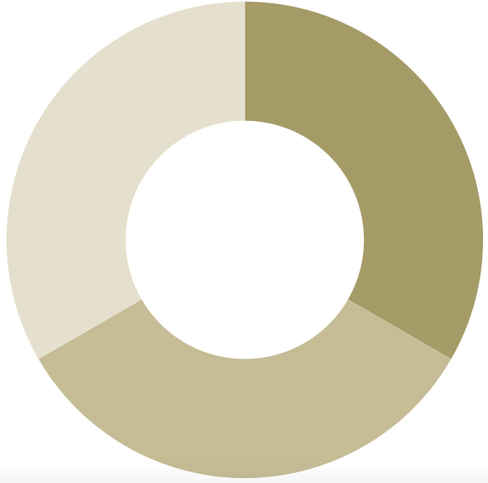
Consequences of NFI reporting
Developing credibility and trust
Current reporting trends and drivers
Current assurance standards and the IAASB
NFI assurance research
Conclusions
If we want organisations to pick this up as a market based solution, greater evidence needed of benefit
Shareholder base
loyalty
Improved analyst reporting
What gets reported get managed
Breakdown of silos
Internal benefit
External benefit
Reduced
information
risk,
share price
appreciation,
cost of capital
reduction
Positive
impact
on investors’
investment
decisions
Improved decision-making,
market positioning,
cost savings/revenue
opportunities

Slide 18
Recent Regulatory Initiatives
Developing credibility and trust
Current reporting trends and drivers
Current assurance standards and the IAASB
NFI assurance research
Conclusions
EU leading the way
Non-financial reporting directive (NFRD, 2014). Starting from 2018, large public interest entities (PIEs) must disclose NFI in form of management commentary in the Annual Report or in a separate NFI report.
The NFRD also refers to independent assurance. EU Member States shall ensure that statutory auditor undertake consistency check on whether the NFI is provided. Some countries require information to be assured.

Slide 19
Recent Regulatory Initiatives (cont.)
Developing credibility and trust
Current reporting trends and drivers
Current assurance standards and the IAASB
NFI assurance research
Conclusions
Internationally:
Creation of International Sustainability Standards Board (ISSB) by IFRS trustees, sitting alongside IASB
In the US, major initiative has been evolution of Sustainability Accounting Standards Boards (SASB) has been development of guidance on NFI disclosures in specific industries, (and then merger with IIRC to create Value Reporting Foundation (VRF))
At time of announcement of creation of IAASB, announcement of proposed merger with VRF and CDSB and publication of prototype climate disclosure requirements
Significant impetus, with proposed outputs assurable

Slide 20
Structure for Session
Role of sustainability (NFI) reporting and assurance: developing credibility and trust.
Trends and Drivers in NFI reporting and assurance
Assurance standards, and IAASB
Why undertake NFI assurance research, current knowledge, and research opportunities
Conclusions

Slide 21
Competition for Assurance Standards
Developing credibility and trust
Current reporting trends and drivers
Current assurance standards and the IAASB
NFI assurance research
Conclusions
Main two assurance standards used in practice:
(IAASB) ISAE 3000 and related standards (ISAE 3410 on GhG), and
AA1000 Assurance Standard (2020).
Accounting profession tends to use IAASB
IAASB encourage other users
Sometimes both used

Slide 22
IAASB: NFI Assurance
Developing credibility and trust
Current reporting trends and drivers
Current assurance standards and the IAASB
NFI assurance research
Conclusions
Authoritative
Non-Authoritative
ISAE 3000 (Revised) – Other than audits or reviews of historical financial information
ISAE 3410 – Greenhouse Gas Statements
Guidance: Extended External Reporting (EER) Assurance Engagements (Approved March 2021)
2x further items of support material
Continue to monitor
ISAE 3000 (Revised)
Assurance Engagements

Slide 23
Challenges for assurance
Developing credibility and trust
Current reporting trends and drivers
Current assurance standards and the IAASB
NFI assurance research
Conclusions
IAASB identified ten main challenges in undertaking EER assurance engagements (2016, challenges, 2021 guidance):
Scoping EER assurance engagements
Suitability of criteria
Materiality
Building assertions in planning and performing the engagement
5. Maturity of governance and internal control processes
Narrative information
Future-oriented information
Professional skepticism and professional judgment
Competence of practitioners performing the engagement
Form of the assurance report

Slide 24
2021 Guidance on NFI (Extended External Reporting)
Developing credibility and trust
Current reporting trends and drivers
Current assurance standards and the IAASB
NFI assurance research
Conclusions
Why?
Future prospects of an entity impacted by wider range of factors than those presented in the financial statements
Development of other frameworks to report EER information
Increased demand for assurance on EER information and increased reporting by entities
Example EER Reporting and Frameworks Used
Greenhouse Gas Emissions | WBCSD/WRI GHG Protocol
Integrated Reporting | IIRC Integrated Reporting Framework
Intellectual Capital | WICI Intangibles Reporting Framework
Management Commentary | IASB Management Commentary Practice Statement
Public Sector Service Performance Statements | Law, Regulation or Standards
Sustainability | CDSB Framework, GRI Standards, SASB Standards, TCFD Framework
Objective
Enable more consistent and appropriate application of ISAE 3000 (Revised)
Status
Approved at March 2021 IAASB Meeting
Continuing to provide thought leadership on assurance issues

Slide 25
Other factors affecting Credibility and Trust (IAASB 2021)
Developing credibility and trust
Current reporting trends and drivers
Current assurance standards and the IAASB
NFI assurance research
Conclusions
Four factors influence credibility and trust:
Sound reporting framework – Essential first and foremost is the framework – the objectives of which are closely aligned with the user’s information needs.
Strong governance – Reporting processes, controls and potentially external professional services engagements are initiated under strong governance oversight.
Consistent wider information – Users perform their own evaluation of the consistency of the EER report with wider available sources of information to which they have access.
External professional services and other reports – Users also have access to any published reports issued under external assurance or other professional services engagements that relate to the EER report.

Slide 26
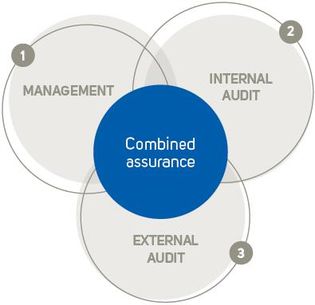
Other credibility enhancing mechanisms: Combined assurance
Developing credibility and trust
Current reporting trends and drivers
Current assurance standards and the IAASB
NFI assurance research
Conclusions
South Africa market - King IV Report recommends combined assurance
Integrating & aligning assurance processes
Improving assurance quality
Better coordination of assurance providers

Slide 27
Structure for Session
Role of sustainability (NFI) reporting and assurance: developing credibility and trust.
Trends and Drivers in NFI reporting and assurance
Assurance standards, and IAASB
Why undertake NFI assurance research, current knowledge, and research opportunities
Conclusions

Slide 28
But why should I research Assurance for NFI?
Developing credibility and trust
Current reporting trends and drivers
Current assurance standards and the IAASB
NFI assurance research
Conclusions
Financial Audit
Assurance of NFI
Research in auditing is a “mature industry”. Any additional research will be incremental.
Some, but limited, ability to have impact
Data advantages, but many researchers using available datasets
More mainstream publishing
Research in assurance of NFI is at its beginning stages, but growing
Lot of current regulatory innovations means currently high impact
Data embryonic
Competitive market, accounting profession and others
Evidence questions are different
Publishing in leading journals increasing
Notes:
General international view is of a profession under pressure (possible exception being the US- why? SOX? Education? Competition?)
Professional firms audit revenue percentage – now around 15-20%;
Greater pressure, especially in UK, to create “audit-only firms” and “two signing audit firms”
Recruitment, margin erosion and review overload challenges increasing;

Slide 29
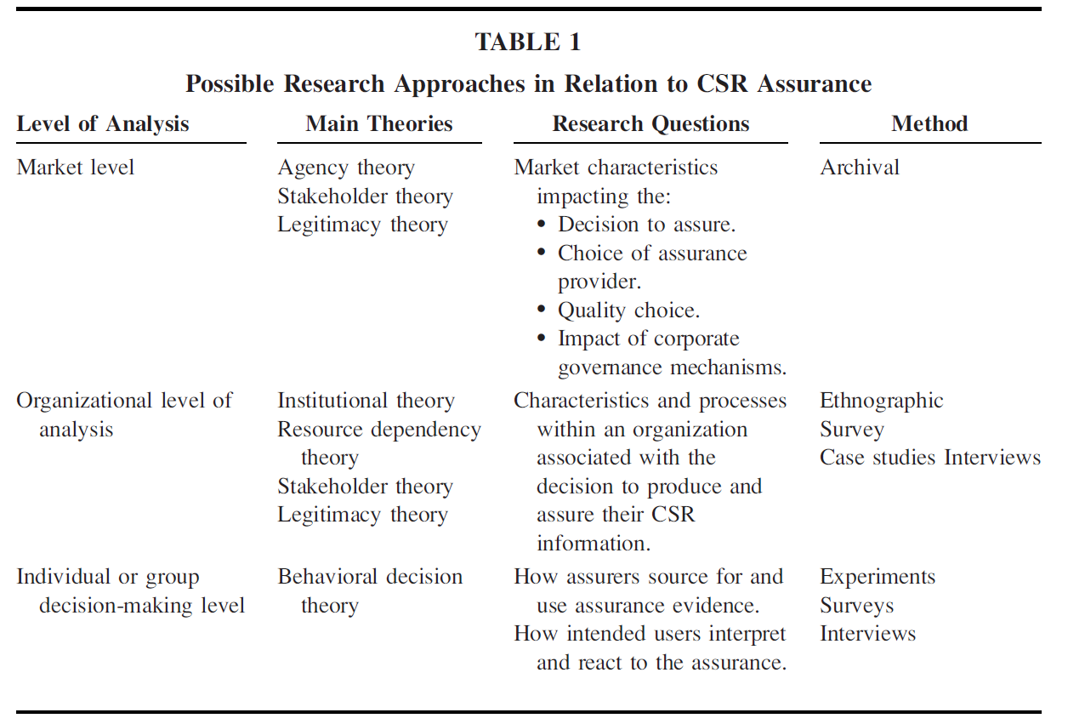
Research Approaches (Cohen & Simnett AJPT 2015)
Developing credibility and trust
Current reporting trends and drivers
Current assurance standards and the IAASB
NFI assurance research
Conclusions

Slide 30
What do we know from research?
Developing credibility and trust
Current reporting trends and drivers
Current assurance standards and the IAASB
NFI assurance research
Conclusions
Venter & van Eck (V&V) 2021 in Journal of International Financial Management and Accounting (JIFMA) undertook a literature review of EER assurance research 2009-2020:
Identified 121 articles on EER assurance published since 2009 across 35 journals rapid increase in this literature with almost half of the articles published 2018-2020
Most common research approach was archival methods (49.6%), with a fairly equal spread between experimental (12.4%), content analysis (14.9%) and interviews (14.9%).

Slide 31
Archival Research
Developing credibility and trust
Current reporting trends and drivers
Current assurance standards and the IAASB
NFI assurance research
Conclusions
Determinants of Assurance of NFI (mature area)
Firm level characteristics (e.g. Firm size, choice of provider)
Industry level characteristics (e.g. social, environmental impact)
Country level characteristics (e.g. Code versus Common law)
Consequences of Assurance of NFI (research needed)
Disclosure Quality (of environmental)
Capital Market Impacts (firm value, information risk and associated costs of capital, analysts forecasts and reporting, investor decision making)

Slide 32
Experimental Research
Developing credibility and trust
Current reporting trends and drivers
Current assurance standards and the IAASB
NFI assurance research
Conclusions
Investor decision-making (potential area)
Stock price assessments/decisions to invest (e.g. quality of research questions and subjects drives research quality)
Type of assurance provider and levels of assurance (e.g. social, environmental impact)
Response to different types of information
Research tips (research needed)
Theory, questions asked and manipulations must be incremental
Quality of subjects, (Analysts yes, investors maybe, students no)

Slide 33
Other research methods
Developing credibility and trust
Current reporting trends and drivers
Current assurance standards and the IAASB
NFI assurance research
Conclusions
Content analysis
Beneficial for impact, should be related to policy question
Interviews and case studies
Lots to be learned from major decision makers (policy makers, client’s decisions around assurance provider, and type of provider, assurance partner around decisions such as new evidence techniques)
Surveys
Beneficial for impact, relate to policy questions

Slide 34
Some Ideas for future research
Developing credibility and trust
Current reporting trends and drivers
Current assurance standards and the IAASB
NFI assurance research
Conclusions
Built around IAASB Guidance (10 key Challenges) 2021
Use of multidisciplinary teams. Archival where can identify teams (IAASB encourages disclosures), behavioral of impact on including assurance experts and subject matter experts
Management bias, and professional scepticism in reporting and assurance provider reaction (behavioral)
Understanding assurance reports and conclusions, level of assurance, description of procedures (archival and behavioral)
Materiality, disclosure of process, and description of procedures (takes us into mature area)

Slide 35
Tips for researchers
Developing credibility and trust
Current reporting trends and drivers
Current assurance standards and the IAASB
NFI assurance research
Conclusions
Always consider impact. Who’s behavior are you informing, trying to influence?
Natural domain from public-interest perspective and reach for auditing and assurance is standard-setting. Is it national or international?
Pay attention to future work programs of standard-setters to see whether they align with your interest.
Research must be of high quality else get poor (wrong) public-interest outcome.
Try to make it easy for the intended audience. Not only use as motivation, but what are the explicit take-aways. Sometimes these can be in professional summaries of your work.
And always, research those topics which you are passionate about. Makes it so much easier.
Notes:
Policy making research is difficult
International policy related research is very difficult
Archival research with Australian/International data is difficult to publish in A* US journals. Behavioral research easier.
The divide between practitioners and researchers in accounting is one of the largest of the professions (social science much more removed compared with STEM)
There are few practitioners who understand our research, and the numbers have been getting fewer (is the trend reversing)?
Do academics understand the underlying subject matter? (accounting and auditing), or are they now mainly trained in research?

Slide 36
Structure for Session
Role of sustainability (NFI) reporting and assurance: developing credibility and trust.
Trends and Drivers in NFI reporting and assurance
Assurance standards, and IAASB
Why undertake NFI assurance research, current knowledge, and research opportunities
Conclusions

Slide 37
Developing credibility and trust
Current reporting trends and drivers
Current assurance standards and the IAASB
NFI assurance research
Conclusions
Developments in sustainability reporting
Significant increased interest in sustainability reporting
Governance and internal control systems and consequential reporting practices maturing
Investor focused reporting frameworks consolidating, meaning more information will be included in annual report and financial statements
Major initial impetus appears to be around climate change
Notes:
Companies can choose to not allow publication of this data

Slide 38
Developments in sustainability assurance
Developing credibility and trust
Current reporting trends and drivers
Current assurance standards and the IAASB
NFI assurance research
Conclusions
EER is still evolving to meet the emerging needs of a variety of stakeholders for wider information about the entity.
There is demand for actions to support credibility and trust, but this is not limited to calls for professional services.
Various types of professional services engagements are performed in relation to EER reports, but primarily advisory and assurance engagements.
There is a need for flexibility in the nature of professional services as reporting frameworks evolve, to enable the delivery of credibility and trust in an appropriate manner.

Slide 39
Great potential research area
Developing credibility and trust
Current reporting trends and drivers
Current assurance standards and the IAASB
NFI assurance research
Conclusions
Great area to undertake research
Many large companies are producing these reports
Many are assured, some are not (can more clearly identify Cost-Benefit of assurance, examine economic theory)
If assured not necessarily by assurance profession
Many topic areas need better understanding. Examples include:
Risk identification
Materiality
Evidence-gathering procedures
Need to identify consequences.
Does assurance, type of assurance, have an impact?
Ability to impact standard-setting + audit firm procedures

Slide 40
Sustainability Reporting and Assurance Practices November 2021
= Finish =

