Slide 1
Sustainability Metrics and ESG Investment
Aneesh Raghunandan
2022 MMPA Conference

Slide 2
Overview
What?
  When investors or firms say “ESG”:
    What are they referring to in practice? What hard data is being used?
    What are some things to keep in mind as we attempt to measure ESG performance?
Why?
  How do we assess a firm’s or investment’s sustainability?
  Are ESG investment products doing what they say they are?
  Increasing amount of, and pressure for ESG disclosure…
    But how is the quality of this information?

Slide 3
Roadmap
Over the next 30 minutes, I’ll focus on four main issues:
  #1: What are the “right” metrics to use?
  #2: What have ESG investment products done historically? Where do we go from here?
  #3: Things to watch out for even with “better” ESG data
  #4: Where does the push for mandatory disclosure fit into all of this?

Slide 4

Issue #1: What are the “right” metrics to use?
When it comes to traditional, ‘shareholder-centric’ investing: we have a single metric ($$)
When it comes to sustainable/ESG investing: we have a dimensionality problem

Slide 5
ESG metrics: the “E”
When it comes to E: we seem to be converging on a world where the primary metric is CO₂ emissions.
  Paris agreement highlights first-order importance of emissions for mitigating climate change
  Many investors now market “Paris-aligned” portfolios
  Several existing and proposed disclosure mandates worldwide
However: even with this convergence, we have a lot of measurement issues… more on this later!

Slide 6
ESG metrics: the “S”
When it comes to S, we have a problem: “S” encompasses a number of different stakeholders, e.g.,:
  Customers
  Employees
  Community
How do we measure how firms treat these stakeholders? Two methods:
  Somewhat narrow, but easier to measure, proxies for stakeholder-centric behavior (e.g., product safety violations; gender/racial pay gaps)
  Broad, but harder to measure, proxies for things like ‘corporate culture’ more generally

Slide 7
ESG scores
A common approach, more similar to the second method from the prior slide: ESG scores
ESG scores are put out by various third parties, attempting to rank/rate companies on their ESG performance.
  Analogous to credit ratings that attempt to rate companies’ creditworthiness
  Heavily used by investors to screen companies on social responsibility grounds

Slide 8
ESG scores: pros and cons
The good side of ESG scores: they represent a starting point for those interested in understanding companies’ social responsibility or sustainability.
But does this do more good than harm?
  We’re placing an enormous amount of faith into rating agencies, whose models are a black box and whose ratings don’t correlate well.
    Berg, Koelbel, and Rigobon (2022): the average pairwise correlation between different agencies’ ESG scores is only 0.66 (this is about 0.97 for credit ratings)
  ESG scores seem to fixate on the quantity of disclosure, but not quality

Slide 9

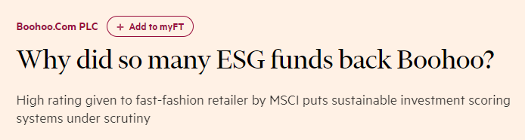
ESG score example: Boohoo
Boohoo: UK fast fashion retailer
In 2020, came to light that Boohoo’s supply chain involved modern slavery in factories in Leicester
And yet…Boohoo was included in most UK ESG funds, and given a high ESG score because it had a lot of domestic production (and played this up)
  Nobody bothered to actually check what was happening in those factories!

Slide 10
Issue #2: Do ESG investment products’ methods make sense?
ESG funds typically claim to invest in firms with superior ESG records.
  Historically, these were mostly based on exclusionary screening: simply omit firms in “bad” industries (alcohol, firearms, oil & gas)
  However, these days we see way more explicit inclusion decisions: investors use some sort of ESG metrics – often ESG scores – to pick specific stocks.
    What metrics are funds choosing? Do these metrics make sense?
  How can we tell what an ESG fund actually does?

Slide 11
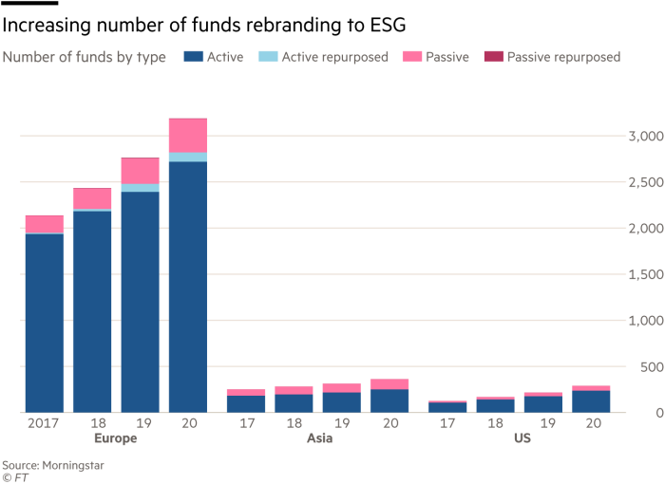
Why focus on ESG investment products specifically?
Explosion of
(i) money pouring into the sector; and
(ii) available ‘ESG’ investment products
  Some new; some just existing funds rebranding themselves (see graphic to the right)

Slide 12
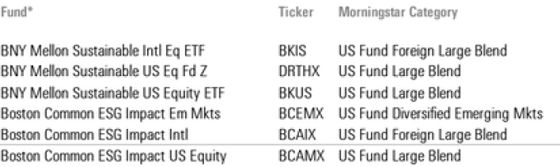
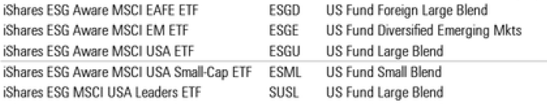
ESG investment products
The issue: what sustainability metrics is a fund using to back up its claims of being socially responsible?
For example: from the names to the right, can you tell me what any of those funds actually do?

Slide 13
Can we figure out what metrics ‘sustainable’ funds use if we read the prospectus?
Sometimes, yes. Here’s the Invesco Global Clean Energy ETF:
  The Underlying Index is comprised primarily of companies whose technologies focus on the generation and use of cleaner energy, conservation and efficiency, and the advancement of renewable energy […]companies in wind, solar, biofuels, hydro, wave, tidal, geothermal and other relevant renewable energy businesses and those involved in energy conversion, storage, conservation, efficiency, materials relating to those activities, carbon and greenhouse gas reduction, pollution control, emerging hydrogen and fuel cells.
But sometimes, not really. Here’s the BNY Mellon Sustainable US Equity Fund:
  The fund normally invests at least 80% of its net assets, plus any borrowings for investment purposes, in equity securities of US companies that demonstrate attractive investment attributes and sustainable business practices…

Slide 14
ESG investments and sustainability metrics
Why is it important to know what metrics a fund uses to judge potential investments’ sustainability?
  Need to know how to judge an investment product!
My own research: on average, ESG funds pick firms with higher ESG scores but worse labor and environmental records…
  Except for those that clearly state a focus on CO₂ emissions!

Slide 15
Issue #3: Data quality
Even if we move beyond scores to ‘hard data’, we still need to be careful…
Two defining characteristics of key financial statement data: (i) subject to mandatory disclosure (no self-selection) and (ii) checked by auditors and regulators
  Can we assume that (i) and (ii) apply to the ESG setting?
Two examples:
  Example 1 (private vendor-supplied): Carbon emissions data
  Example 2 (government-mandated disclosure): UK gender pay gap reporting

Slide 16
Example: measurement issues in emissions data
Huge demand for emissions data given its primacy as a measure of “E”.
A potential issue: most carbon emissions data (especially in North America) is estimated by vendors, rather than actually disclosed by firms.
  Vendor-estimated data might be in highest demand for non-disclosing firms!
How do they estimate this data?
  Generally as a function of financial fundamentals (net sales, PP&E, various financial ratios)
  Implicitly assume within-industry homogeneity.

Slide 17
Implications of using estimated emissions
If estimated emissions are just a linear combination of various financial ratios, then…
  Is a relation between “emissions” and stock market performance ACTUALLY reflective of investors caring about emissions?
  Or is it just reflective of the well-known link between financial fundamentals and stock market performance?

Slide 18
Issue #4: Does mandatory disclosure get us the data we need?
Recall data quality example #2: gender pay gap reporting in the UK
  High-profile, comprehensive example of “S” disclosure mandate
More generally: much more mandatory disclosure likely on the horizon.
  For example: EU CSR Directive, EU Sustainable Finance Disclosures Regulation (SFDR)
  One potential drawback: still leaves a lot of discretion to companies about what metrics to disclose

Slide 19
Mandatory disclosure…but what about verification?
Here, again, the comparison to financial reporting is useful:
  Financial regulators (e.g., US SEC) investigate suspicious reporting
  Public companies’ mandatory disclosures are audited
Gender pay gap example:
  Data not required to be audited; regulator in charge doesn’t verify the figures (only cares about timely filing)
  As such: 13% of disclosures are mathematically impossible
    What can we actually learn about companies’ gender pay parity from this data?

Slide 20
Wrap up
Sustainability/ESG considerations becoming increasingly important for investors and the broader public in assessing firms
But: we have a dimensionality problem, which to overcome we need:
  Investment products to be up front about how they pick stocks
  Well-defined, understandable measures (e.g., emissions or gender pay gap) even if these are sometimes narrow in scope
  Verification of these measures

