Slide 1
Introducing the ISSB
Jingdong Hua
Vice-Chair, ISSB
2022 MMPA Conference

Slide 2
Overview
The IFRS Foundation
1
Market demand
2
Digital financial reporting
Introducing the ISSB
3
Our proposals
4
Digital financial reporting
What’s ahead
5

Slide 3
The IFRS Foundation

Slide 4
The IFRS Foundation develops and maintains Standards that are:
Better information for better decisions
In the public interest
High-quality
Understandable
Enforceable
Globally acceptable
Our purpose is to empower people with the right information to support better economic decision-making.
Notes:
The IFRS Foundation was founded on the belief that better information leads to better economic and investment decisions.
As a public interest organisation, we work to achieve this vision through the development of high quality, global standards that result in corporate information that informs investment decisions.
This work contributes towards efficient and resilient capital markets, thus fulfilling society’s needs.

Slide 5
Our work serves the public interest by fostering trust and long-term stability in the global economy.
IFRS Standards bring transparency, accountability and efficiency

Slide 6
Structure
Public accountability
IFRS Foundation Monitoring Board
Governance, strategy, oversight
IFRS Foundation Trustees
Independent standard-setting
International Accounting Standards Board (IASB)
International Sustainability Standards Board (ISSB)
IFRS Interpretations Committee
Notes:
The Foundation has a three-tier governance model and Trustees are responsible for strategy and oversight of the standards-setting boards
Slide shows two standard-setting boards operating next to each other
As a form of visual identity, we have branded in colour the different areas of our organisational structure – IFRS red (to represent the IFRS Foundation); Accounting blue (to represent the IASB); Sustainability blue (to represent the ISSB) and IFRS grey (for general application).

Slide 7
Market drivers of the ISSB
Investors are increasingly alert to global challenges, such as the pandemic, climate change and rising inflation.
They need access to comparable, consistent and comprehensive disclosures to respond.

Slide 8
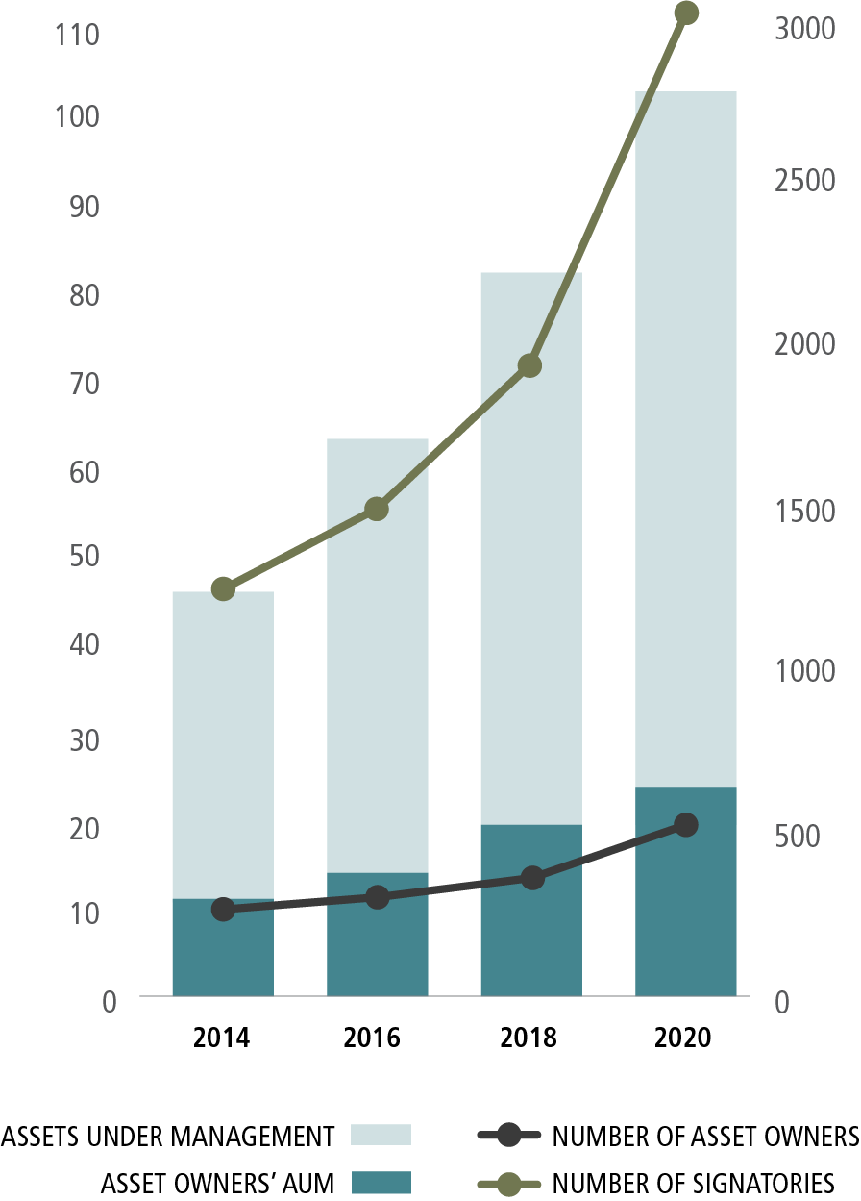
Market drivers
Over 3,100* PRI Signatories have committed to:
Seek appropriate disclosure on ESG issues by the entities in which they invest
Incorporate ESG issues into investment analysis and decision-making processes
Be active owners and incorporate ESG issues into their ownership policies and practices.
* As of June 2020 ** Reflects three of six PRI Principles, to which all signatories commit.
Principles for Responsible Investment (PRI) Signatory Growth
Notes:
The Foundation has a three-tier governance model and Trustees are responsible for strategy and oversight of the standards-setting boards
Slide shows two standard-setting boards operating next to each other
As a form of visual identity, we have branded in colour the different areas of our organisational structure – IFRS red (to represent the IFRS Foundation); Accounting blue (to represent the IASB); Sustainability blue (to represent the ISSB) and IFRS grey (for general application).

Slide 9
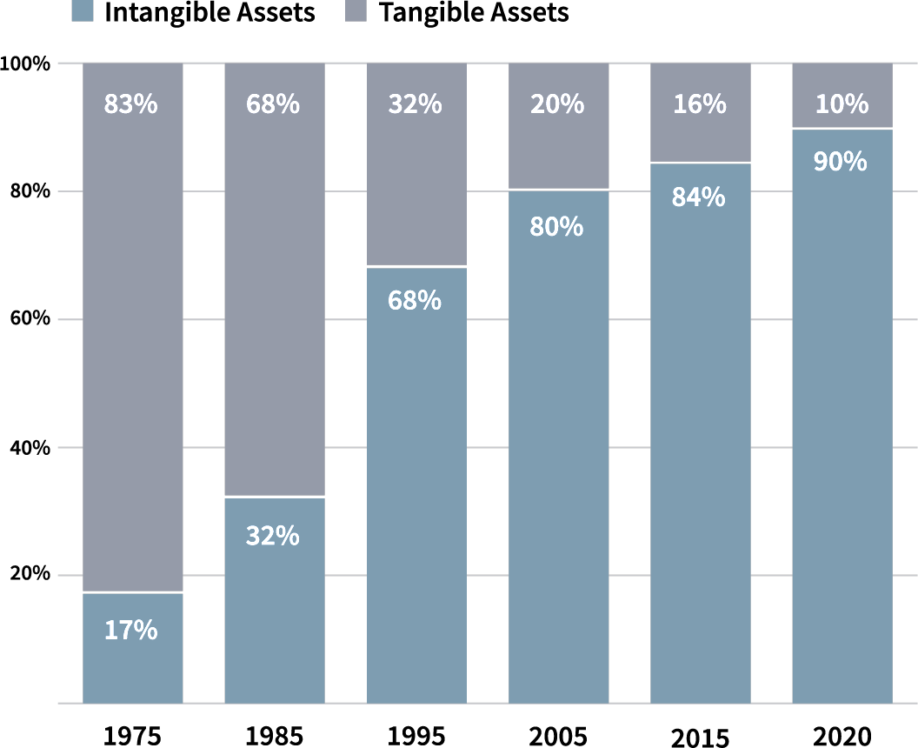
Market drivers
The changing components of S&P 500 Market Value means broader information set required to understand risk.
Source: Ocean Tomo, Ocean Tomo’s Intangible Asset Market Value Study
Notes:
The Foundation has a three-tier governance model and Trustees are responsible for strategy and oversight of the standards-setting boards
Slide shows two standard-setting boards operating next to each other
As a form of visual identity, we have branded in colour the different areas of our organisational structure – IFRS red (to represent the IFRS Foundation); Accounting blue (to represent the IASB); Sustainability blue (to represent the ISSB) and IFRS grey (for general application).

Slide 10
Market drivers
The sustainability disclosure landscape wasn’t delivering.
Voluntary initiatives
Incomplete application
Multiple standard available
Need for rationalisation.
Mandatory jurisdictional initiatives
Different jurisdictions, different requirements
Differences in scope, ambition, pace.
Notes:
The Foundation has a three-tier governance model and Trustees are responsible for strategy and oversight of the standards-setting boards
Slide shows two standard-setting boards operating next to each other
As a form of visual identity, we have branded in colour the different areas of our organisational structure – IFRS red (to represent the IFRS Foundation); Accounting blue (to represent the IASB); Sustainability blue (to represent the ISSB) and IFRS grey (for general application).

Slide 11
Introducing the International Sustainability Standards Board

Slide 12
ISSB objectives
Develop standards for global baseline of sustainability disclosures, and a digital taxonomy to enable electronic tagging of information
Meet information needs of investors
Enable companies to provide comprehensive sustainability information to global capital markets
Facilitate addition of disclosures that are jurisdiction-specific / aimed at broader stakeholder groups
Notes:
The ISSB’s remit is to develop a global baseline of sustainability disclosure standards and a taxonomy to facilitate digital reporting
Its focus is on meeting investors and other capital market participants’ information needs
The ISSB’s standards will enable companies to provide comprehensive information about sustainability-related matters to the financial markets
The standards will be developed to facilitate compatibility with requirements that are jurisdiction specific or aimed at a wider group of stakeholders (for example, the European Union’s planned Corporate Sustainability Reporting Directive as well as initiatives in the Americas and Asia-Oceania).

Slide 13
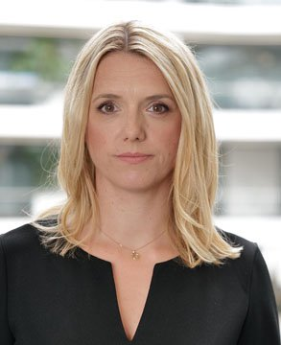
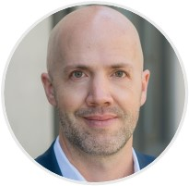
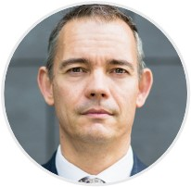
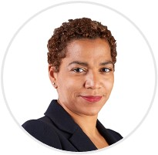
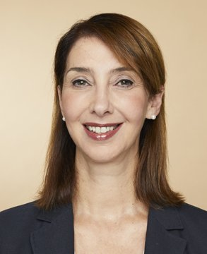
ISSB members
Emmanuel Faber
Chair
Jingdong Hua
Vice-Chair
Sue Lloyd
Vice-Chair
Richard Barker
Jenny Bofinger-Schuster
Verity Chegar
Jeffrey Hales
Michael Jantzi
Hiroshi Komori
Bing Leng
Ndidi Nnoli-Edozien
Tae-Young Paik
Veronika Pountcheva
Elizabeth Seeger

Slide 14
Simplifying the sustainability disclosure landscape
Consolidated into the IFRS Foundation
*
Climate Disclosure Standards Board
IFRS Sustainability Disclosure Standards built off market-leading, widely adopted frameworks and standards.
*Integrated Reporting integration goes beyond IFRS Sustainability Disclosure Standards. It will be used to drive connectivity between IFRS Accounting Standards and IFRS Sustainability Disclosure Standards

Slide 15
Five reasons companies and investors support and engage with the new ISSB
1: Continuity with existing standards | 2: Investor Demand will continue | 3: Simplification of the ESG landscape | 4: Harmonization across jurisdictions
5: Investors want industry-based sustainability disclosure standards that:
Are focused on sustainability issues which are relevant to business models and related risks and opportunities in a given industry
Improve comparability of data across companies and markets
Help reduce the burden to reporting companies.

Slide 16
IFRS Standards within the broader reporting landscape
GRI
Other corporate reporting (multi-stakeholder focus)
Jurisdictional initiatives
Sustainability-related financial disclosures
General- purpose financial reporting
(investor focused)
Jurisdictional initiatives
Financial statements
Other GAAP
Management Commentary / Integrated Reporting
Notes:
How does general-purpose financial reporting relate to broader stakeholder reporting?
Corporate reports comprise general-purpose financial reports for investors plus any incremental information for broader stakeholders (eg, suppliers, customers, employees, governments, regulators).
What is the difference between the interests of investors and the interests of broader stakeholders? Let’s look at some examples.
A simple example is information about a localised pollution incident that is likely to MATTER FOR affected members of the public, but might not be material to investors IN THE SENSE WE USE THAT TERM if it relates to a one-off event and is small compared to the company’s financial information taken as a whole IE IT MAY NOT BE REASONABLY CERTAIN TO AFFECT INVESTMENT DECISIONS.
Another example can relate to a company’s investment strategy. Investors may be interested in a company’s investment strategy to keep up with efficiency innovations that will reduce future costs and enhance the company’s future value. In contrast, broader stakeholders may be interested in promoting a particular behaviour and, therefore, may be interested in the extent to which a company’s investment strategy ‘gives back’ to the community in which it is located.
Broader reporting may also be designed to meet public policy needs including to gather information required by regulatory or government authorities. For example, government authorities may be interested in information about a company’s tax payments by jurisdiction regardless of magnitude of those tax payments. In contrast, investors would be interested in information about tax that can affect their assessments of the company’s prospects or of the management’s stewardship of the company’s resources and hence affect investors decisions about providing resources to the company.
But, this is a dynamic area. Going back to our examples:
In our localised pollution example, if the event is indicative of an underlying issue with the business model, the information would likely be material to investors. This could be the case even though the size of any associated regulatory fine is not expected to be significant.
Investors may also be interested in a company’s investment strategy to ‘give back’ to the community if, for example, all of the company’s customers and employees are located in that community and it will affect enterprise value. As a consequence, the company’s reputation may depend on its relationships with people in the community, who are current and prospective customers and employees. This may consequently affect the company’s ability to hire staff, sell products, and generate future cash flows or the price that an investor is willing to pay to invest in the company.
Likewise, if a company’s tax practices in a particular jurisdiction could affect the company’s reputation and as a consequence affect the company’s prospects for future cash flows, investors would be interested in that information even if the respective tax payments in the jurisdiction are insignificant in quantitative terms.
How do our requirements for general-purpose financial reporting ‘fit’ with other disclosure requirements?
Our requirements are expected to be interoperable with jurisdictional and GRI requirements to meet broader stakeholder information needs [note → we use the word ‘connected’ when talking about within the IFRS Foundation (connectivity between IASB and ISSB). We use the word ‘interoperable’ when talking about our Standards working with other organisations’ Standards)].
In addition, the ISSB’s proposals are GAAP-agnostic. This means that, the ISSB’s standards are intended to be used with any set of financial accounting requirements (eg, US GAAP). However, because the IASB and ISSB are housed within the IFRS Foundation, it is expected that ISSB Standards will be most closely connected to IASB’s requirements than to other sets of financial accounting requirements (including for example by having more consistent use of terms and concepts).

Slide 17
IFRS Sustainability Disclosure Standards
and GRI Standards
Announcement of intent to collaborate
First step
Future work plan
IFRS Foundation and GRI announce Memorandum of Understanding in
March 2022
ISSB and GRI join each other’s consultative bodies related to sustainability reporting activities
Align, where possible, terminology, standards structure and metrics, helping to reduce the reporting burden for companies

Slide 18
ISSB at COP27: Towards implementation
Partnership Framework to support capacity building and implementation of IFRS Sustainability Disclosure Standards launched
International cooperation with jurisdictions
CDP to align platform to IFRS S2, reducing market fragmentation and supporting the global baseline
Notes:
ISSB’s Partnership Framework launched with 20 day one partners from public and private institutions across the world including
Brazilian Institute of Corporate Governance (IBGC);
Group of Latin American Accounting Standard Setters (GLASS);
International Corporate Governance Network (ICGN);
and many more

Slide 19
Partnership Framework for capacity building
~30 partners - global and local - committed to ensuring readiness
Considering specific circumstances of emerging and developing economies and smaller entities
Focused on enabling consistent and comparable high-quality disclosures to bring benefits of sustainability-related disclosures to all.

Slide 20
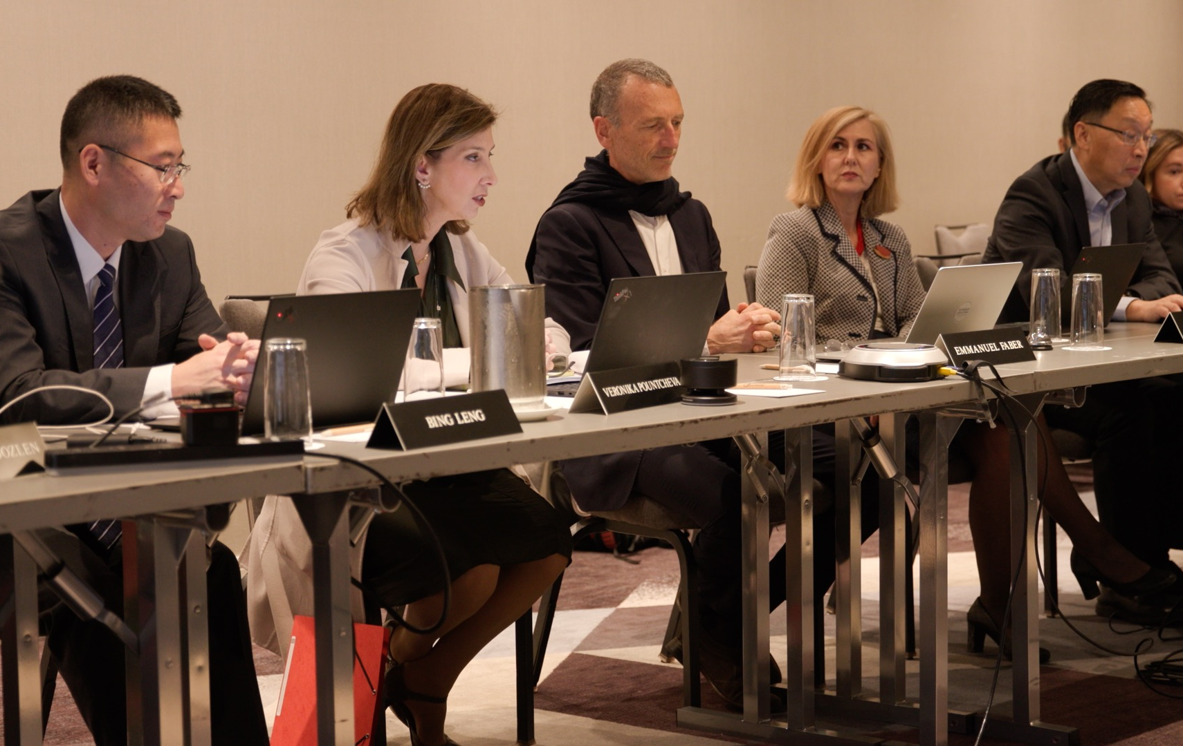
Outcomes of November board meeting included:
Agreed to clarify that the requirement to revise comparative information to reflect updated estimates does not apply to forward-looking information
Reinforced agreement to make the development of the Taxonomy a priority to ensure the ISSB is digital from day one
Clarified disclosure requirements on how climate transition-planning effects strategy and decision-making
Confirmed that sustainability-related information must be provided at the same time as financial statements – with a period for transition relief.

Slide 21
ISSB milestones
COP26: ISSB created
Chair appointed
Jurisdictional Working Group
meets
Inaugural meeting
All 14 members appointed
GRI MoU
IOSCO statement
African ministers communique
G20 Chair’s Summary
Nov
Dec
Jan
Feb
Mar
Apr
May
Jun
Jul
Aug
Sep
Oct
Nov
Prototypes
Exposure drafts
Digital taxonomy staff draft
1,400+ comment letters
Redeliberation at ISSB meetings
CDSB consolidated
Frankfurt MoU
Montreal MoU
VRF consolidated
Notes:
Appointed all 14 ISSB members. According the organisation’s constitution this means decisions can be reached and work is progressing as planned.
Consulted on the first two proposed IFRS Sustainability Disclosure Standards
Started work to facilitate digital tagging of sustainability disclosures
Created advisory groups to inform and guide ISSB’s work
Completed consolidation with CDSB and VRF
Opened offices in Frankfurt and Montreal
Regular dialogue with other standard-setters and jurisdictions
Welcomed by IOSCO, G20, G7, and African Ministers

Slide 22
Proposals

Slide 23
Designed for communication to investors
International Accounting Standards Board
IFRS Accounting Standards
Investors
and other capital market participants
Financial statements
International Sustainability Standards Board
IFRS Sustainability Disclosure Standards
Sustainability disclosures
Connectivity supported through the principles of integrated reporting.
Notes:
IFRS Sustainability Disclosure Standards are compatible with IFRS Accounting Standards or other GAAP to meet investor needs
The IASB and ISSB will collaborate closely to ensure there is connectivity and compatibility between the IFRS Standards.
Integrated Reporting Council will advise IASB and ISSB on connectivity via fundamental concepts or guiding principles of integrated reporting
The boards will be independent and complementary—to provide comprehensive information to investors and other providers of capital.
They will work in the public interest—both boards will be overseen by the Foundation Trustees, who are in turn accountable to a Monitoring Board of capital market authorities responsible for corporate reporting in their jurisdictions

Slide 24
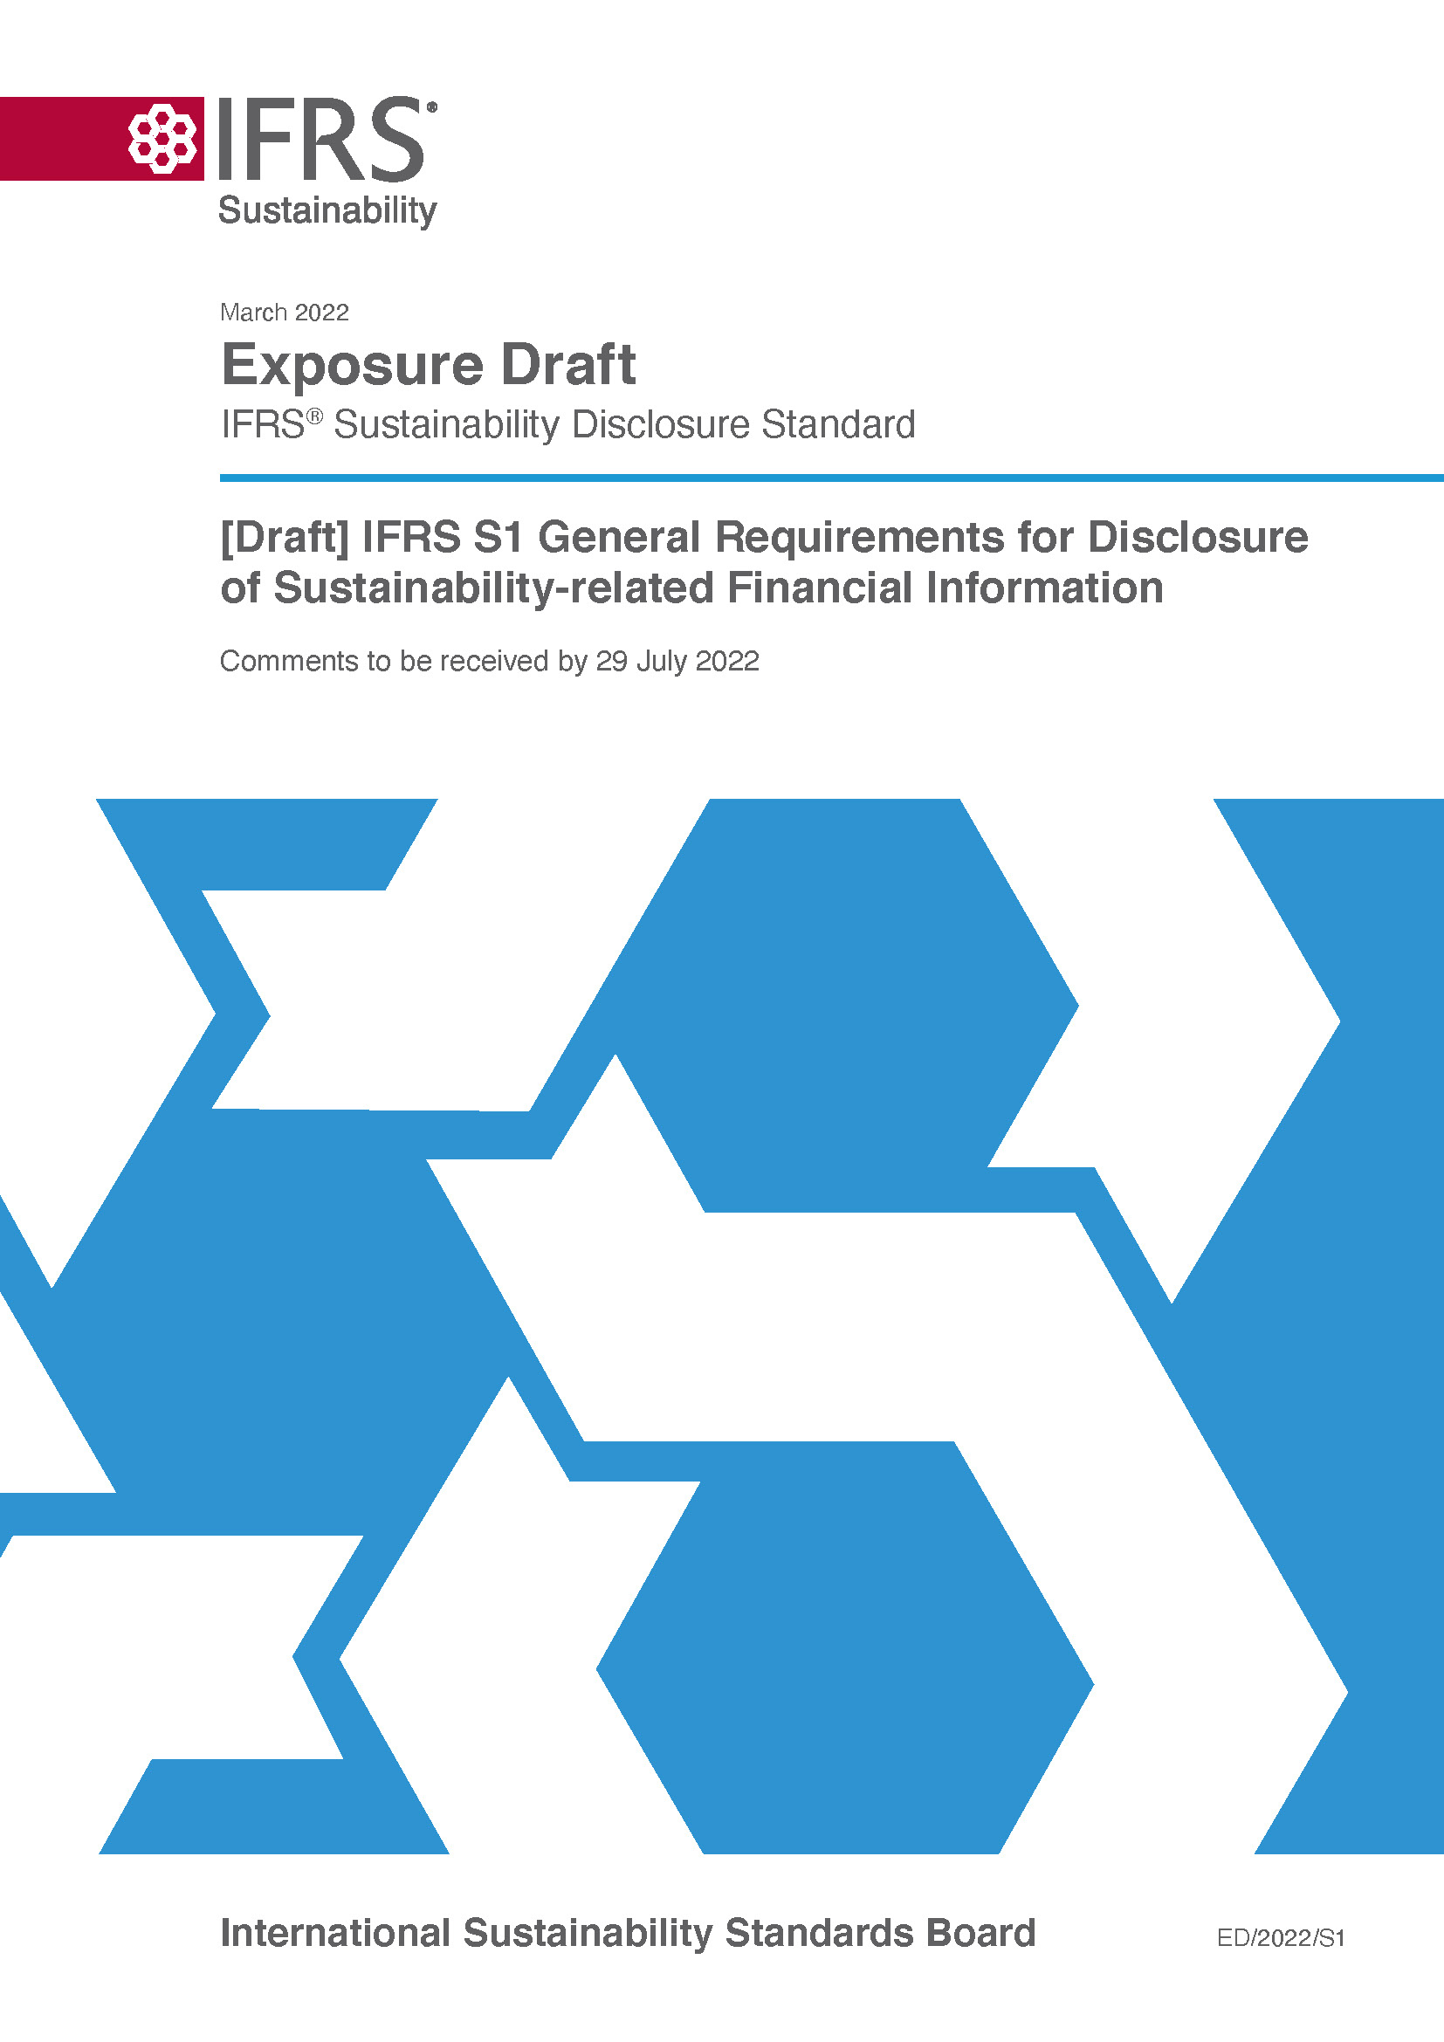
Proposed General Requirements Standard: IFRS S1
Disclosure of material information about sustainability-related risks and opportunities.
Other IFRS Sustainability Disclosure Standards (e.g. Climate Standard) set out specific disclosures
Points to other standards and frameworks in absence of a specific IFRS Sustainability Disclosure Standard
Sets out general reporting requirements (e.g. location and timing of the reporting)
Equivalent to IFRS Accounting Standards IAS 1 and IAS 8.
Notes:
When the Exposure Drafts were published the press release said that the ISSB had set out the proposals for the global baseline of sustainability-related disclosures. It was the general requirements document that provides the basis for that statement because it sets out the overarching requirement that an entity provide information on all material sustainability-related risks and opportunities
This information can be wide ranging. The impacts of a company on the environment, people and the planet, for example, are included in the scope of information required by the ISSB standards when those impacts are material
This exposure draft also sets out general reporting requirements that propose, for example, that sustainability information should be provided as part of the general purpose financial reporting package and that it should be provided at the same time as financial statements. This is important to bring sustainability reporting into mainstream corporate reporting.

Slide 25
Key features
Emphasises need for consistency and connections between financial statements and sustainability reporting by requiring companies to explain linkages in information and use consistent assumptions when relevant
Requires financial statements and sustainability disclosures to be published at the same time
Facilitates application in different jurisdictions by not specifying a particular location for sustainability information and allowing additional information to be provided
Notes:
Emphasises importance of consistency in financial statements and sustainability reporting
Aligns timing of publication of financial statements and sustainability reporting
Facilitates application in different jurisdictions by not specifying a particular location for sustainability information and allowing additional information to be provided

Slide 26
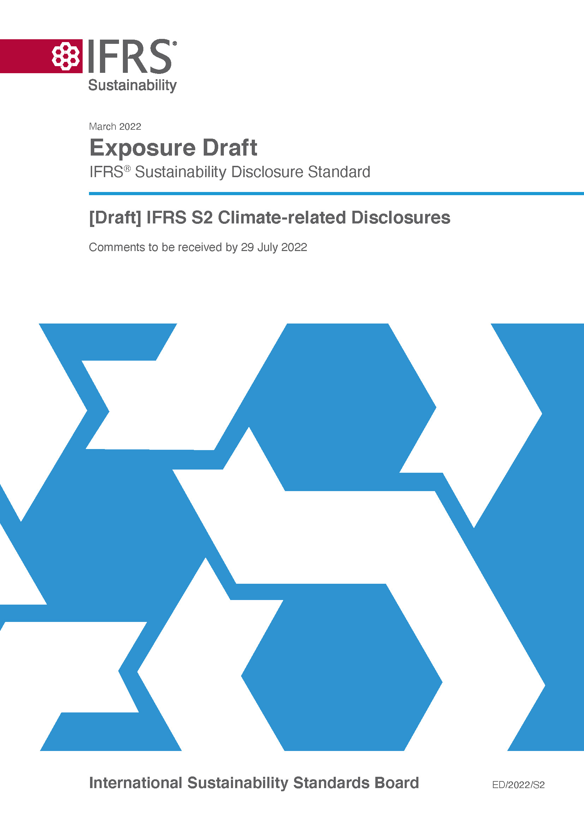
Proposed Climate-related Disclosures Standard: IFRS S2
Disclosure of material information about climate-related risks and opportunities.
Incorporates TCFD Recommendations
Includes SASB Standards climate-related industry-based requirements
Requires disclosure of information about
Physical risks (e.g. flood risk)
Transition risks (e.g. regulatory change)
Climate-related opportunities (e.g. new technology).
Notes:
The second exposure draft is a climate document that allows companies to report climate-related risks and opportunities information to their investors.
The climate exposure draft is built upon the TCFD recommendations and the SASB climate-related industry-based requirements.
The exposure drafts requires disclosure of information about physical risks (eg flood risk), transition risks (eg regulatory change) and climate-related opportunities (eg new technology).

Slide 27
Key features
Transition planning
Emissions targets and use of carbon offsets
Climate resilience
Resilience of business strategy in multiple scenarios
Scope 1-3 emissions
Requirement to disclose GHG emissions in accordance with the GHG Protocol Corporate Standard
Notes:
Climate: key features
Details of use of carbon offsets in transition planning
Resilience of business strategy in multiple scenarios
Requirement to disclose greenhouse gas emissions (scope 1-3) as part of the cross-industry metric categories

Slide 28
Widespread interest
1,400+ responses overall
400+ outreach events during consultation period
Feedback from wide range of stakeholder groups
Wide geographic spread

Slide 29
What’s ahead

Slide 30
Decision-making month-by-month
Public board meetings
Oct
Nov
…
…
ISSB votes on interim technical decisions about how to further evolve the proposed Standards in response to feedback from stakeholders
ISSB votes on overall package of decisions
ISSB finalises Standard, which is issued for adoption

Slide 31
Next steps
Complete discussions on consultation feedback around end of 2022
Issue final Standards as early as possible in 2023
Work to support adoption and application
Consult on proposed digital taxonomy
Consult on future priorities, early 2023
2

Slide 32
Get involved
Download proposed IFRS Standards and supporting materials
Listen to our monthly podcast with highlights from meetings and key developments
Respond to live consultations
Sign up for news alerts
Discover services that can support you, including membership and education
Observe ISSB meetings – the next is w/c 14 November

Slide 33
Follow us online
ifrs.org
@IFRSFoundation
IFRS Foundation
International Sustainability Standards Board
Notes:
Register on our website to stay updated on current news
Don’t forget to follow us on social media

