Slide 1
Competing on Analytics: Business Strategy and AI
Thomas H. Davenport
Babson College/MIT/Deloitte/Int’l Institute for Analytics
MMPA Conference
November 20, 2020

Slide 2
Four Analytical Eras—Accelerating, Overlapping, and Never Ending!
1.0 2.0 3.0 4.0
Artisanal analytics
Big data
analytics
Data economy
analytics
AI-driven
analytics
1975-?
2001-?
2013-?
2018-?

Slide 3
Analytics 1.0│The Artisanal Era
Artisanal
Analytics
1.0
Primarily descriptive analytics and reporting on small data
“Back office” teams of analysts
Internal decision support focus
Some predictive models based on human hypotheses
Still around, but goals of self service, mobile UI, visual analytics, democratization
3 | 2020 © Thomas H. Davenport All Rights Reserved
Notes:
Tom

Slide 4
Analytics 2.0│The Big Data Era
1.0
Artisanal
Analytics
2.0
Big Data Analytics
Complex, large, unstructured data
New computational capabilities required—Hadoop, Python, etc.
“Data Scientists” emerge
Online firms create “data products”
Also early to adopt AI/ML
4 | 2020 © Thomas H. Davenport All Rights Reserved

Slide 5
Analytics 3.0│The Data Economy Era
1.0
Artisanal
Analytics
3.0
The Data Economy
Seamless blend of traditional analytics and big data
Analytics core to the business
Data and analytics-based products in every business
Industrialized decision-making at scale
Now adopting AI/ML
2.0
Big Data
5 | 2020 © Thomas H. Davenport All Rights Reserved

Slide 6
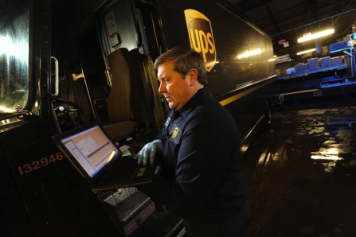
Analytics 3.0│Goals
Developing products and services based on data and analytics—now available to every industry
“Precision agriculture” offerings for growers
Conditional and predictive services
Data and analytics-based decisions at scale and supporting the front line of organizations
Real-time routing of delivery vehicles
Granular, targeted marketing programs
Rapid recovery from logistical problems
6 | 2020 © Thomas H. Davenport All Rights Reserved

Slide 7
Analytics 4.0│The AI Era
1.0
Artisanal
Analytics
The Data Economy
4.0
AI
3.0
Analytics used to make automated decisions
Increasingly autonomous analytics creation
Replacement of human tasks—digital/physical
Augmentation is human focus
2.0
Big Data
7 | 2020 © Thomas H. Davenport All Rights Reserved

Slide 8
(Cumulative) Skills Across the Eras
1.0
Artisanal
Analytics
4.0
AI
3.0
The Data Economy
Natural language processing
Neural networks/deep learning
Work design
Data integration and curation
Storytelling with data
Business acumen
Statistics
Iterative exploration
Machine learning
Agile methods
Event streams/workflow
Change management
2.0
Big Data
Experimentation
Data restructuring
Open source coding
Product development
Visual analytics
8 | 2020 © Thomas H. Davenport All Rights Reserved

Slide 9
The State of AI in Large Companies in Late 2020
About 40% are “AI-aware” globally and actively employing multiple technologies
A few are “AI first,” most less aggressive
Some challenges getting systems into production
Diverse objectives beyond automation, but 63% will automate “as many jobs as possible”
Less ambitious ”low hanging fruit” projects are often more successful than ”moon shots”
The more experienced, the more bullish on AI
Pandemic economy wreaking data havoc on models
Increased focus on automation technologies

Slide 10
What Technologies Are Businesses Using?
Statistical machine learning, deep learning, and computer vision are the top three widely used AI/cognitive technologies.
Source: Deloitte State of Cognitive Survey, August 2020, n = 250
Source: 2020 Deloitte “State of Enterprise AI” global survey

Slide 11
What Objectives Are Being Pursued?
Beyond cost savings: New products, new markets, and more
For example, 26% of Fast Laners report using AI to help them create new products or create new markets. Only 12% of Waders share this goal.
When asked about the primary benefit of AI/cognitive technology, here’s how many respondents said “create new products”:
AI: Primary beneﬁts to companies
51%
38%
Source: 2020 Deloitte “State of Enterprise AI” survey
Fast Lane
Q12 What do you view as the primary benefit of AI/cognitive technology for your company? (Rank the top three) Base: all

Slide 12
How Much AI in Companies?
One major “robo-advisor” application
About 150 AI projects, many in marketing and sales—not drug development
About 1000 projects, mostly in machine learning for credit, risk, marketing
“AI First”—Several thousand projects in search, ads, autonomous vehicles, etc., etc.
12 | 2020 © Thomas H. Davenport All Rights Reserved

Slide 13
How Ambitious Are Projects?
Treating cancer
“Robo-advisor”
Go stores
Drone delivery
“Care concierge”
Predicted no-pays
IT operations
India chatbot
ATM cash
Sales attrition
Fraud detection
Product recs
Merchandising

Slide 14
Evidence of Deployment and “Return on AI” Problems
Seven out of ten companies in an MIT SMR/BCG survey report minimal or no impact from AI thus far
Only 15% of respondents to a NewVantage Partners survey report any production deployment of AI
VentureBeat AI: 87% of data science projects are never deployed
In a McKinsey global survey, only 21% of respondents have embedded AI into multiple business units or functions
The Gartner 2020 CIO Agenda survey report comments: “the reality is that most organizations struggle to scale the AI pilots into enterprise wide production, which limits the ability to realize AI’s potential business value.”
Mission Control in Houston, Apollo 13

Slide 15
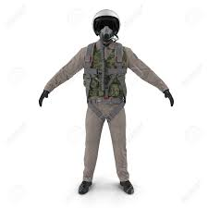
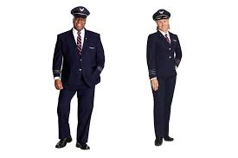
One Big Reason—Too Many Pilots!

Slide 16
Four Paths to Return on AI
R
Reengineer business processes to take advantage of AI and yield productivity
Organization and culture that are data-driven and a fit with AI initiatives
Algorithms and data that are unbiased, transparent, and well-managed over time
Investment that is both substantial and well-managed, with clear metrics
O
A
I
16 | 2020 © Thomas H. Davenport All Rights Reserved

Slide 17
Impacts on Jobs and Skills
Automating jobs
with AI
Changing job roles and skills
Replacing, retaining, retraining
63%
want to cut costs by automating as many jobs as possible
72%
report that AI has already led to moderate or substantial changes
10%
prefer keeping and retraining current employees
36%
say job cuts from AI-driven automation are an ethical risk
82%
say AI will lead to moderate or substantial changes over the next three years
78%
want to either keep or replace employees in equal measure, or to replace current employees with new talent
Source: 2018 Deloitte “State of AI in the Enterprise” survey

Slide 18
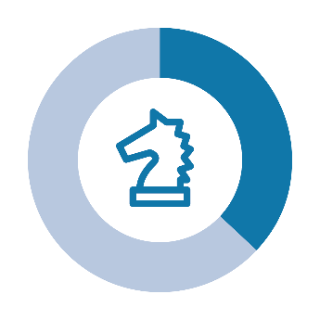
AI Management Structures Off and Running
54% created a process for moving prototypes into production
52% developed an implementation roadmap
45% appointed senior executives across the company as AI champions
37% created a company-wide center of excellence
37% implemented a comprehensive strategy for AI
Source: 2018 Deloitte “State of Enterprise AI” survey

Slide 19
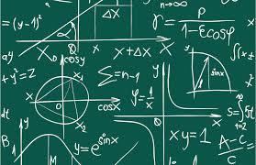
Gamechanger Technologies for Analytics/Data Science/AI
Automated machine learning for democratization and productivity
AI models with sparse data
Transparent deep learning
Smart data discovery
AI embedded into transactional systems

Slide 20
Creating an AI Advantage
Think big—strategize about how AI can transform your strategy, business model, or business processes
Start small--start with pilot projects and less ambitious goals
Scale up--develop a pipeline toward production, and move along it
Skill out—emphasize augmentation, offer skills training, and give employees job options and the time to transition to them
Build on your analytical capabilities
Put an ethical framework in place
Put someone in charge of AI

